Slide 1
Oh, The Things We May Do
Words: | Lizzie DeArmond (1916)
Music: | James H. Hagan (1916)
4/4
A^{b}/E^{b} - SOL
Verses: 3/Chorus
Lead - | SOL
Alto - | MI
Tenor - | DO
Bass - | DO
PDHymns.com

Slide 2
vs. 1 ~ Oh, The Things We May Do

Slide 3
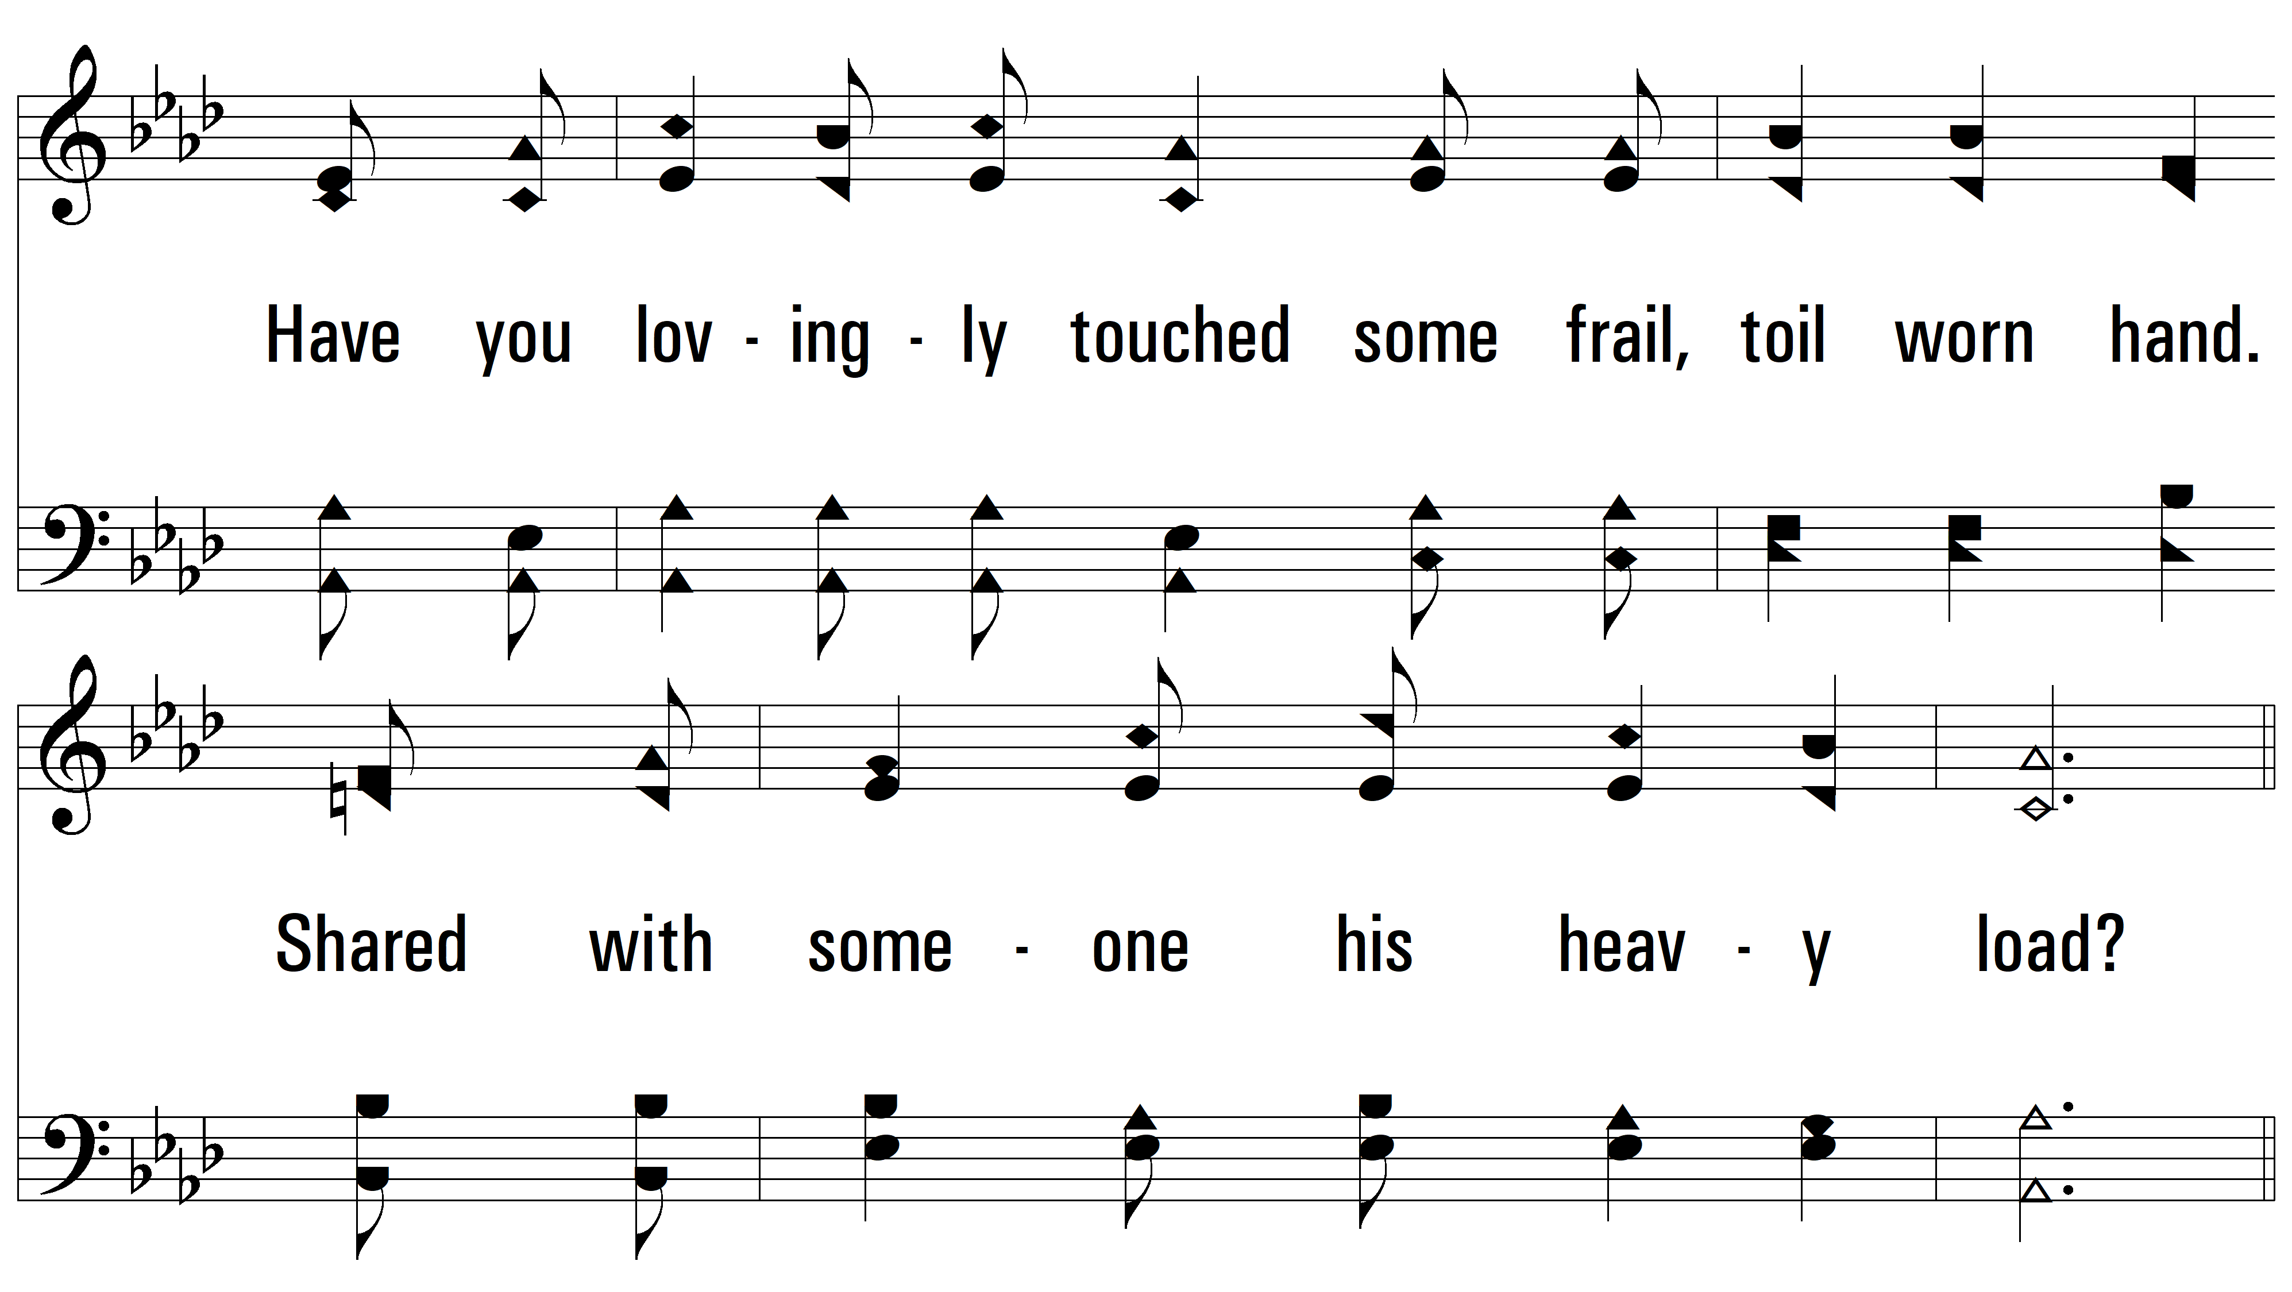
vs. 1

Slide 4
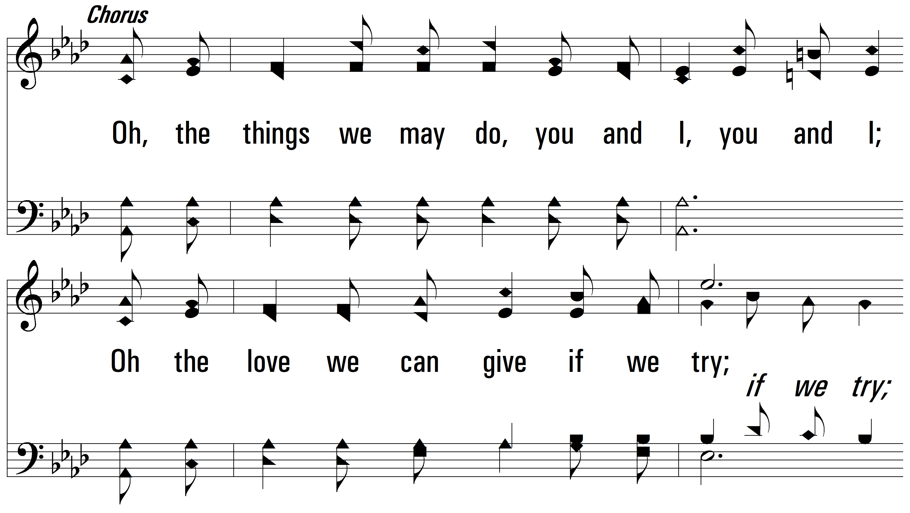
vs. 1

Slide 5
vs. 1

Slide 6
vs. 2 ~ Oh, The Things We May Do

Slide 7
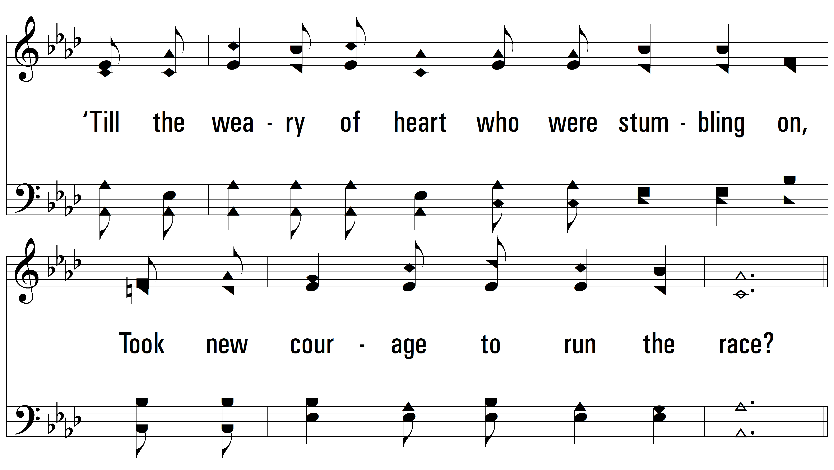
vs. 2

Slide 8
vs. 2

Slide 9
vs. 2

Slide 10
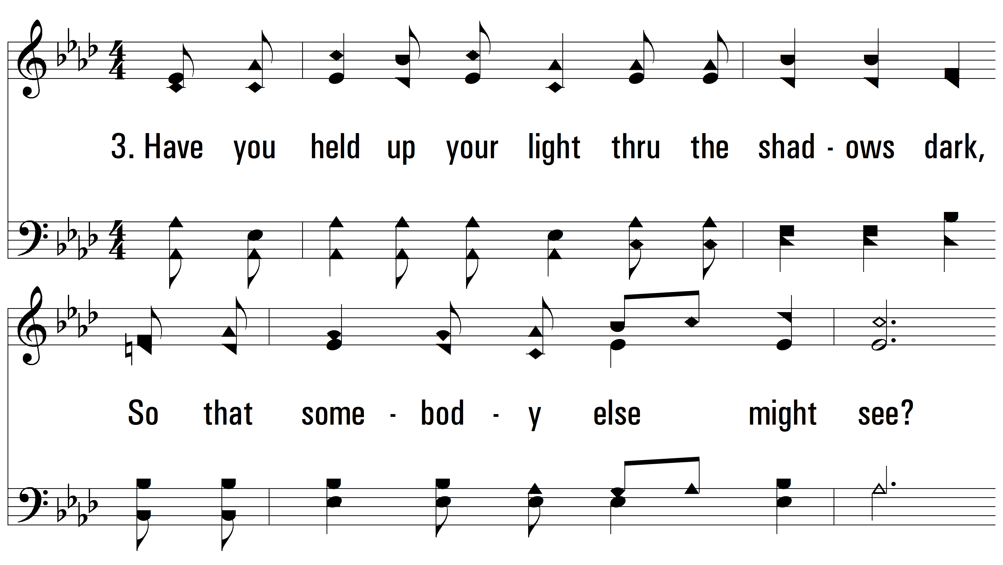
vs. 3 ~ Oh, The Things We May Do

Slide 11
vs. 3

Slide 12
vs. 3

Slide 13
vs. 3
PDHymns.com
END

