Slide 1
Oft In Sorrow, Oft In Woe
HATFIELD
7.7.7.7
Words: | White-Maitland (1806)
Music: | W. T. Porter (1874)
3/8
E^{b}/G - MI
Verses: 4
Lead - | MI
Alto - | DO
Tenor - | SOL
Bass - | DO
PDHymns.com

Slide 2
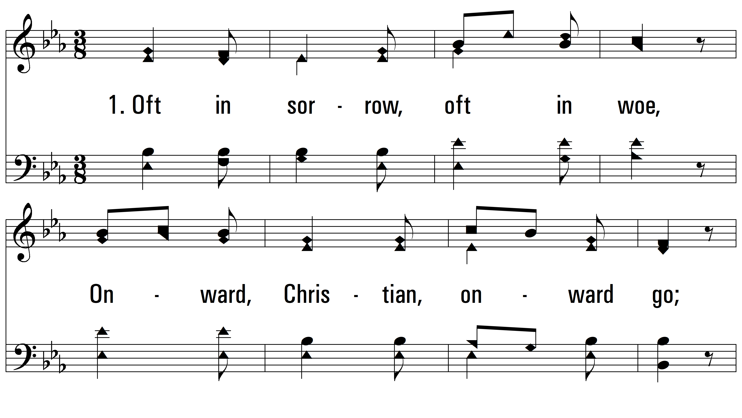
vs. 1 ~ Oft In Sorrow, Oft In Woe

Slide 3
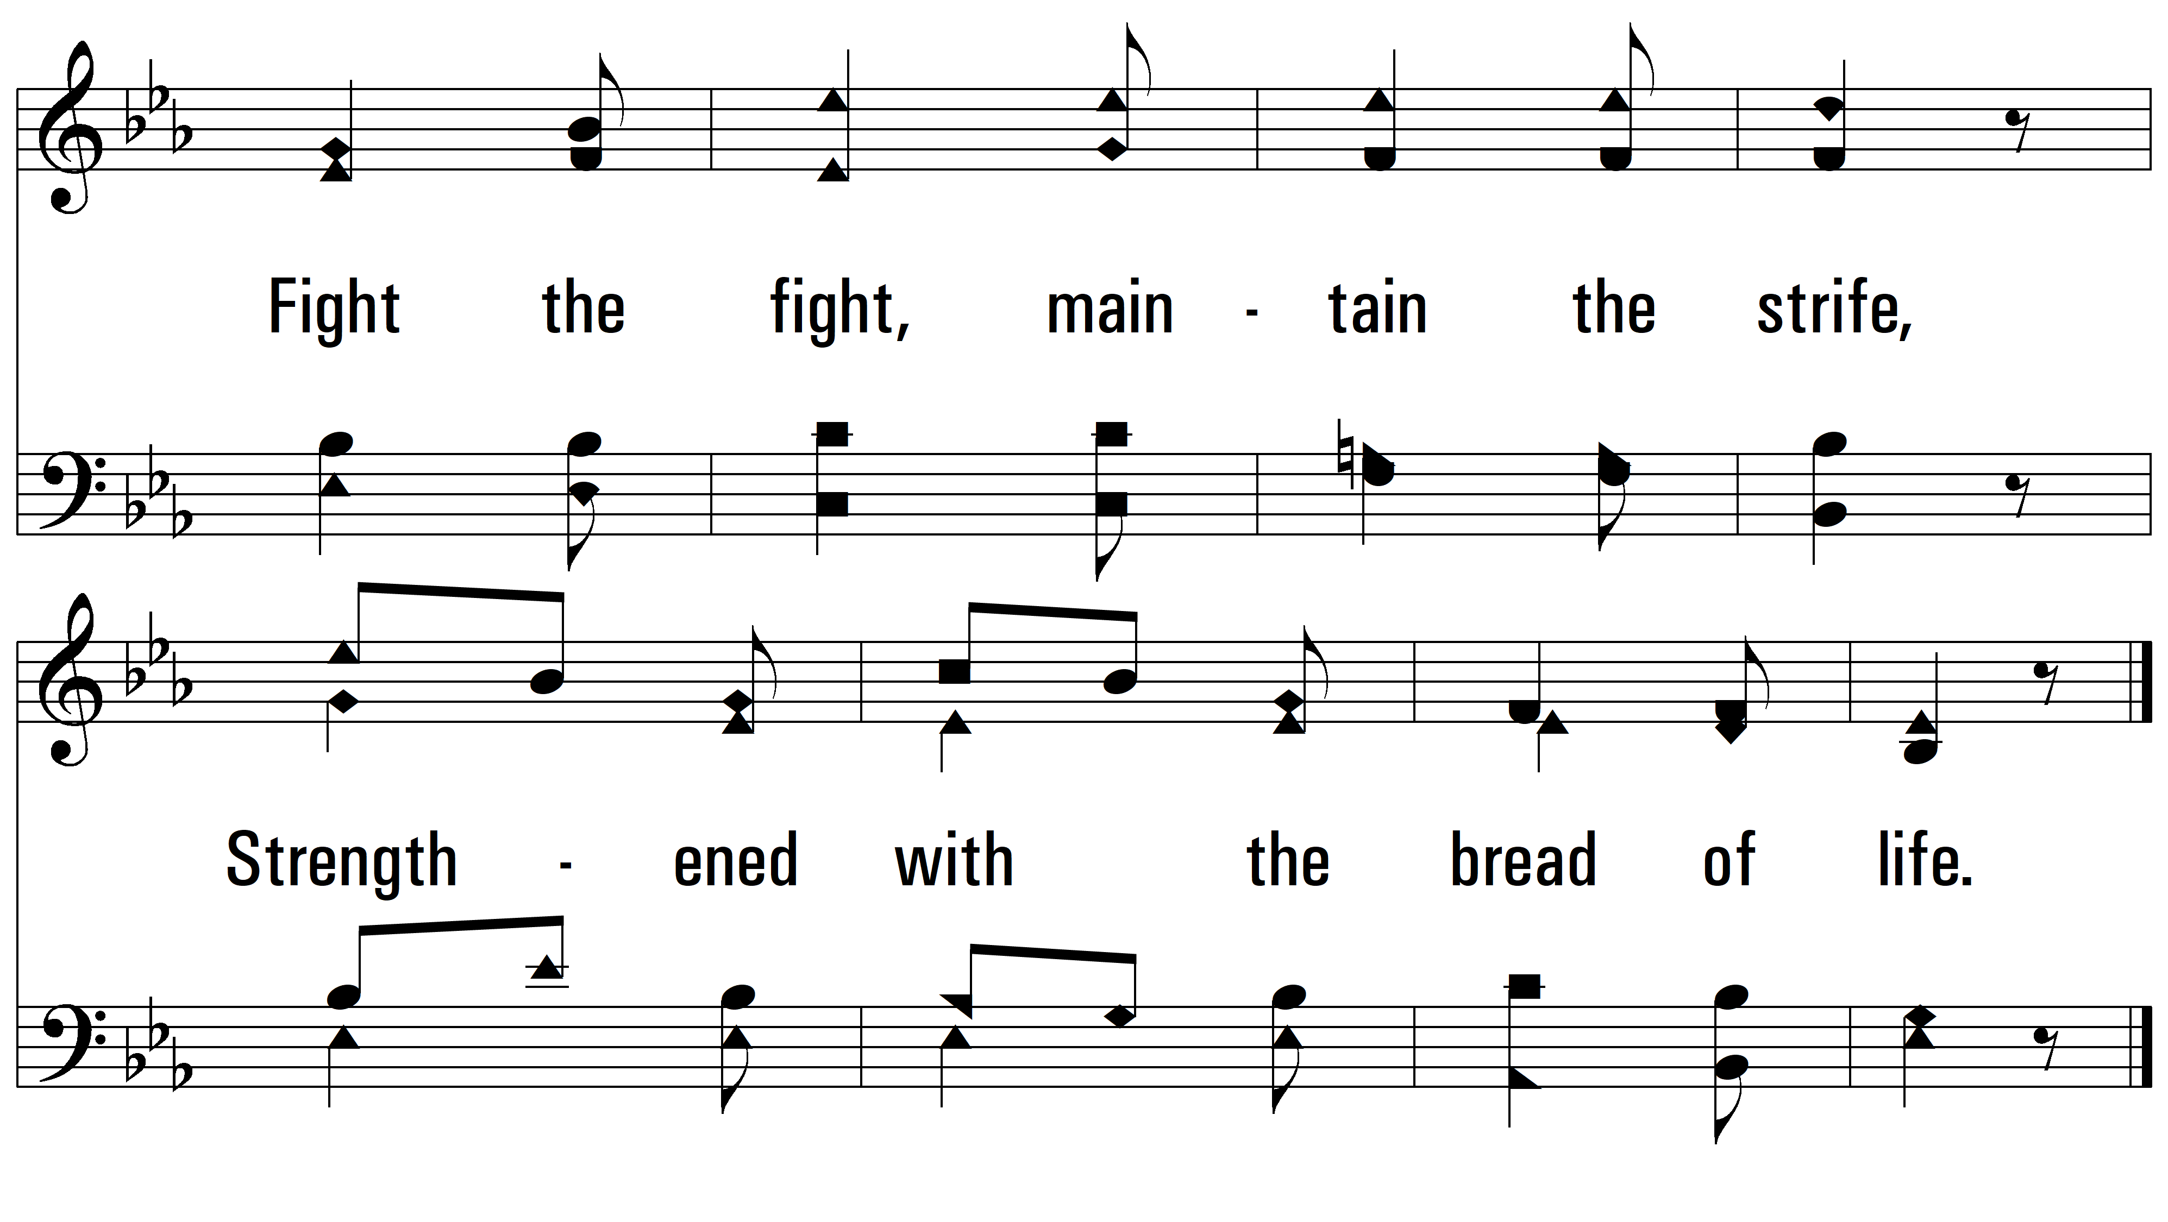
vs. 1

Slide 4
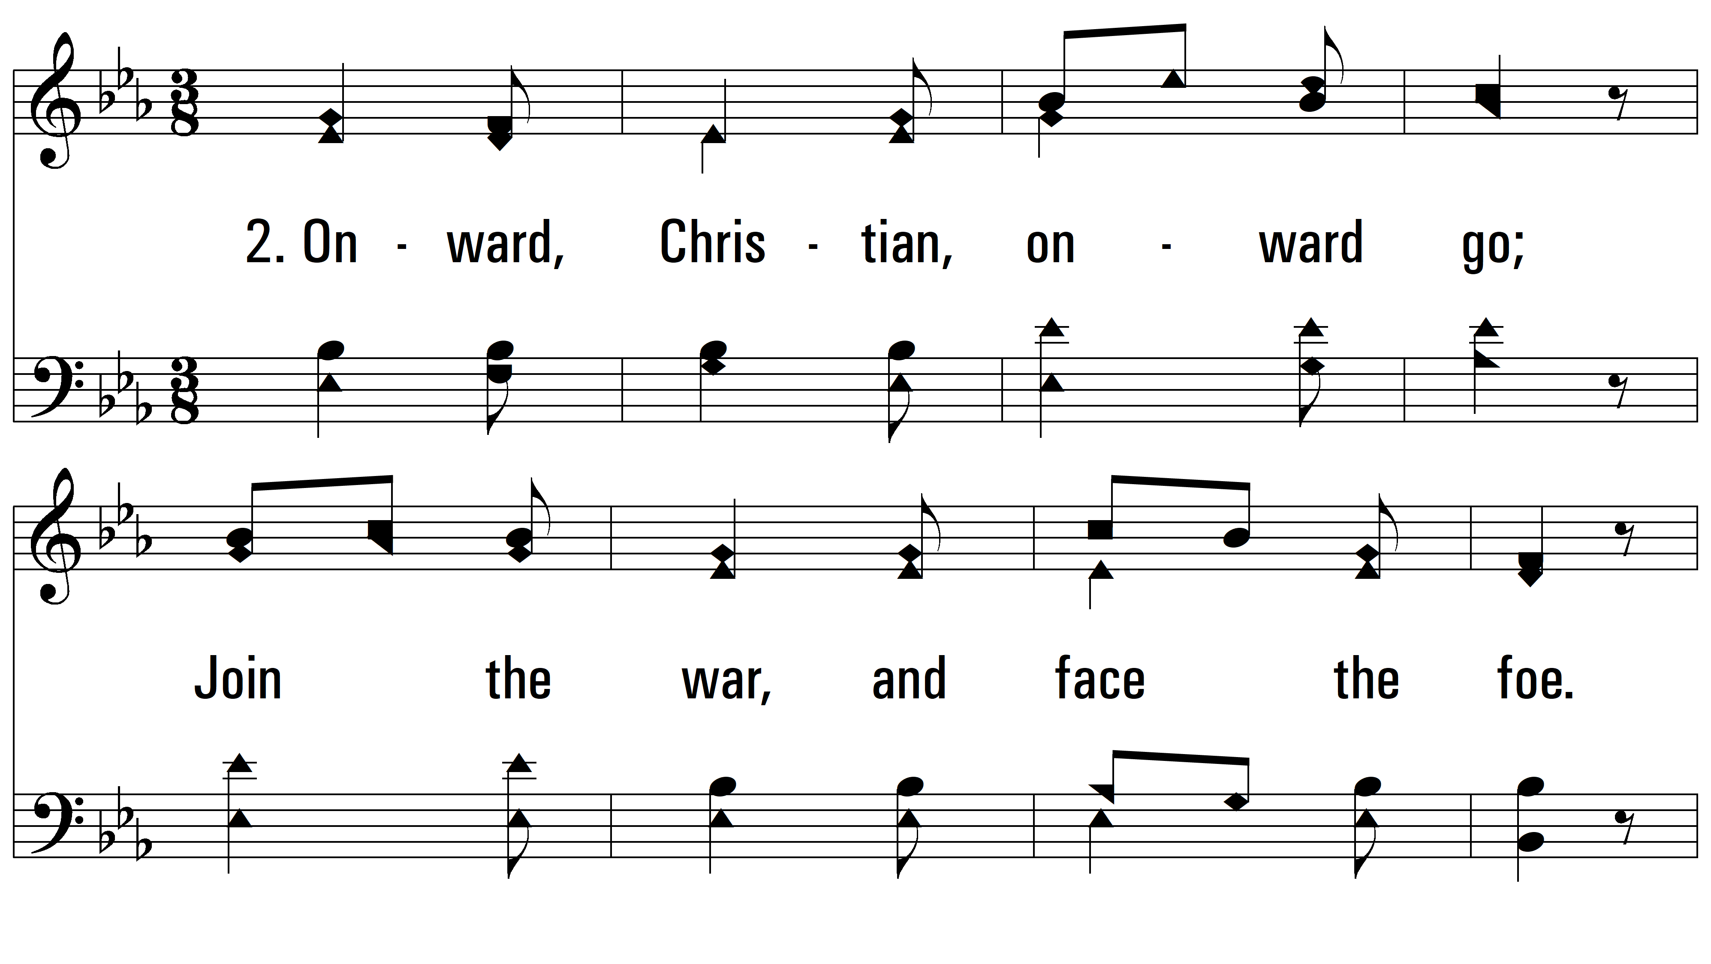
vs. 2 ~ Oft In Sorrow, Oft In Woe

Slide 5
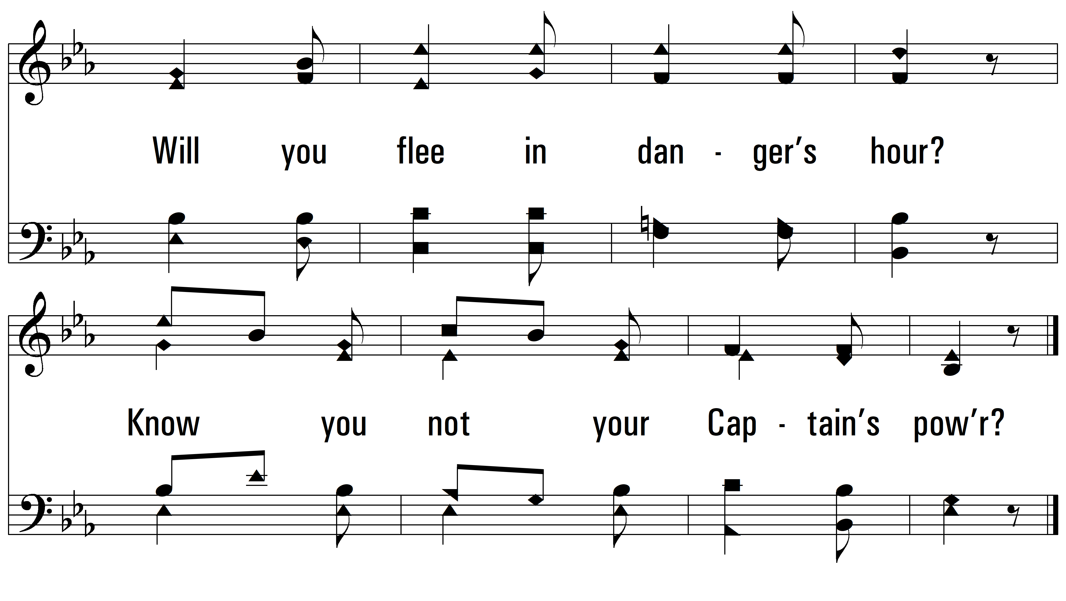
vs. 2

Slide 6
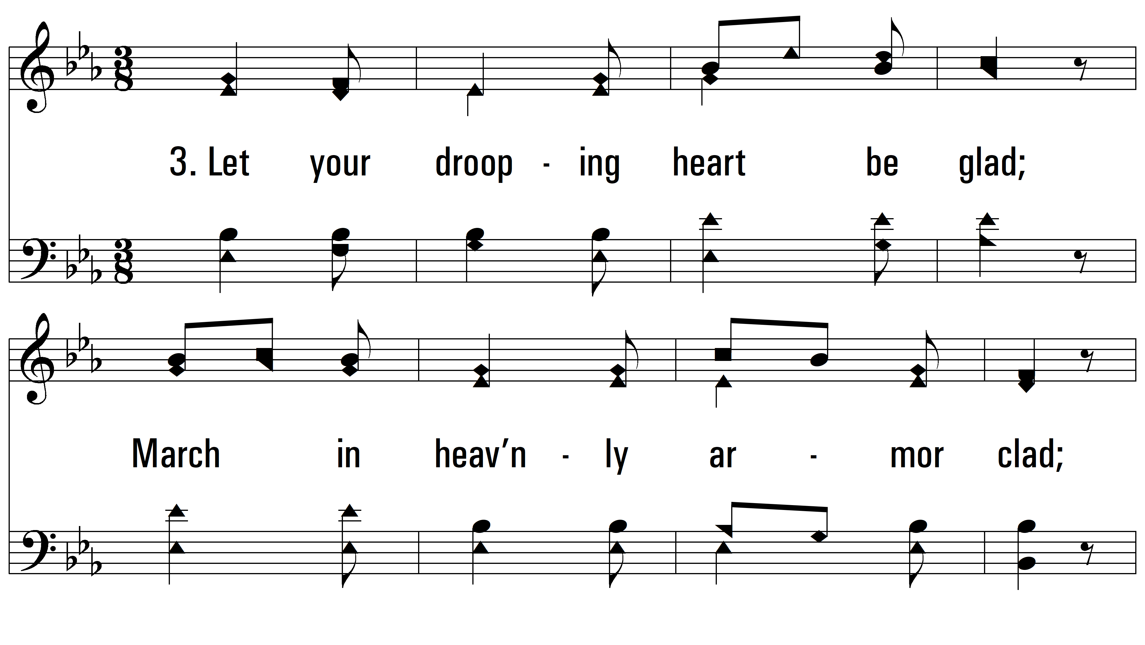
vs. 3 ~ Oft In Sorrow, Oft In Woe

Slide 7
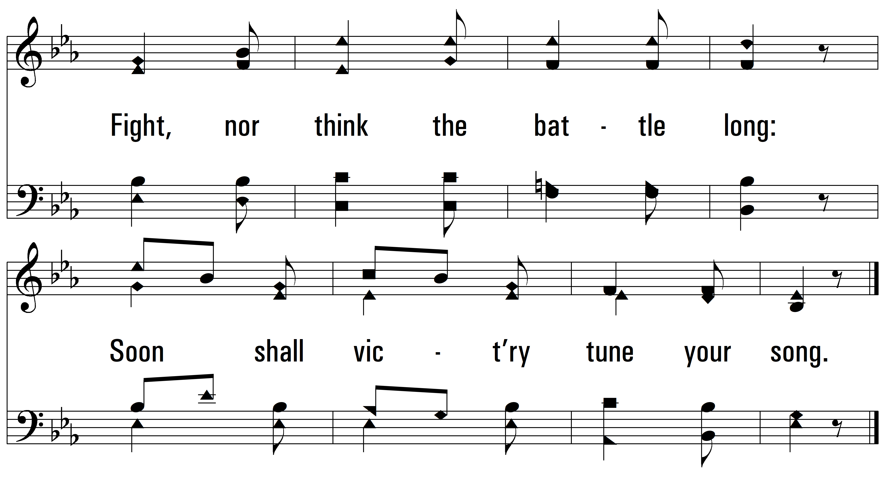
vs. 3

Slide 8
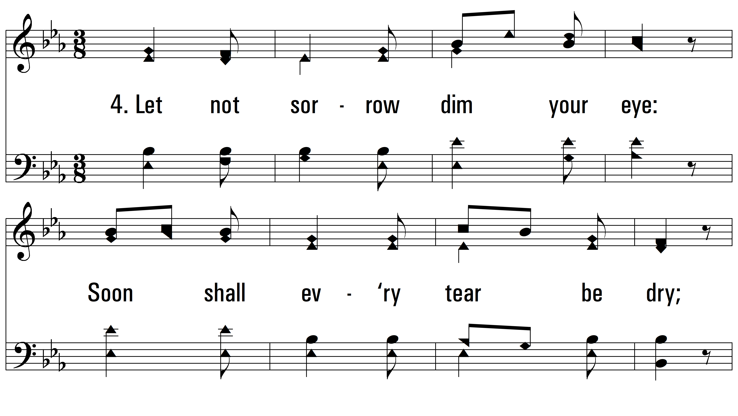
vs. 4 ~ Oft In Sorrow, Oft In Woe

Slide 9
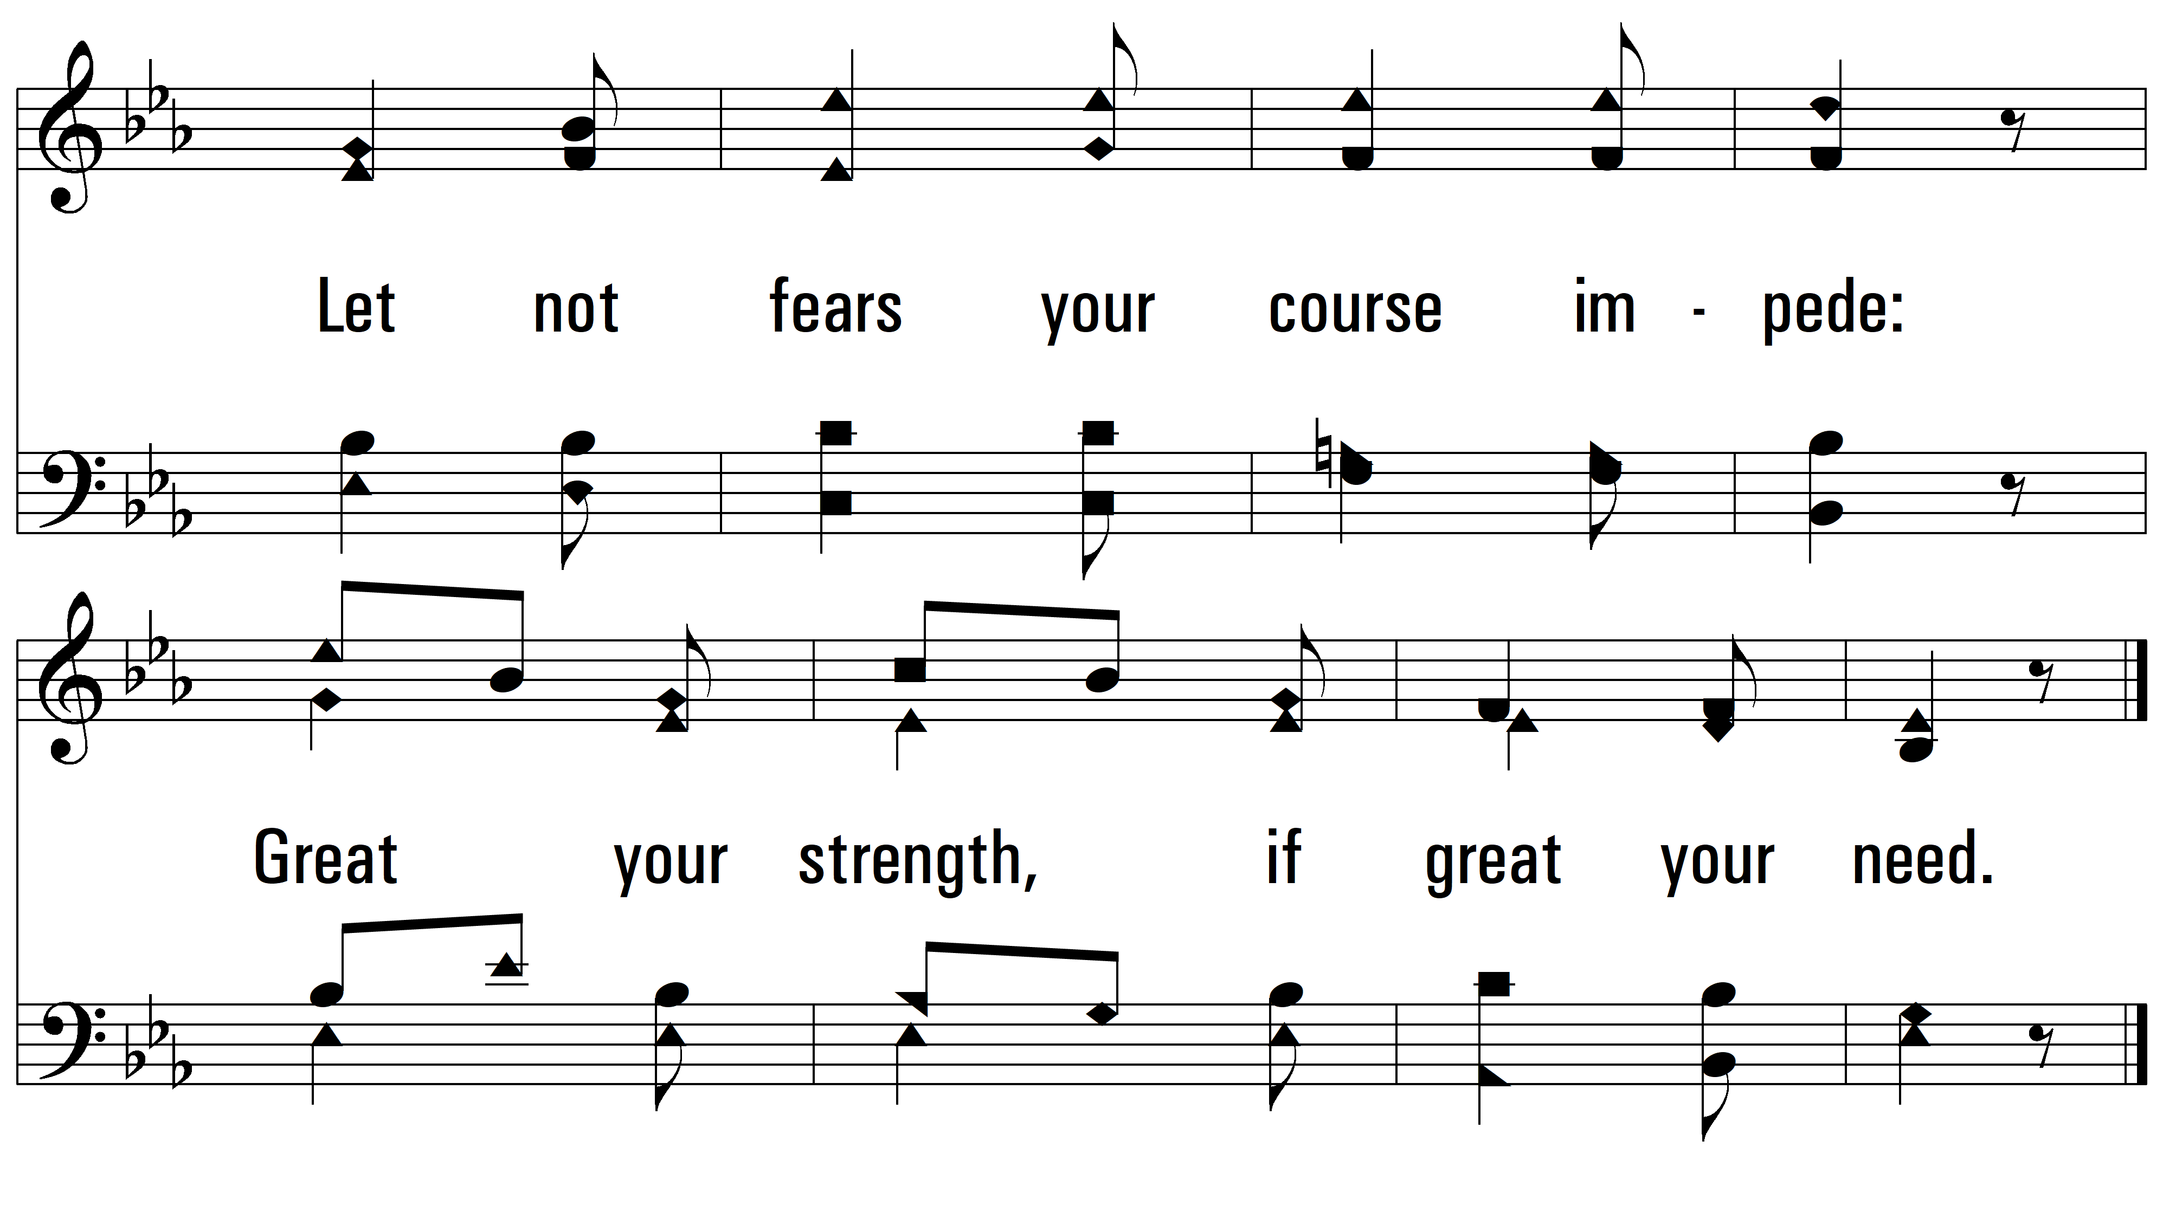
vs. 4
PDHymns.com
END

