Slide 1
O Worship The King
LYONS
5.5.5.5.6.5.6.5
Words: | Robert Grant (1833)
Music: | Attr. Joseph Michael Haydn, in William Gardiner’s Sacred Melodies (1815)
3/4
A^{b}/E^{b} - SOL
Verses: 4
Lead - | SOL
Alto - | MI
Tenor - | DO
Bass - | DO
PDHymns.com

Slide 2
vs. 1 ~ O Worship The King

Slide 3
vs. 1

Slide 4
vs. 2 ~ O Worship The King

Slide 5
vs. 2

Slide 6
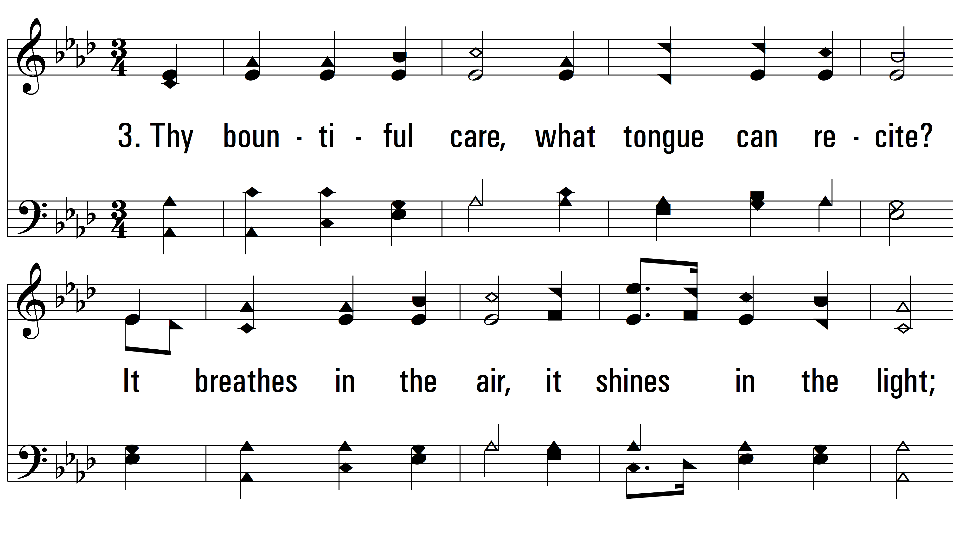
vs. 3 ~ O Worship The King

Slide 7
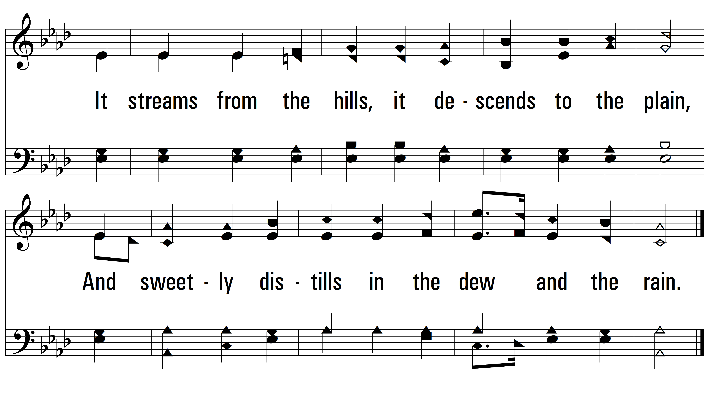
vs. 3

Slide 8
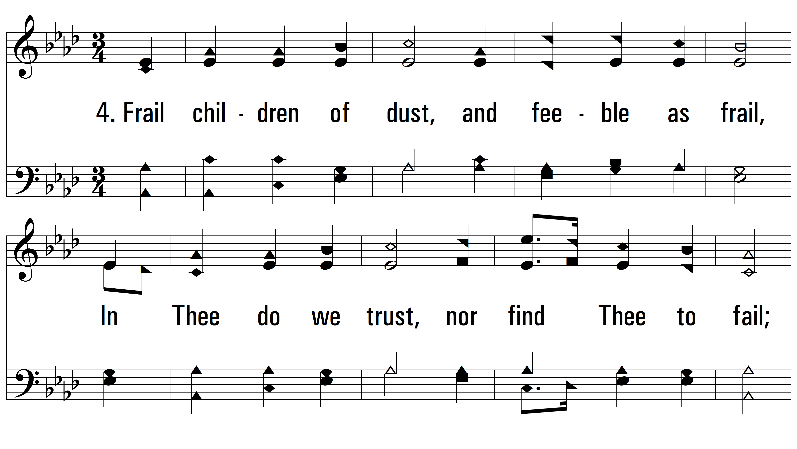
vs. 4 ~ O Worship The King

Slide 9
vs. 4
PDHymns.com
END

