Slide 1
O Why Not Tonight?
Words: | Elizabeth Reed (1842)
Music: | J. Calvin Bushey (1842)
4/4
E^{b}/E^{b} - DO
Verses: 4/Chorus
Lead - | DO
Alto - | DO
Tenor - | MI
Bass - | DO
PDHymns.com

Slide 2
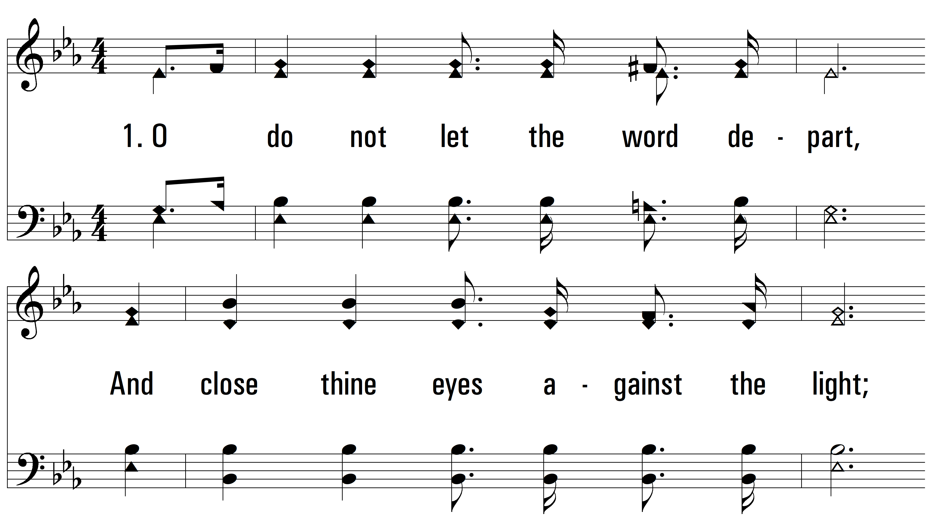
vs. 1 ~ O Why Not Tonight?

Slide 3
vs. 1

Slide 4
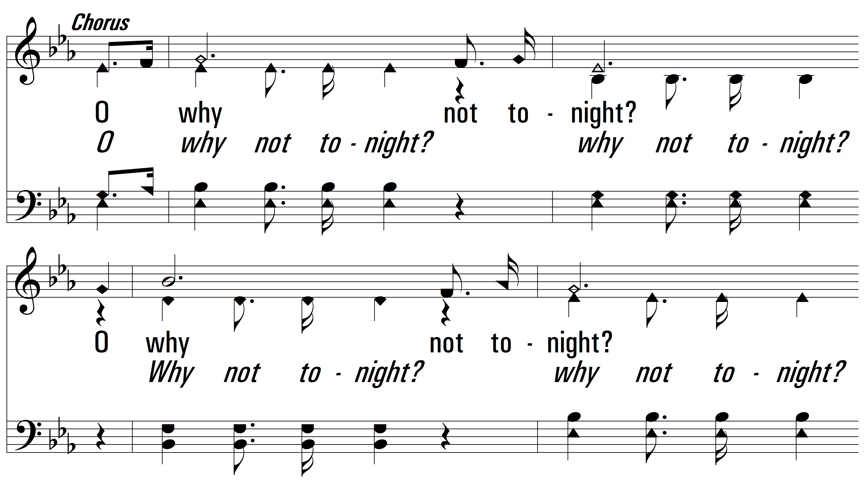
vs. 1

Slide 5
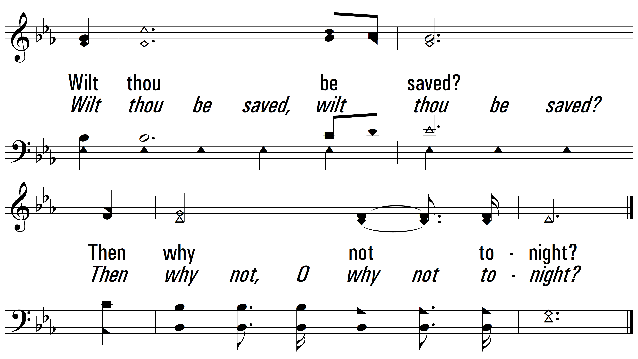
vs. 1

Slide 6
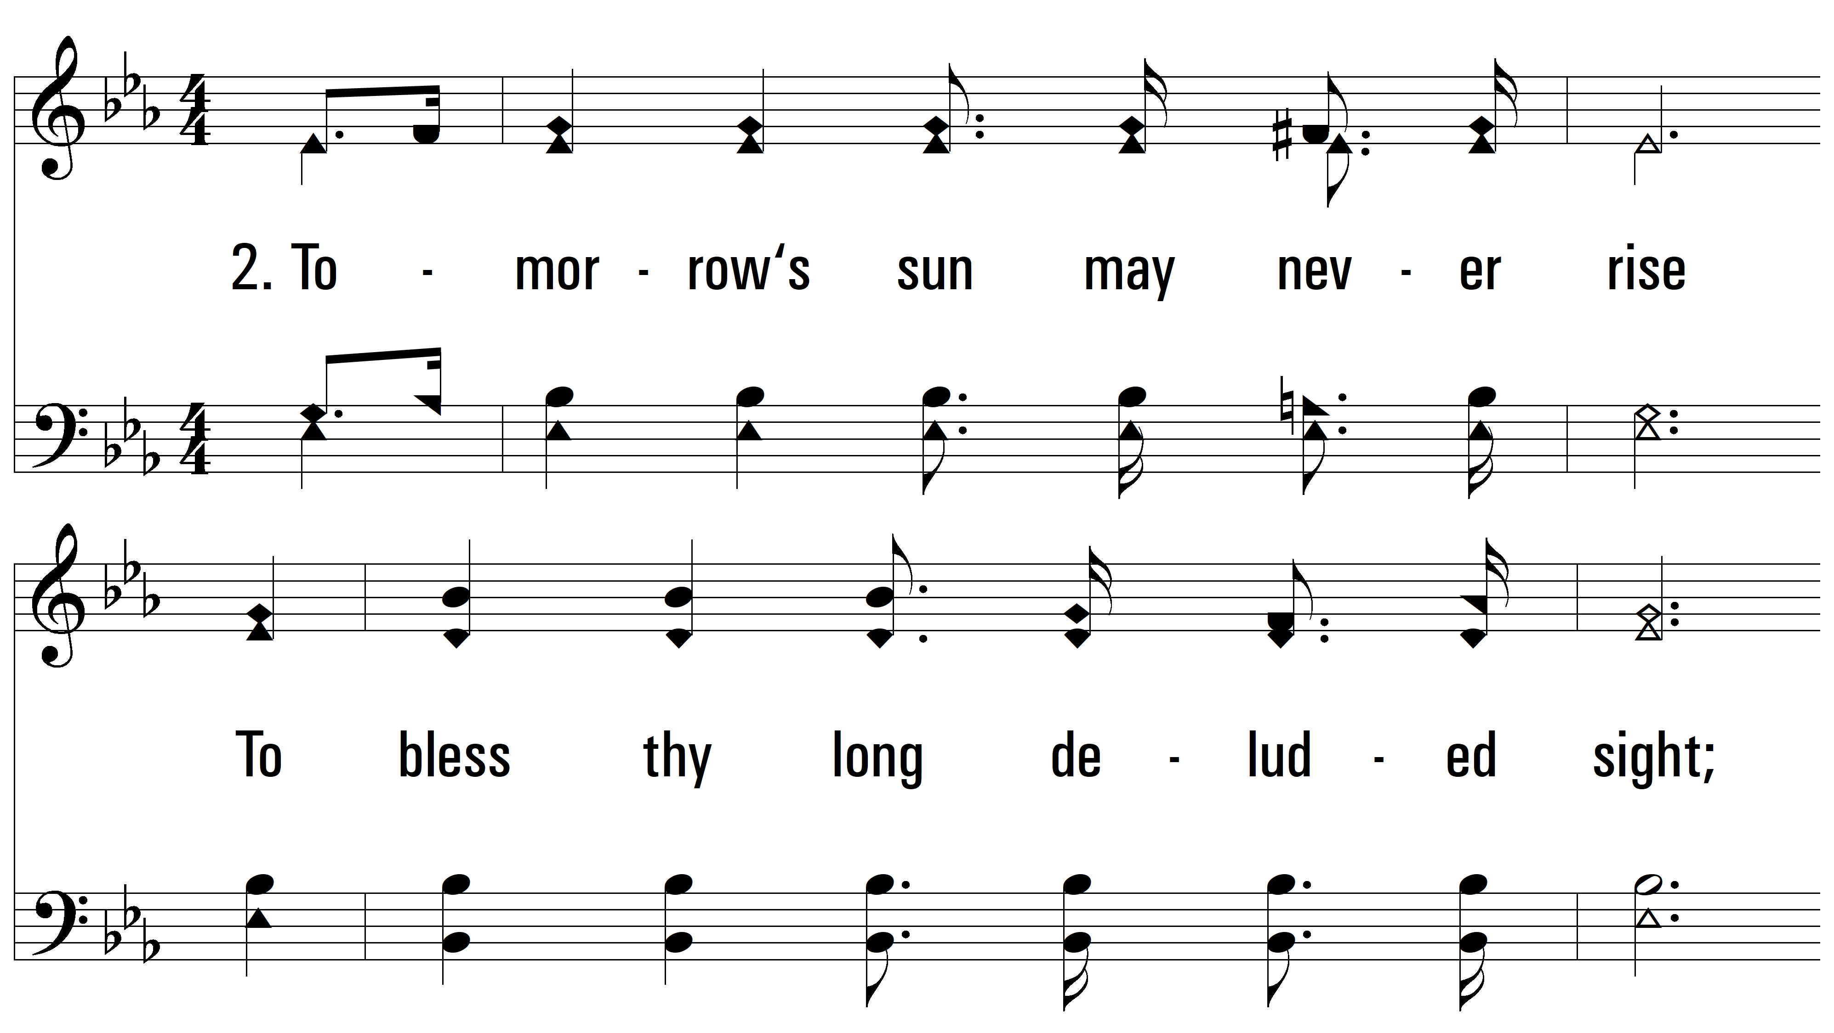
vs. 2 ~ O Why Not Tonight?

Slide 7
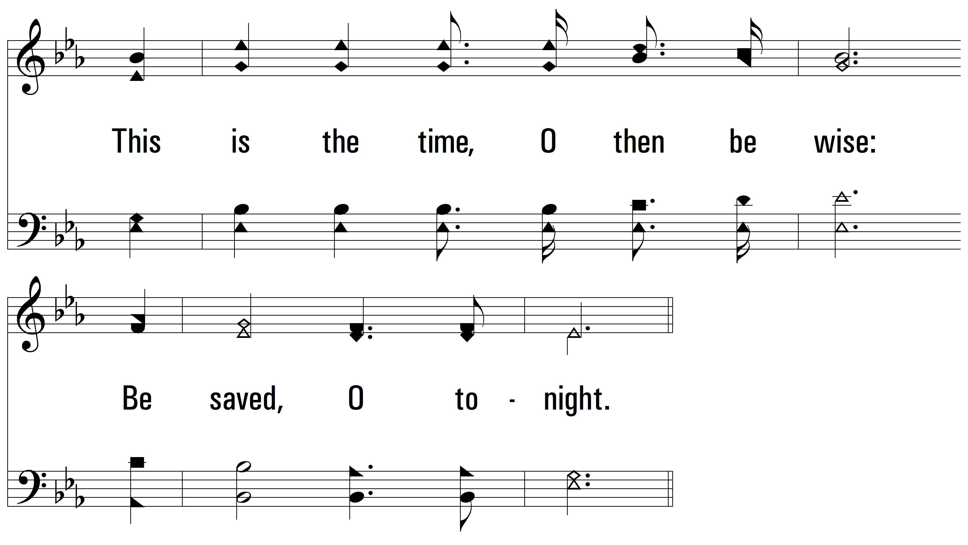
vs. 2

Slide 8
vs. 2

Slide 9
vs. 2

Slide 10
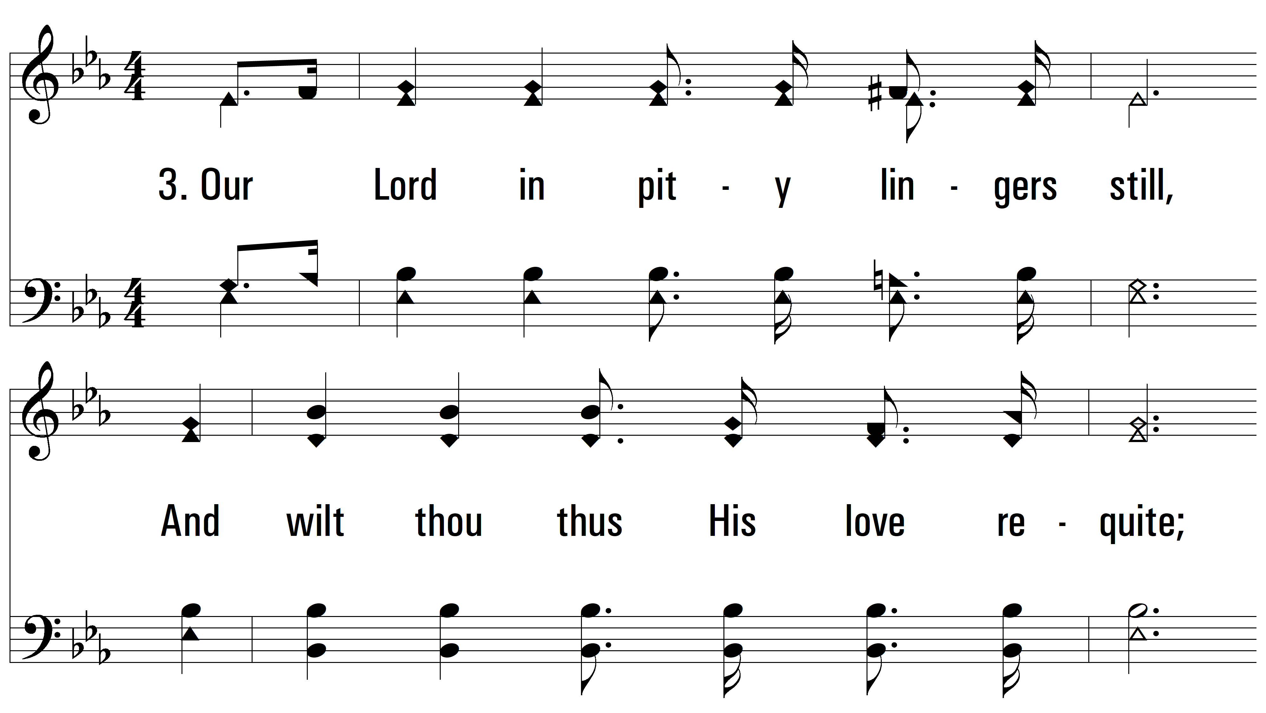
vs. 3 ~ O Why Not Tonight?

Slide 11
vs. 3

Slide 12
vs. 3

Slide 13
vs. 3

Slide 14
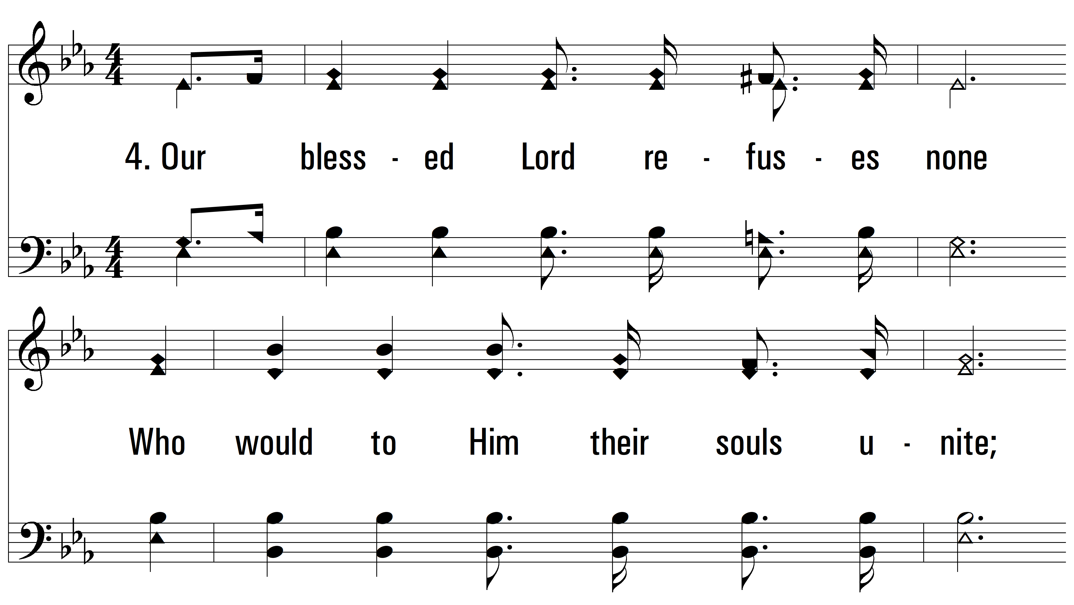
vs. 4 ~ O Why Not Tonight?

Slide 15
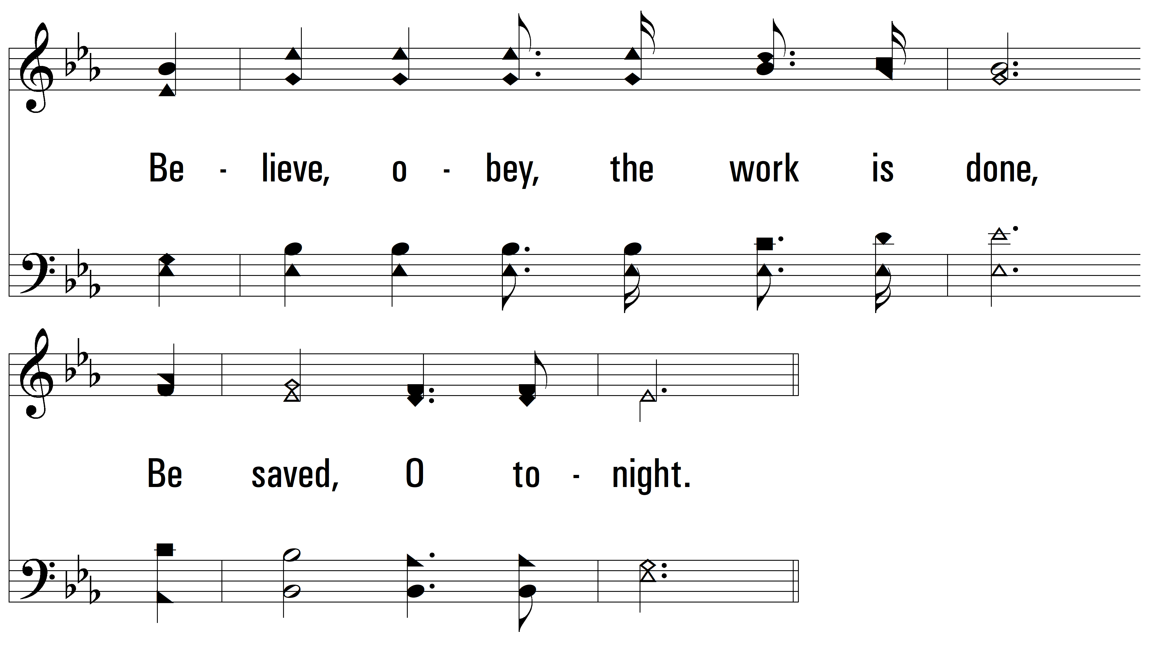
vs. 4

Slide 16
vs. 4

Slide 17
vs. 4
PDHymns.com
END

