Slide 1
O, Thou Fount Of Every Blessing
NETTLETON
8.7.8.7.D
Words: | Robert Robins (1758)
Music: | Wyeth’s Repository of Sacred Music (1813)
3/4
E^{b}/G - MI
Verses: 3
Lead - | MI
Alto - | DO
Tenor - | SOL
Bass - | DO
PDHymns.com

Slide 2
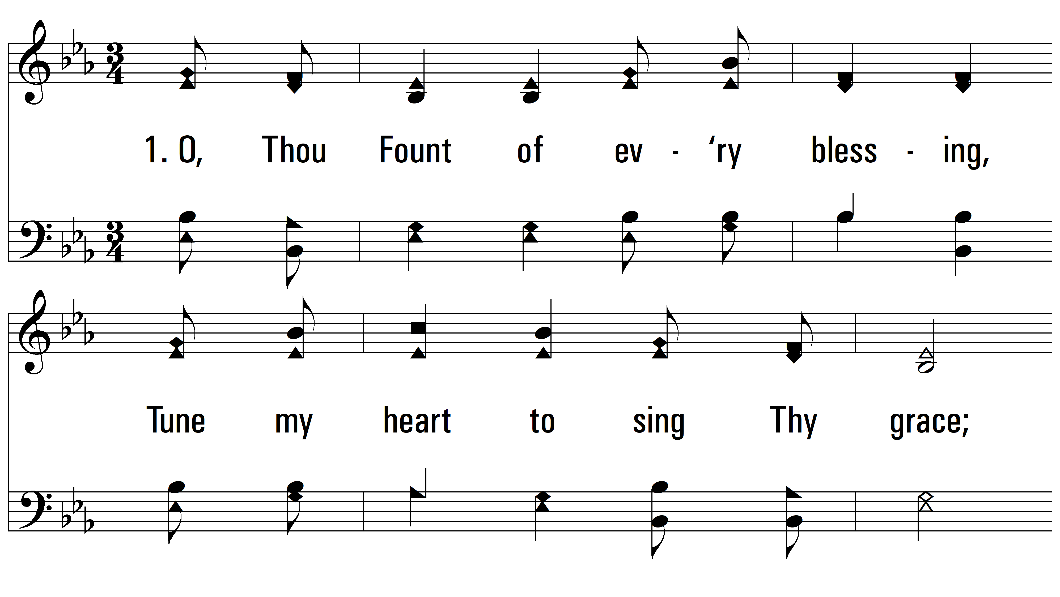
vs. 1 ~ O, Thou Fount Of Every Blessing

Slide 3
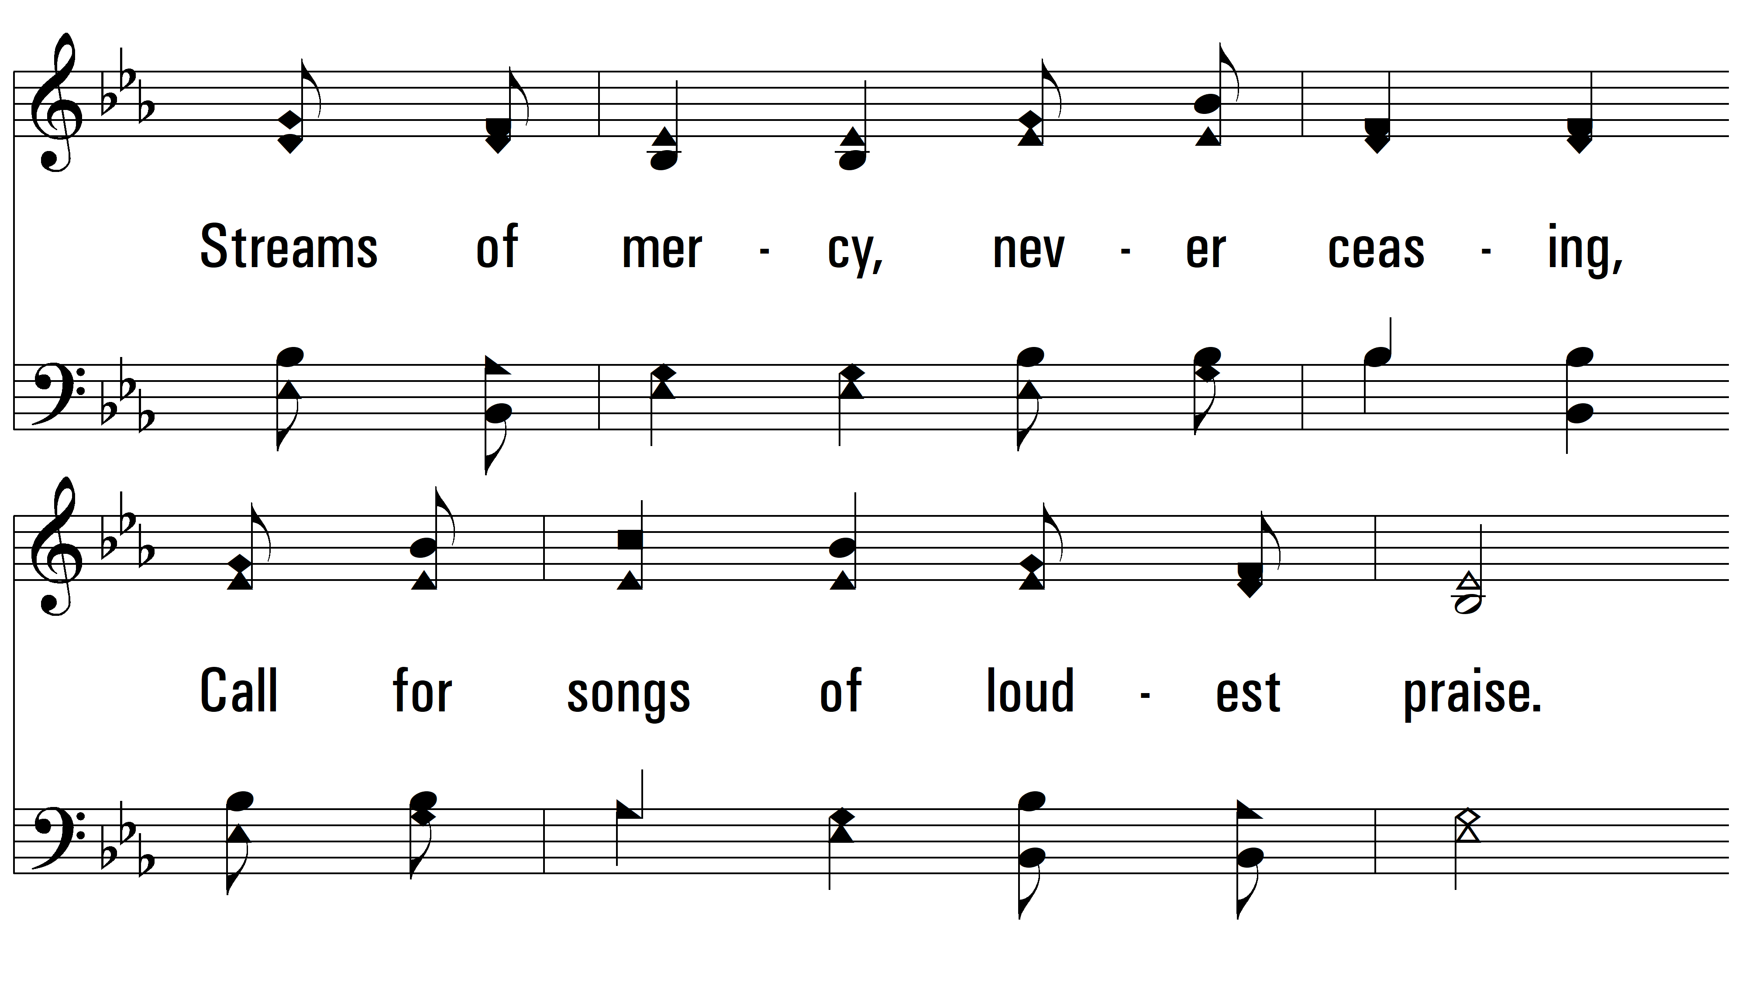
vs. 1

Slide 4
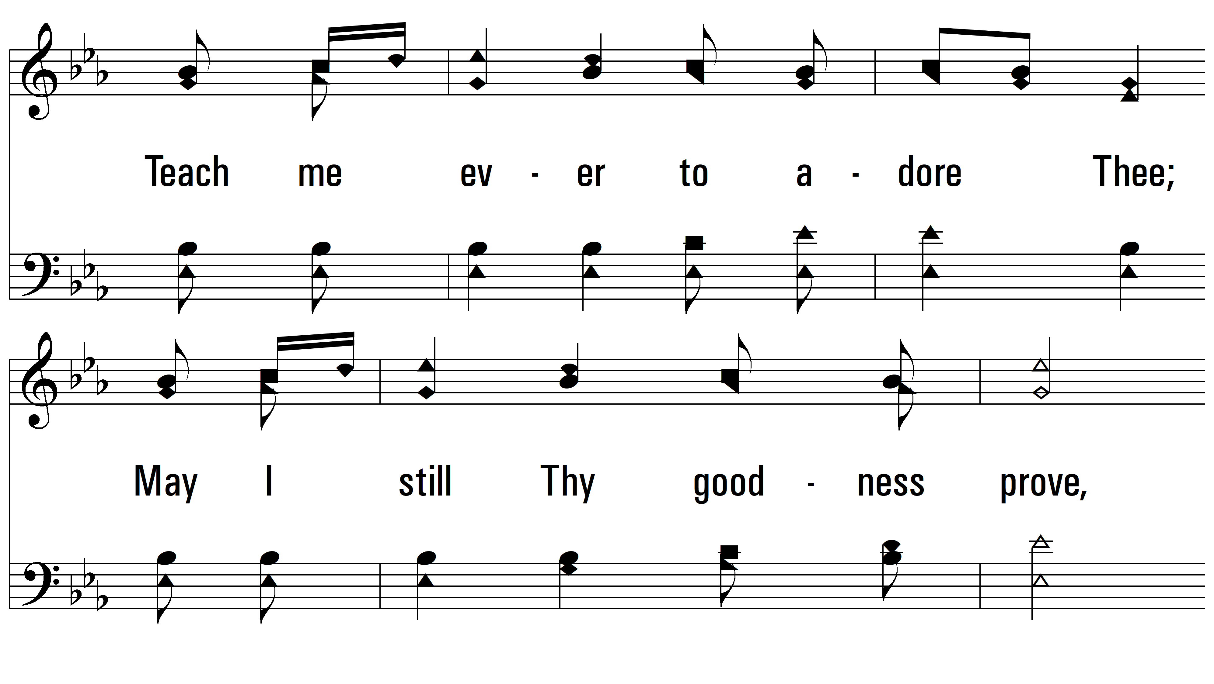
vs. 1

Slide 5
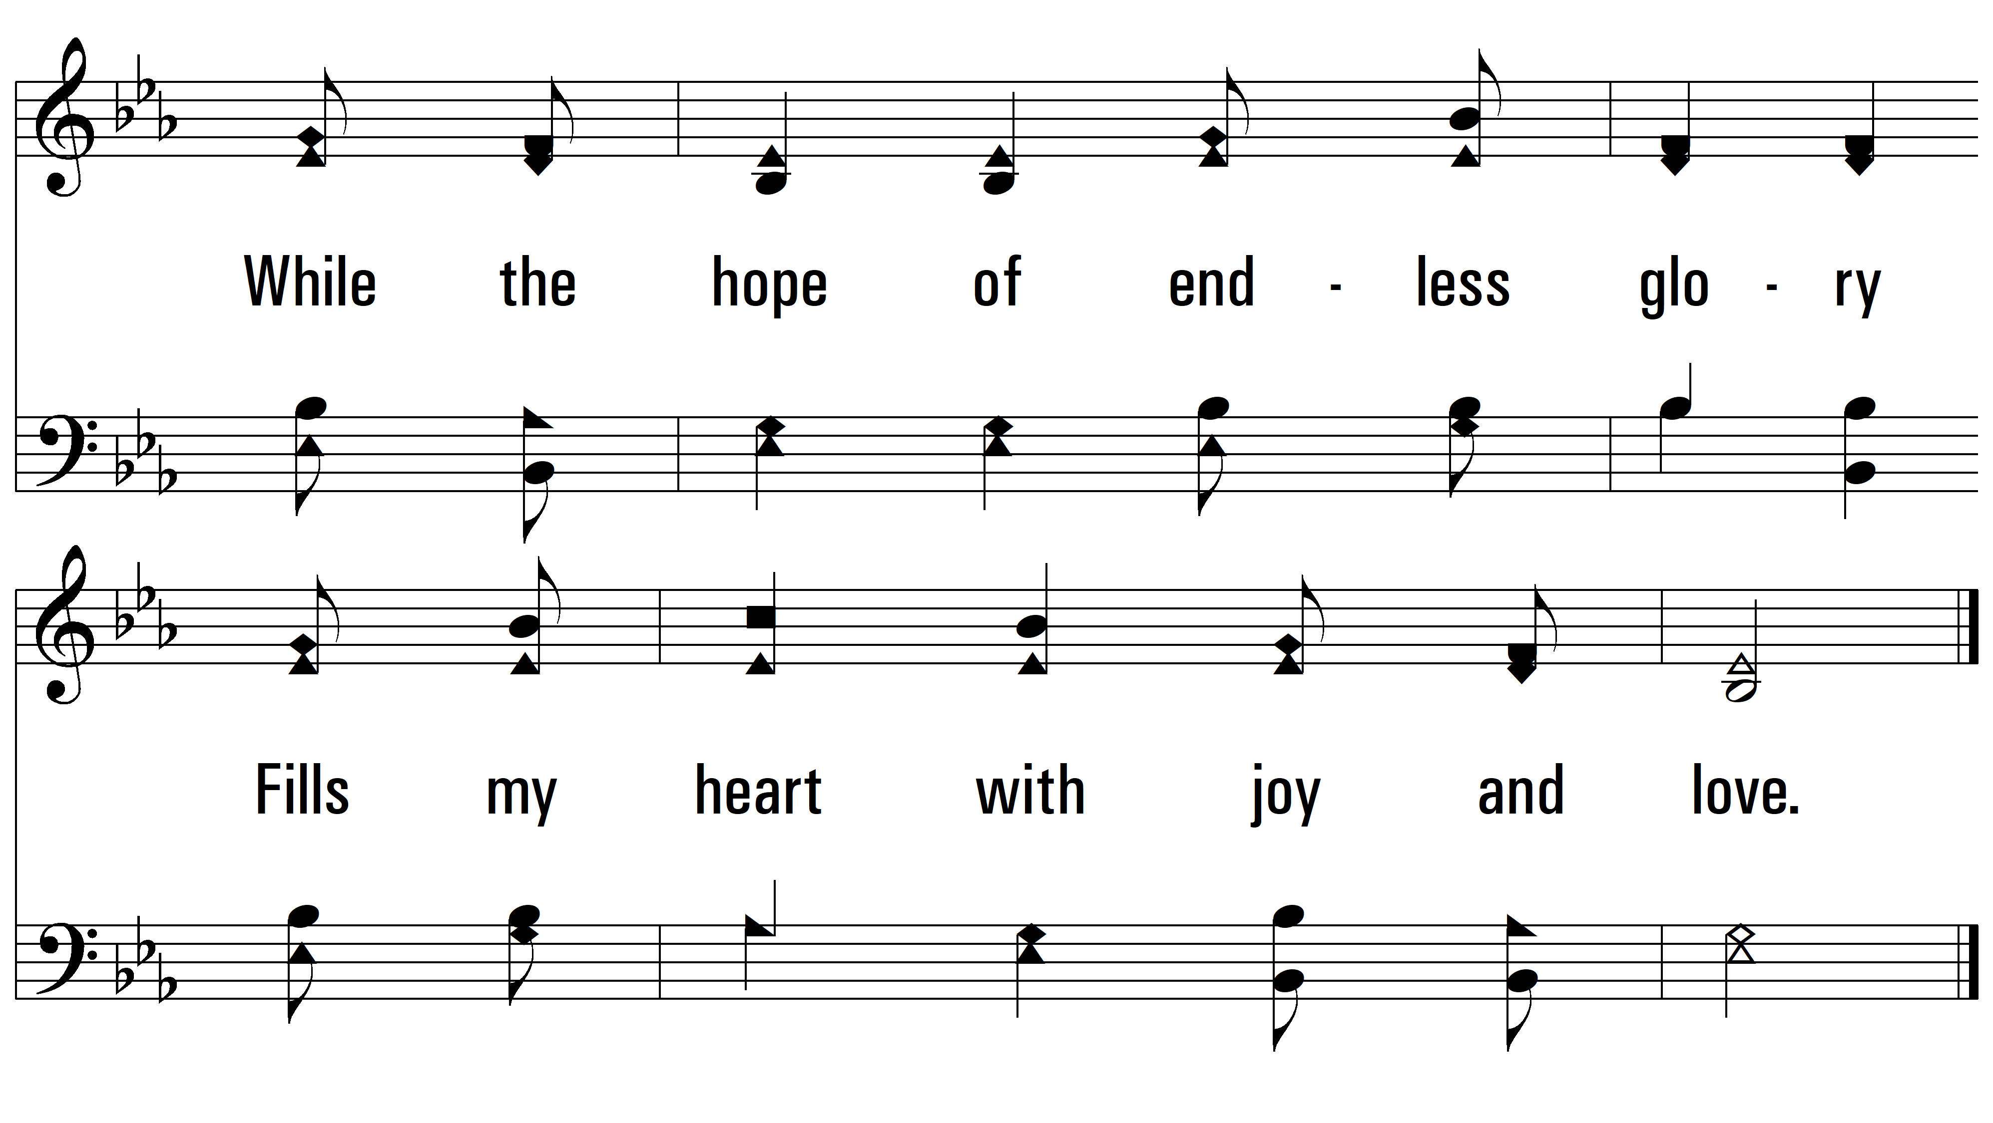
vs. 1

Slide 6
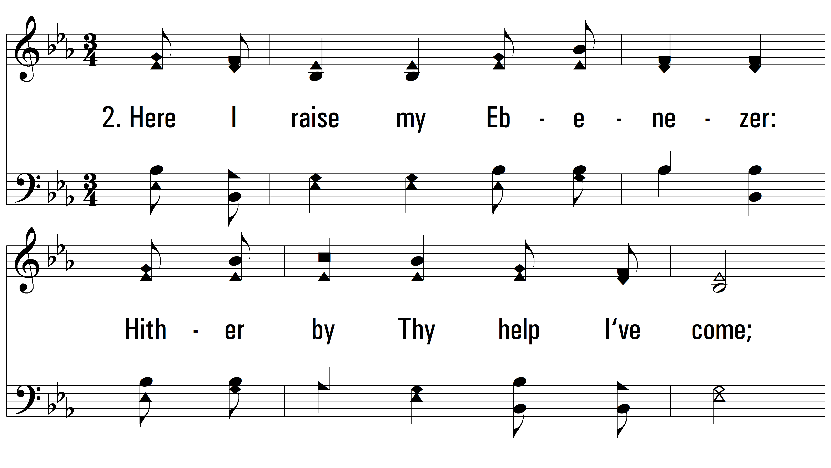
vs. 2 ~ O, Thou Fount Of Every Blessing

Slide 7
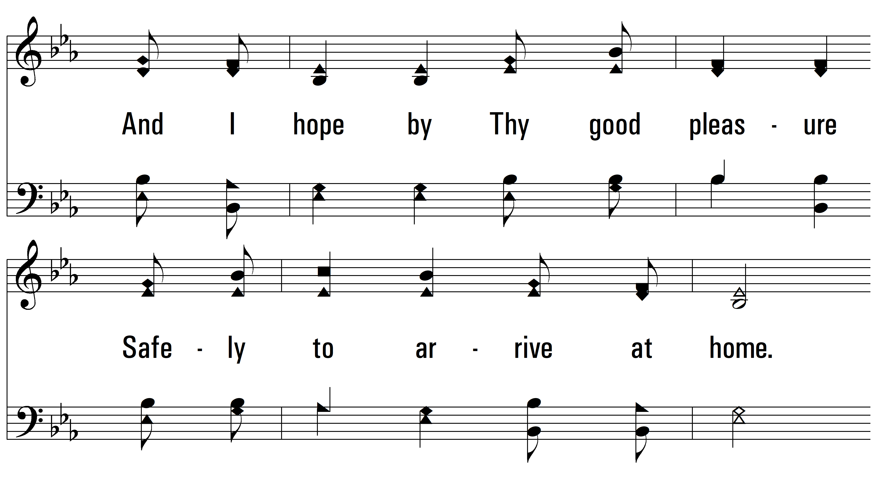
vs. 2

Slide 8
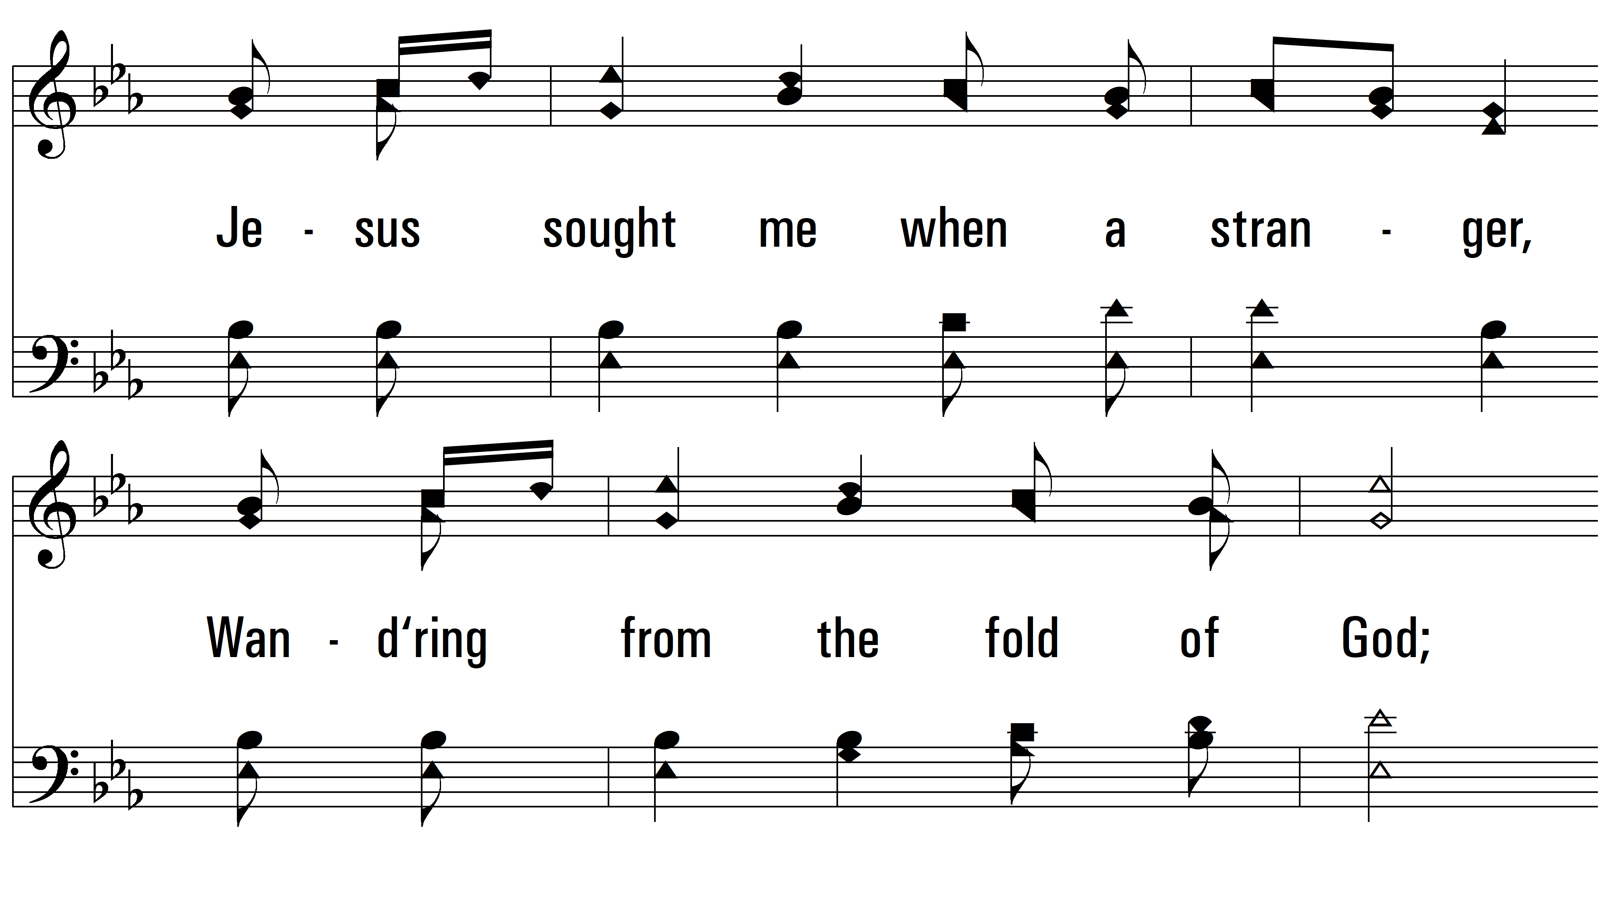
vs. 2

Slide 9
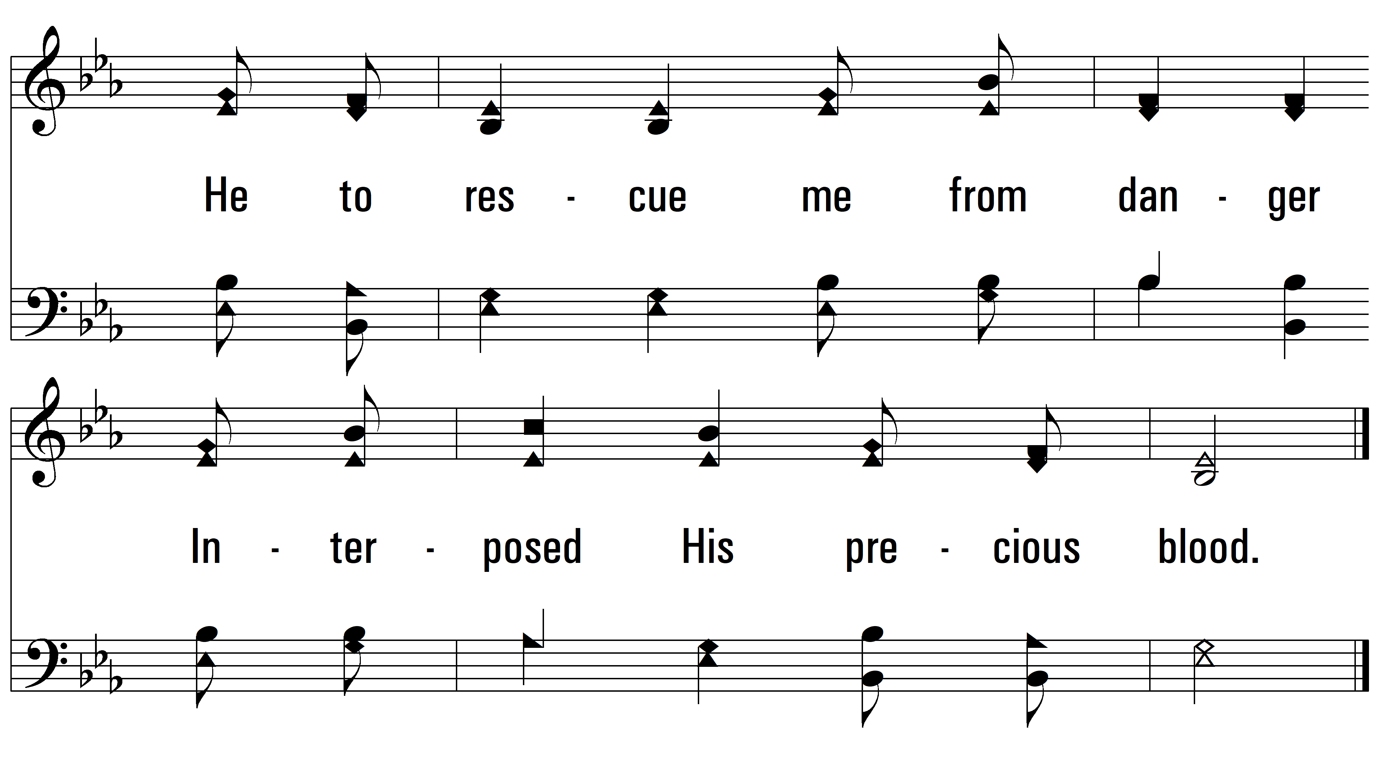
vs. 2

Slide 10
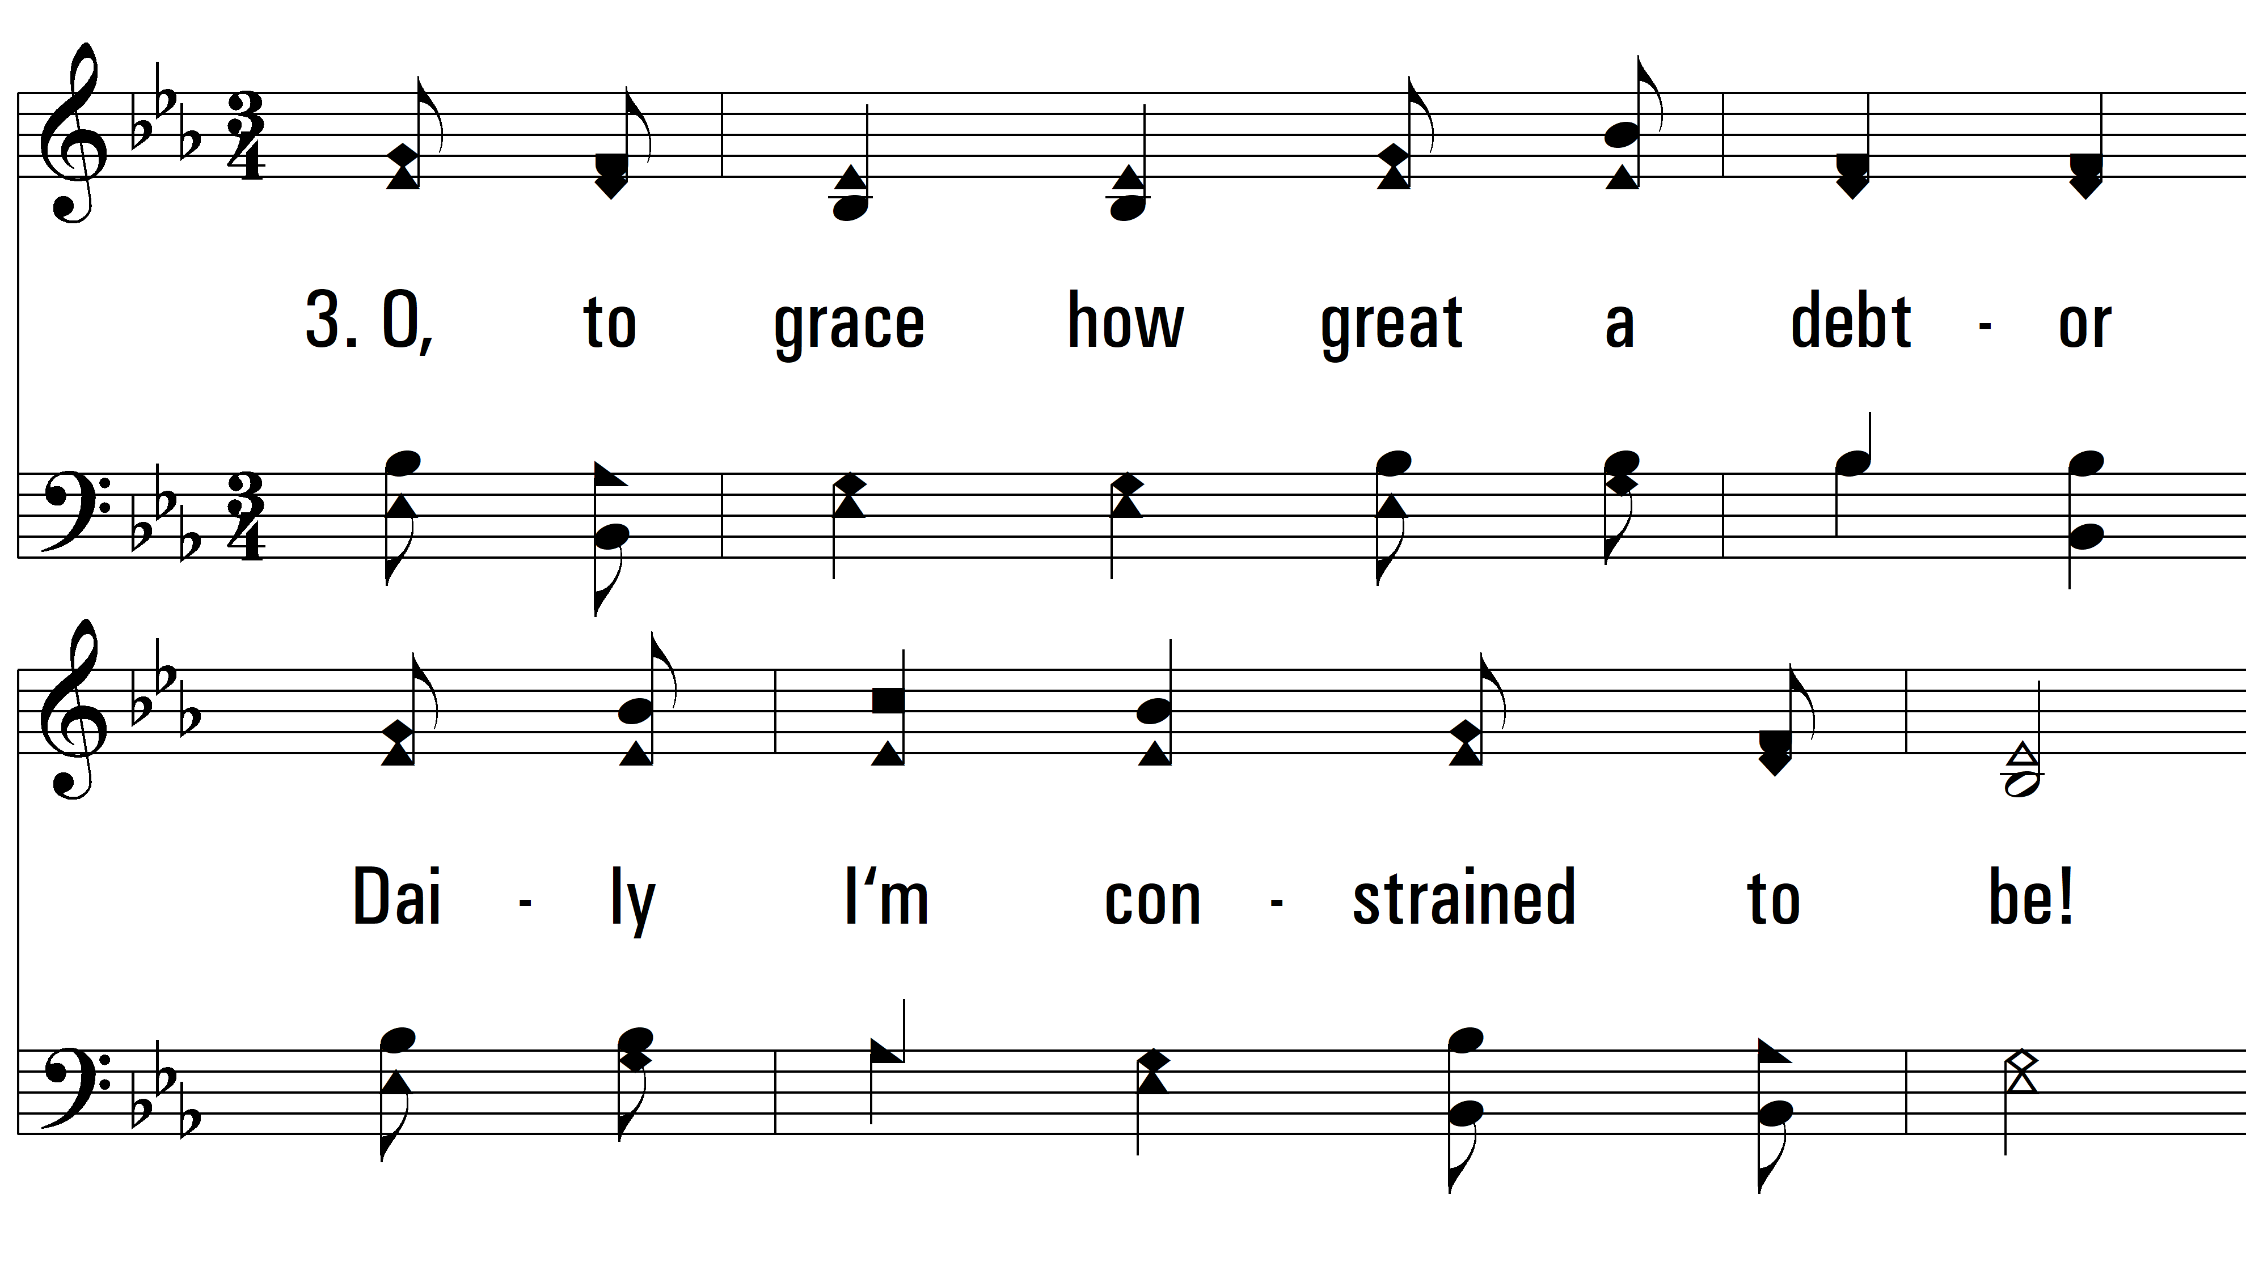
vs. 3 ~ O, Thou Fount Of Every Blessing

Slide 11
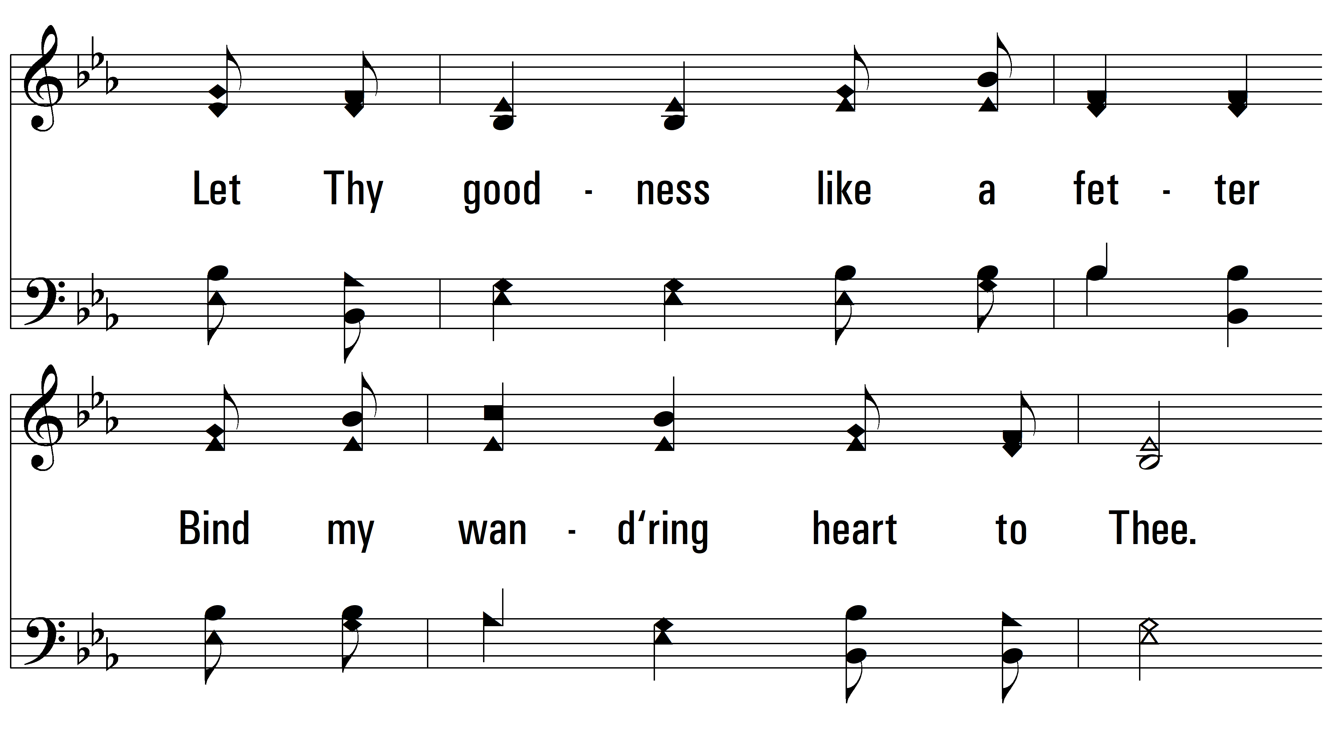
vs. 3

Slide 12
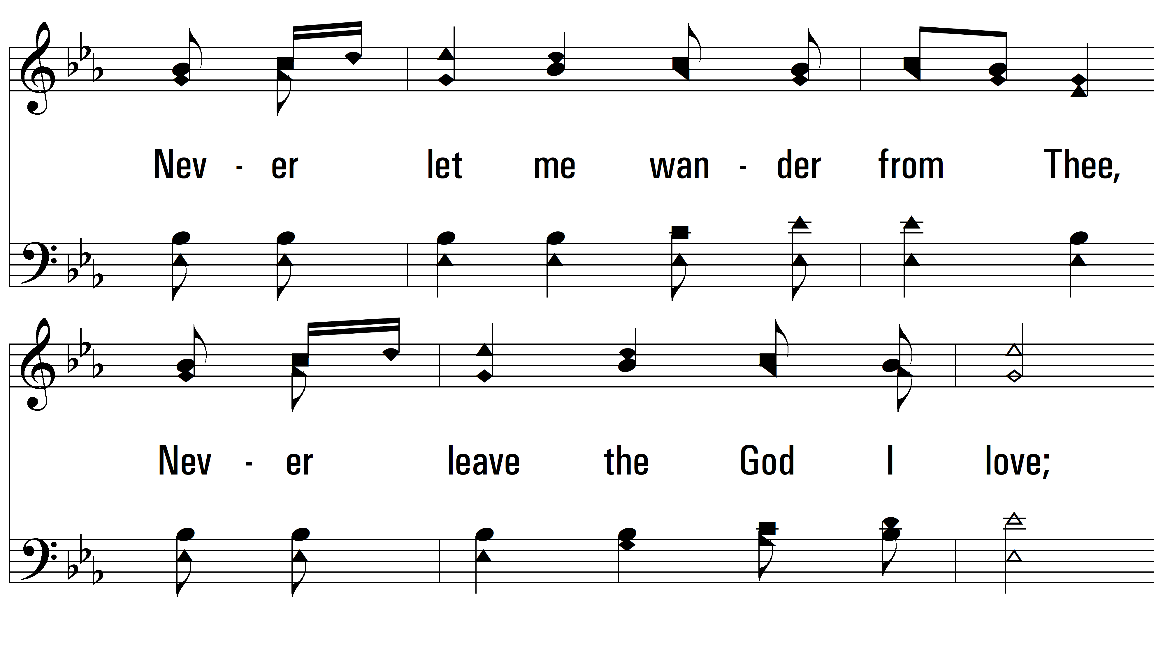
vs. 3

Slide 13
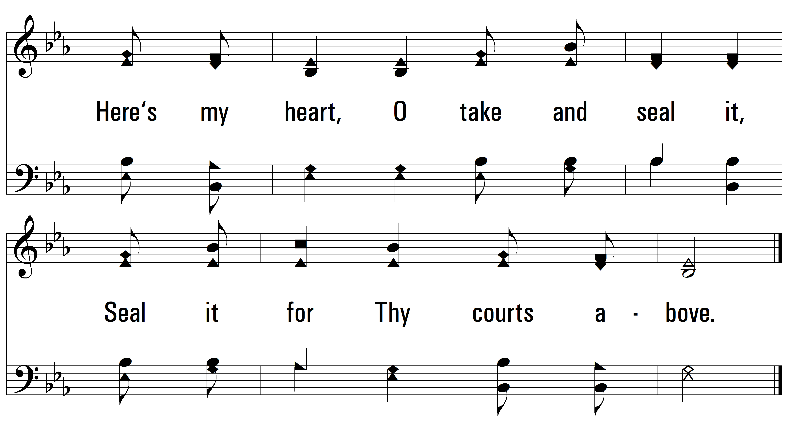
vs. 3
PDHymns.com
END

