Slide 1
Matchless Love
Words: | Samuel W. Beazley (1914)
Music: | Samuel W. Beazley (1914)
4/4
E^{b}/E^{b} - DO
Verses: 3/Chorus
Lead - | DO
Alto - | DO
Tenor - | DO
Bass - | DO
PDHymns.com

Slide 2
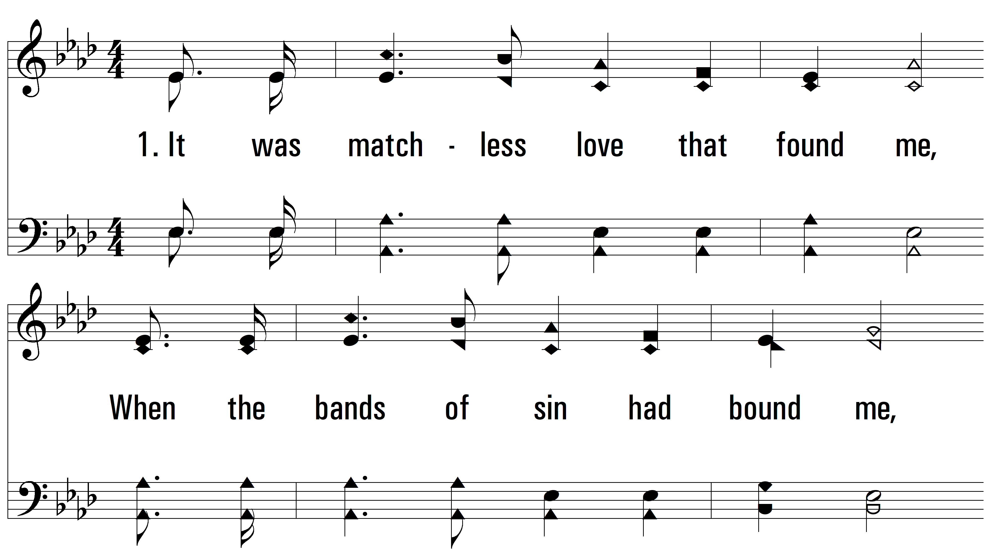
vs. 1 ~ Matchless Love

Slide 3
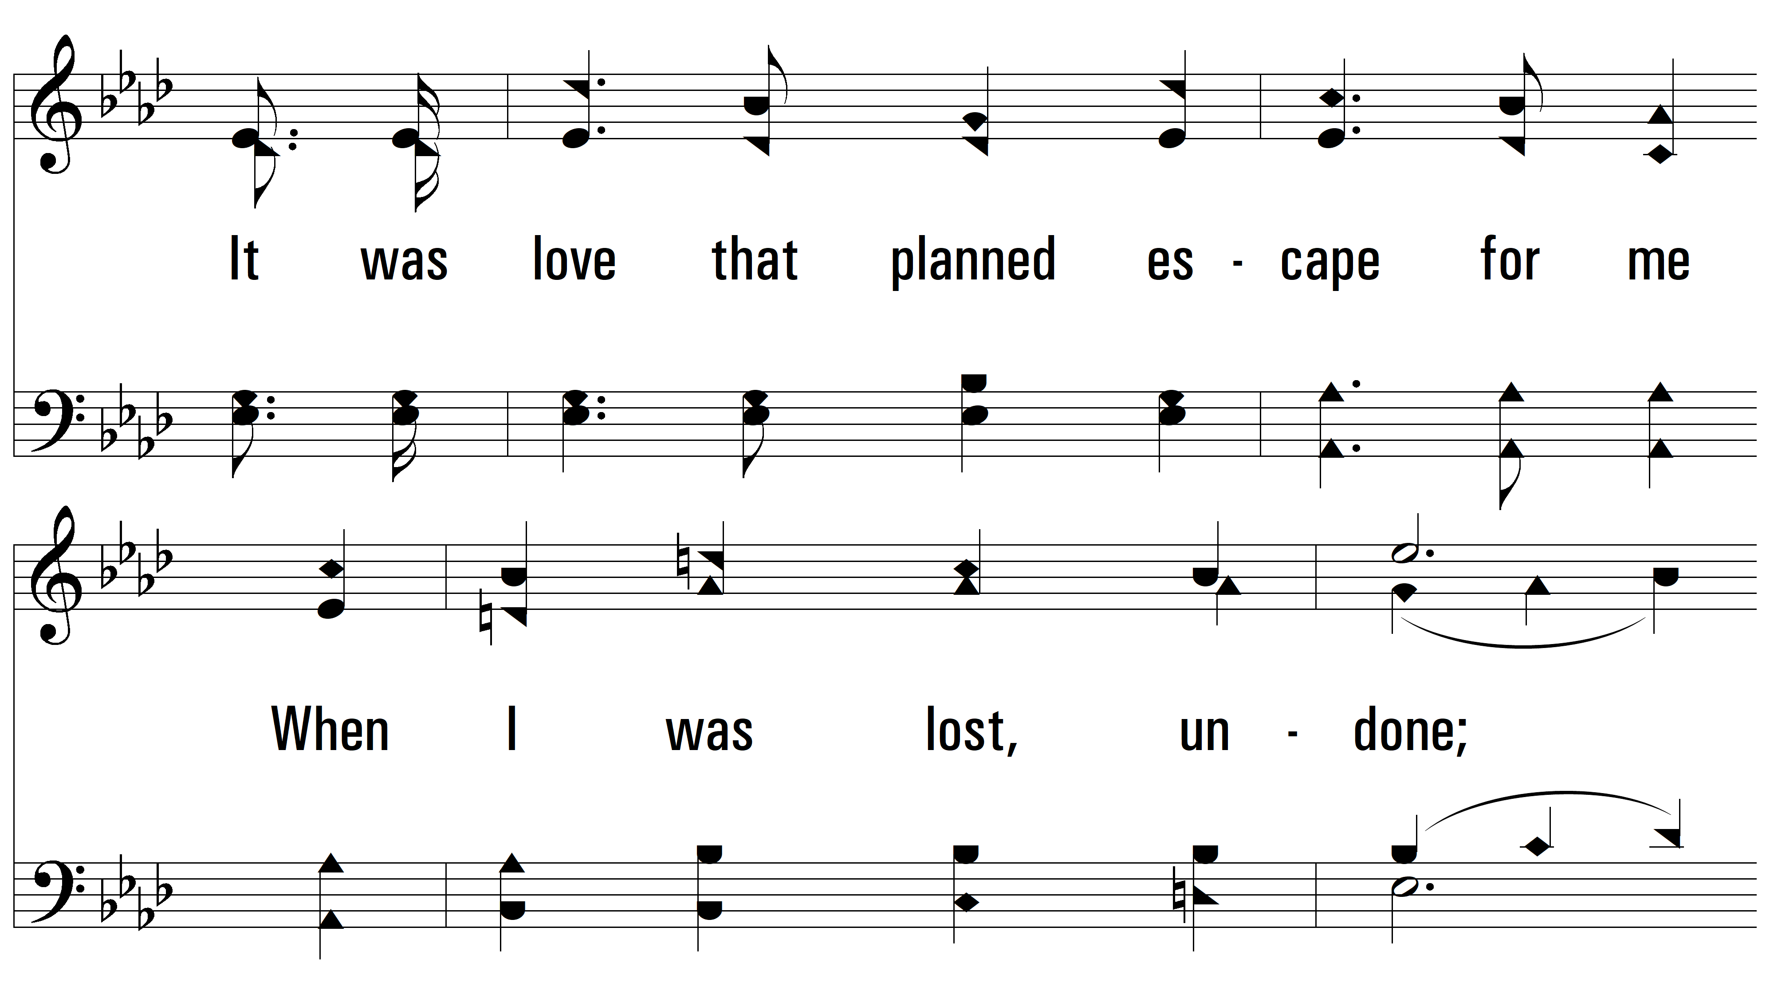
vs. 1

Slide 4
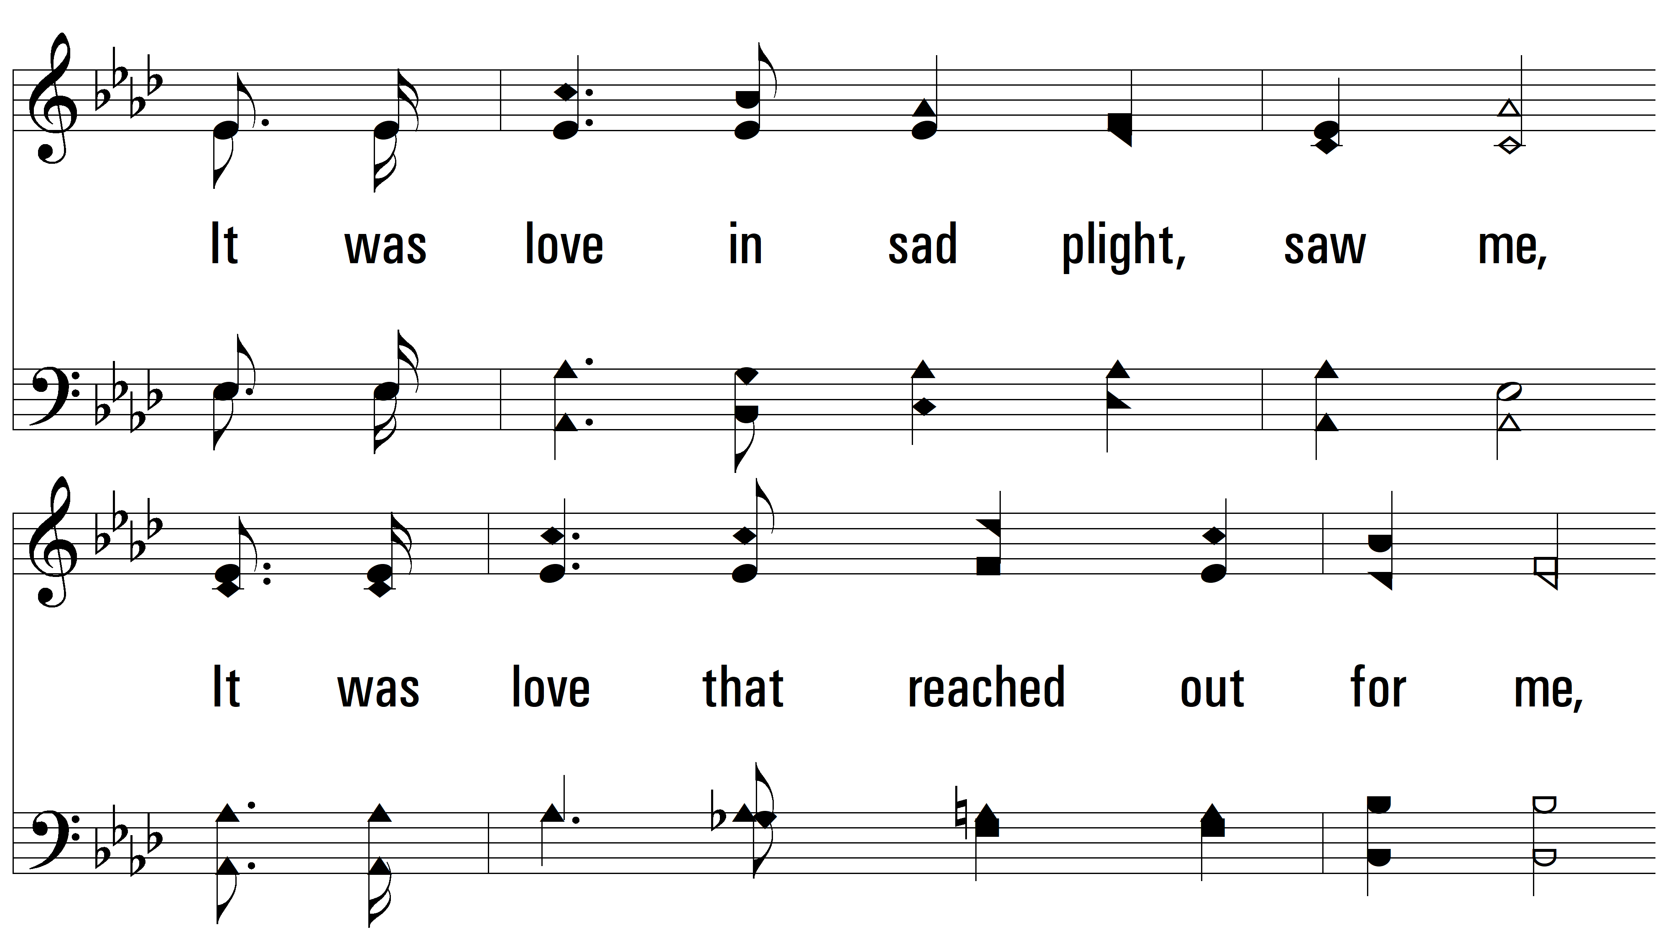
vs. 1

Slide 5
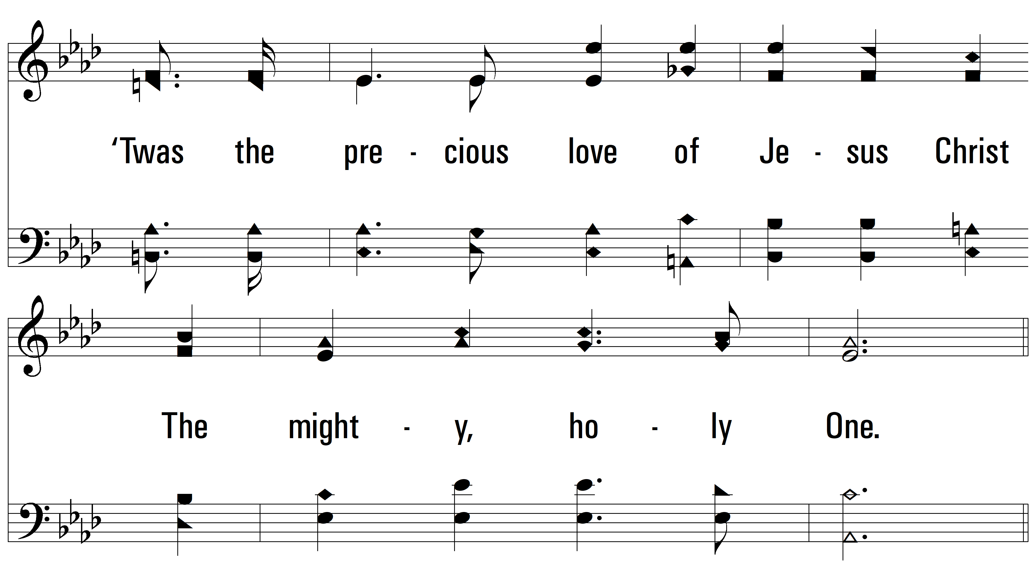
vs. 1

Slide 6
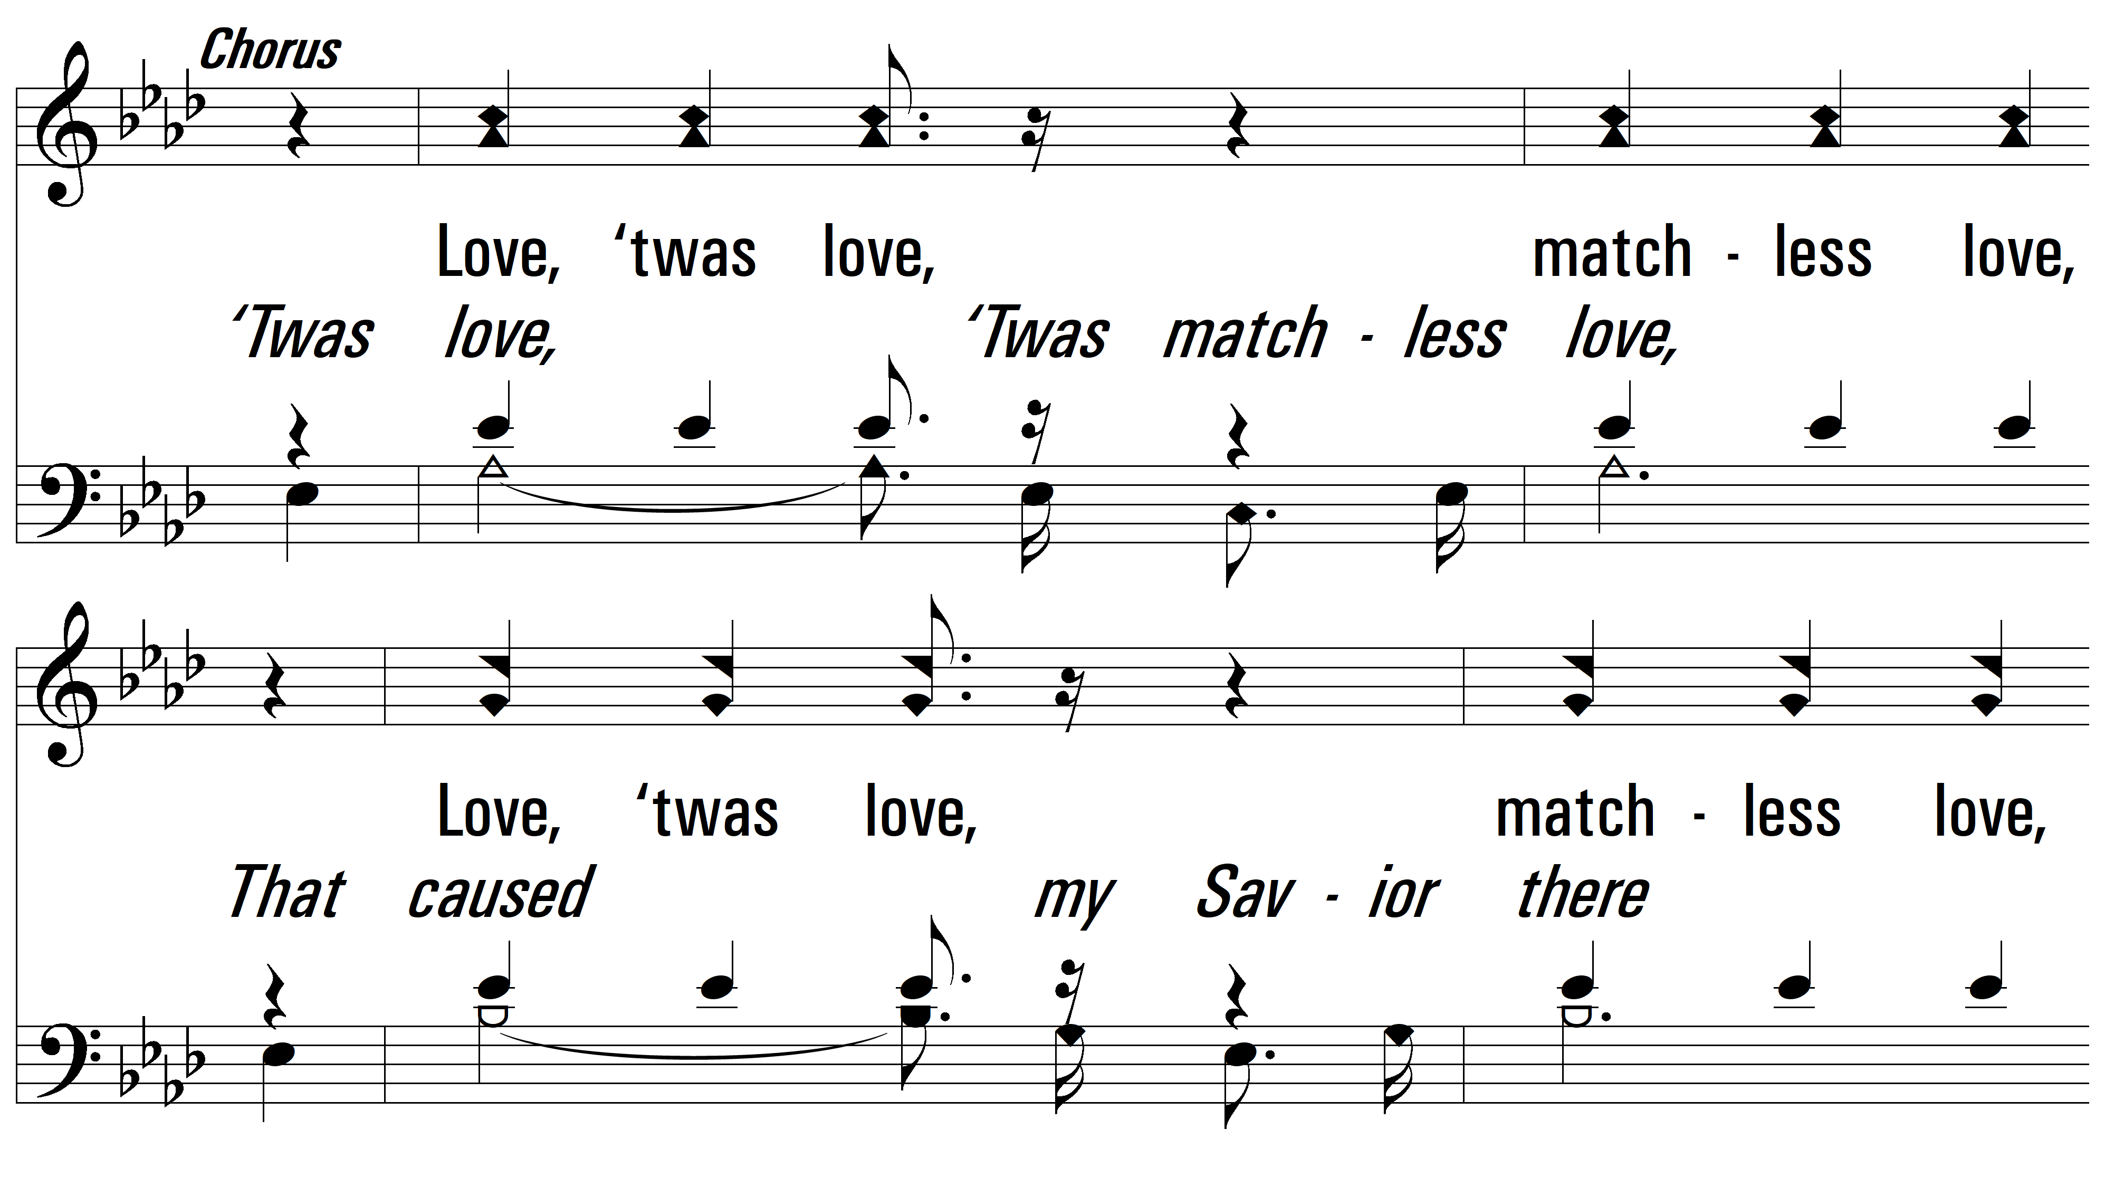
vs. 1

Slide 7
vs. 1

Slide 8
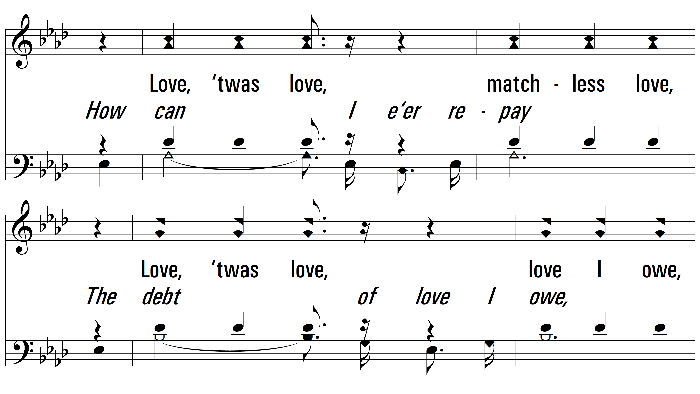
vs. 1

Slide 9
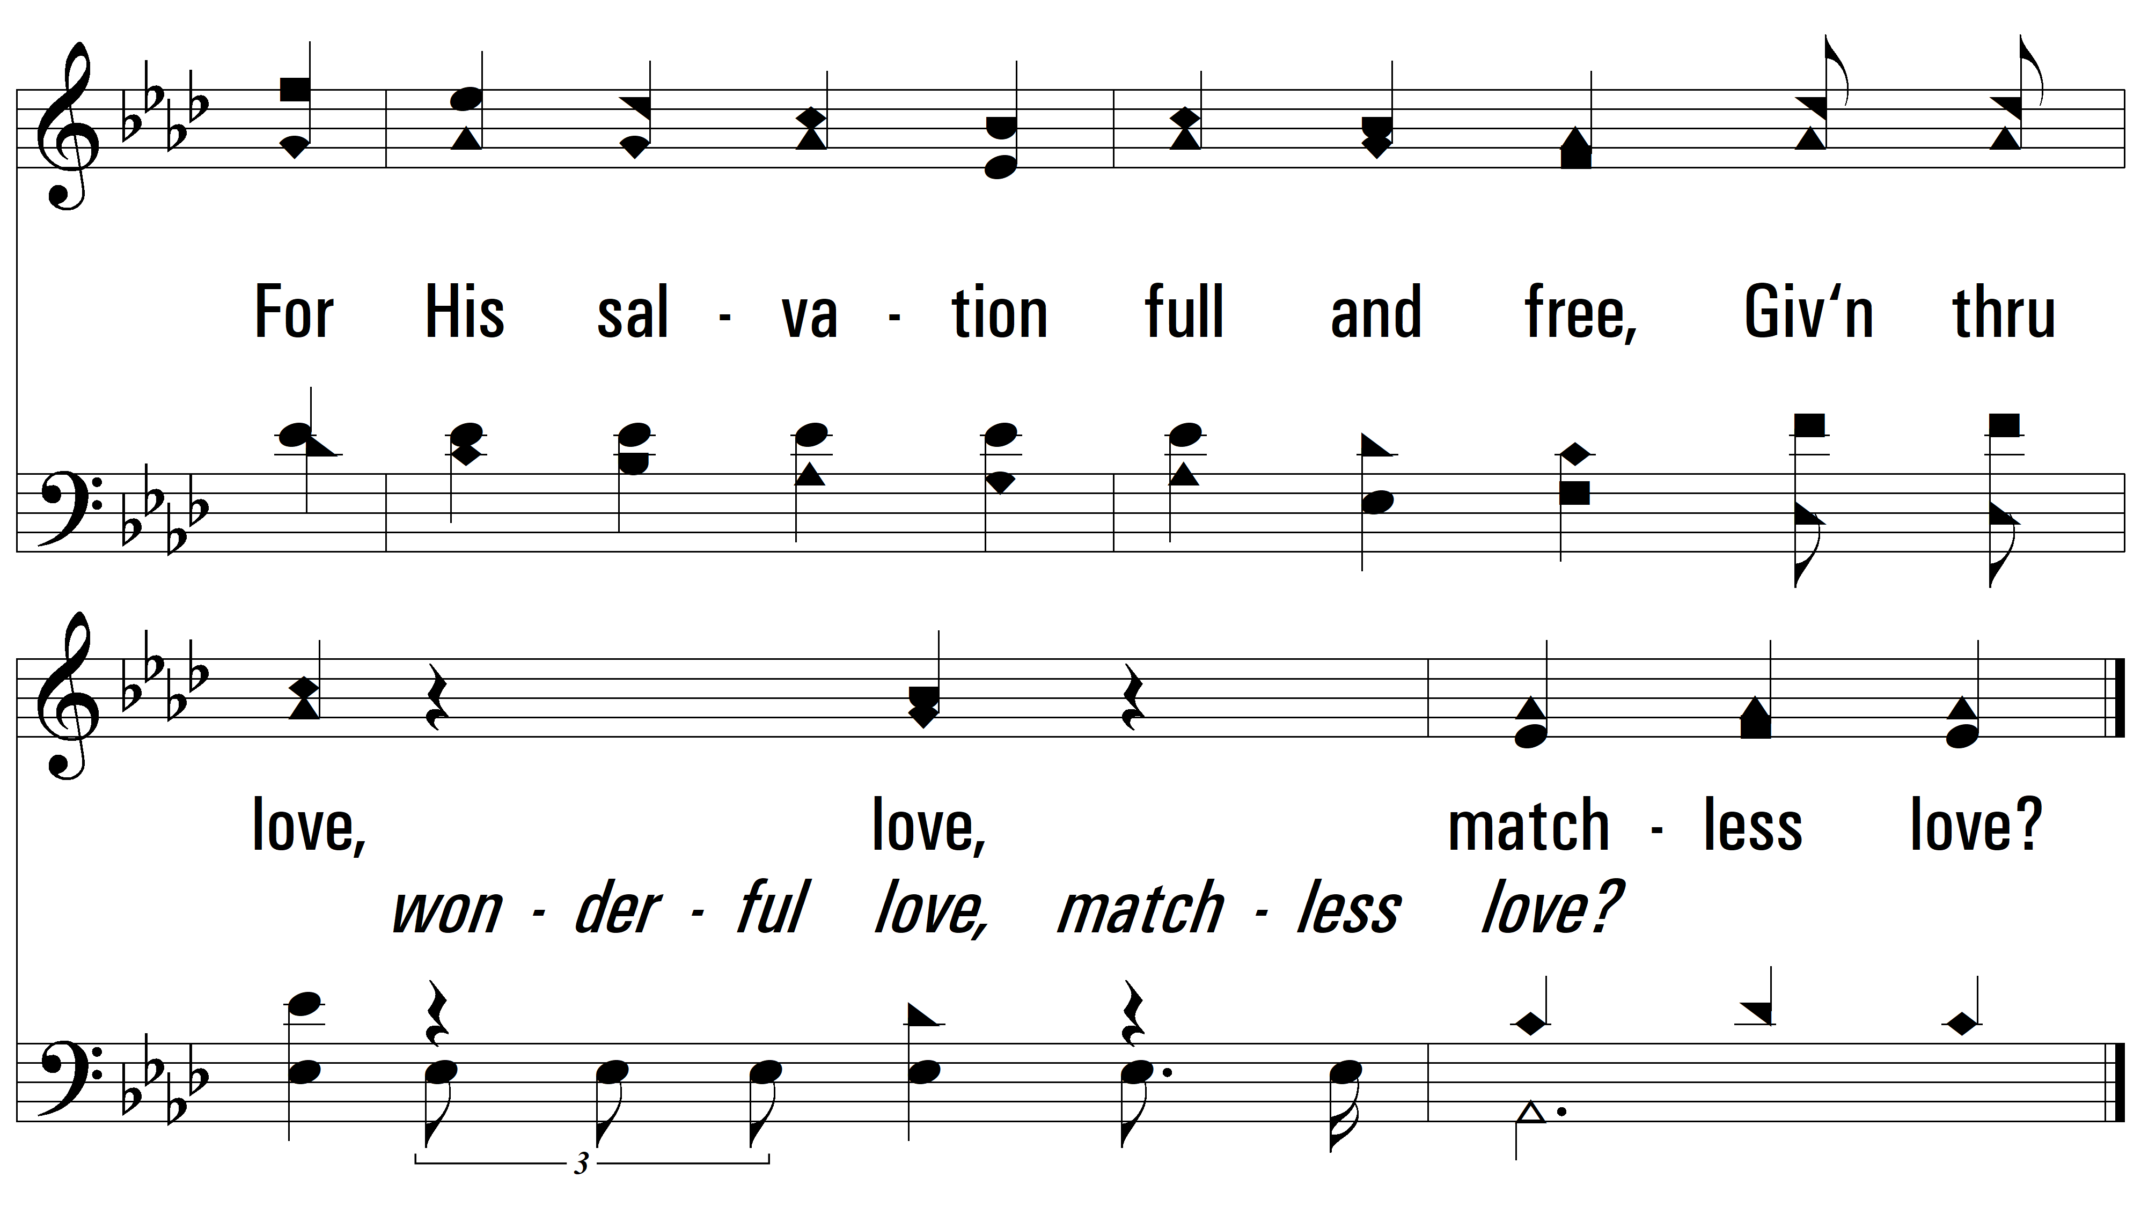
vs. 1

Slide 10
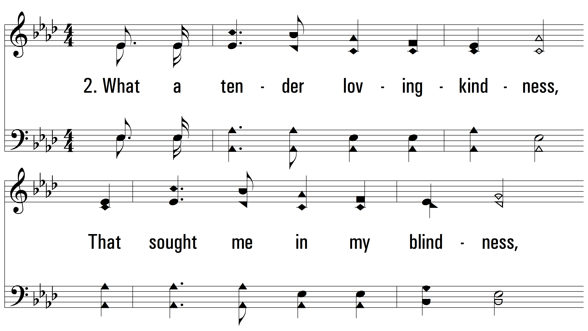
vs. 2 ~ Matchless Love

Slide 11
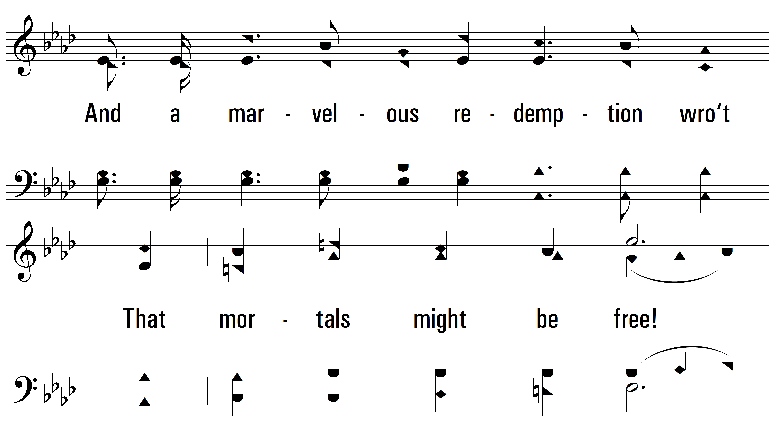
vs. 2

Slide 12
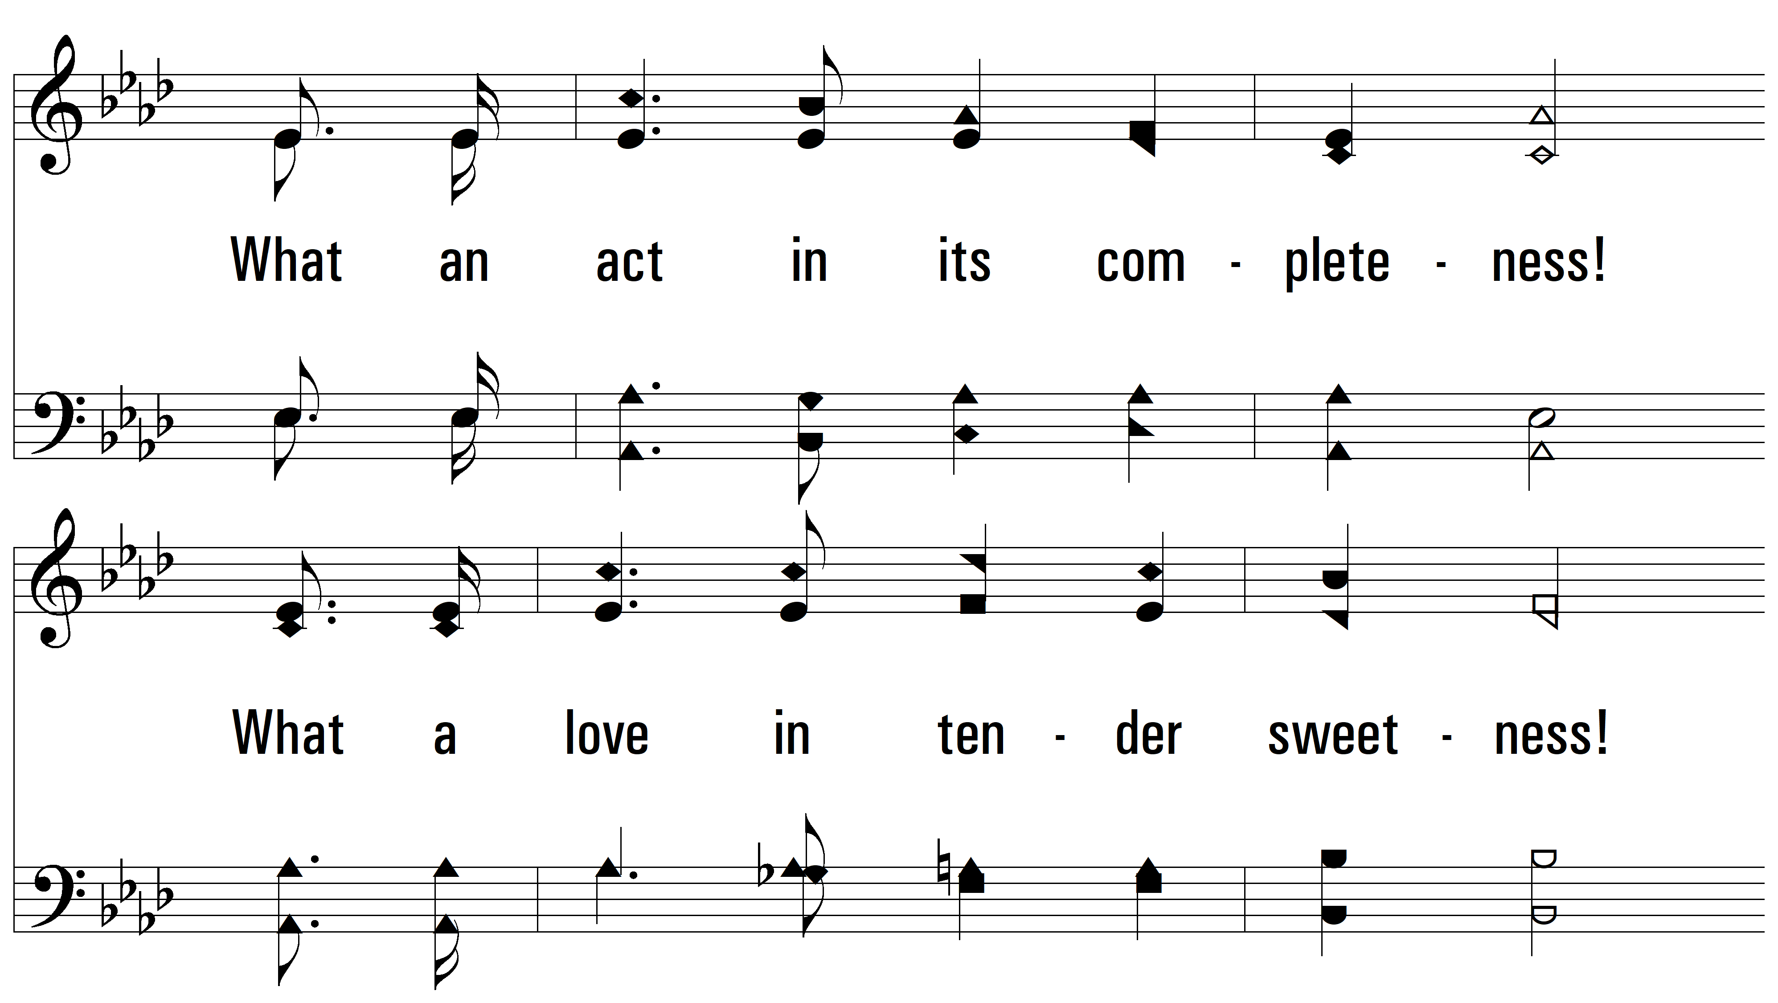
vs. 2

Slide 13
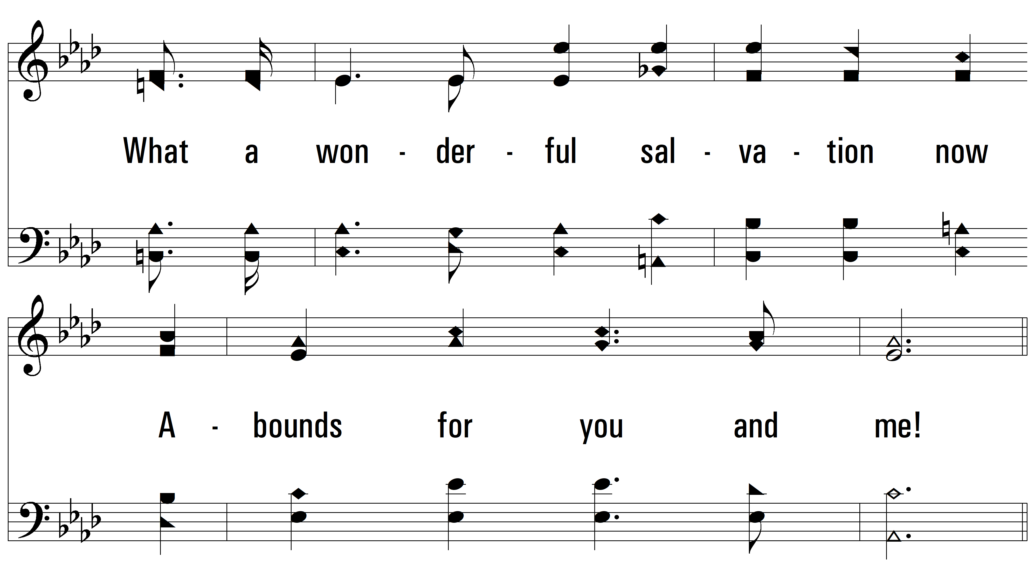
vs. 2

Slide 14
vs. 2

Slide 15
vs. 2

Slide 16
vs. 2

Slide 17
vs. 2

Slide 18
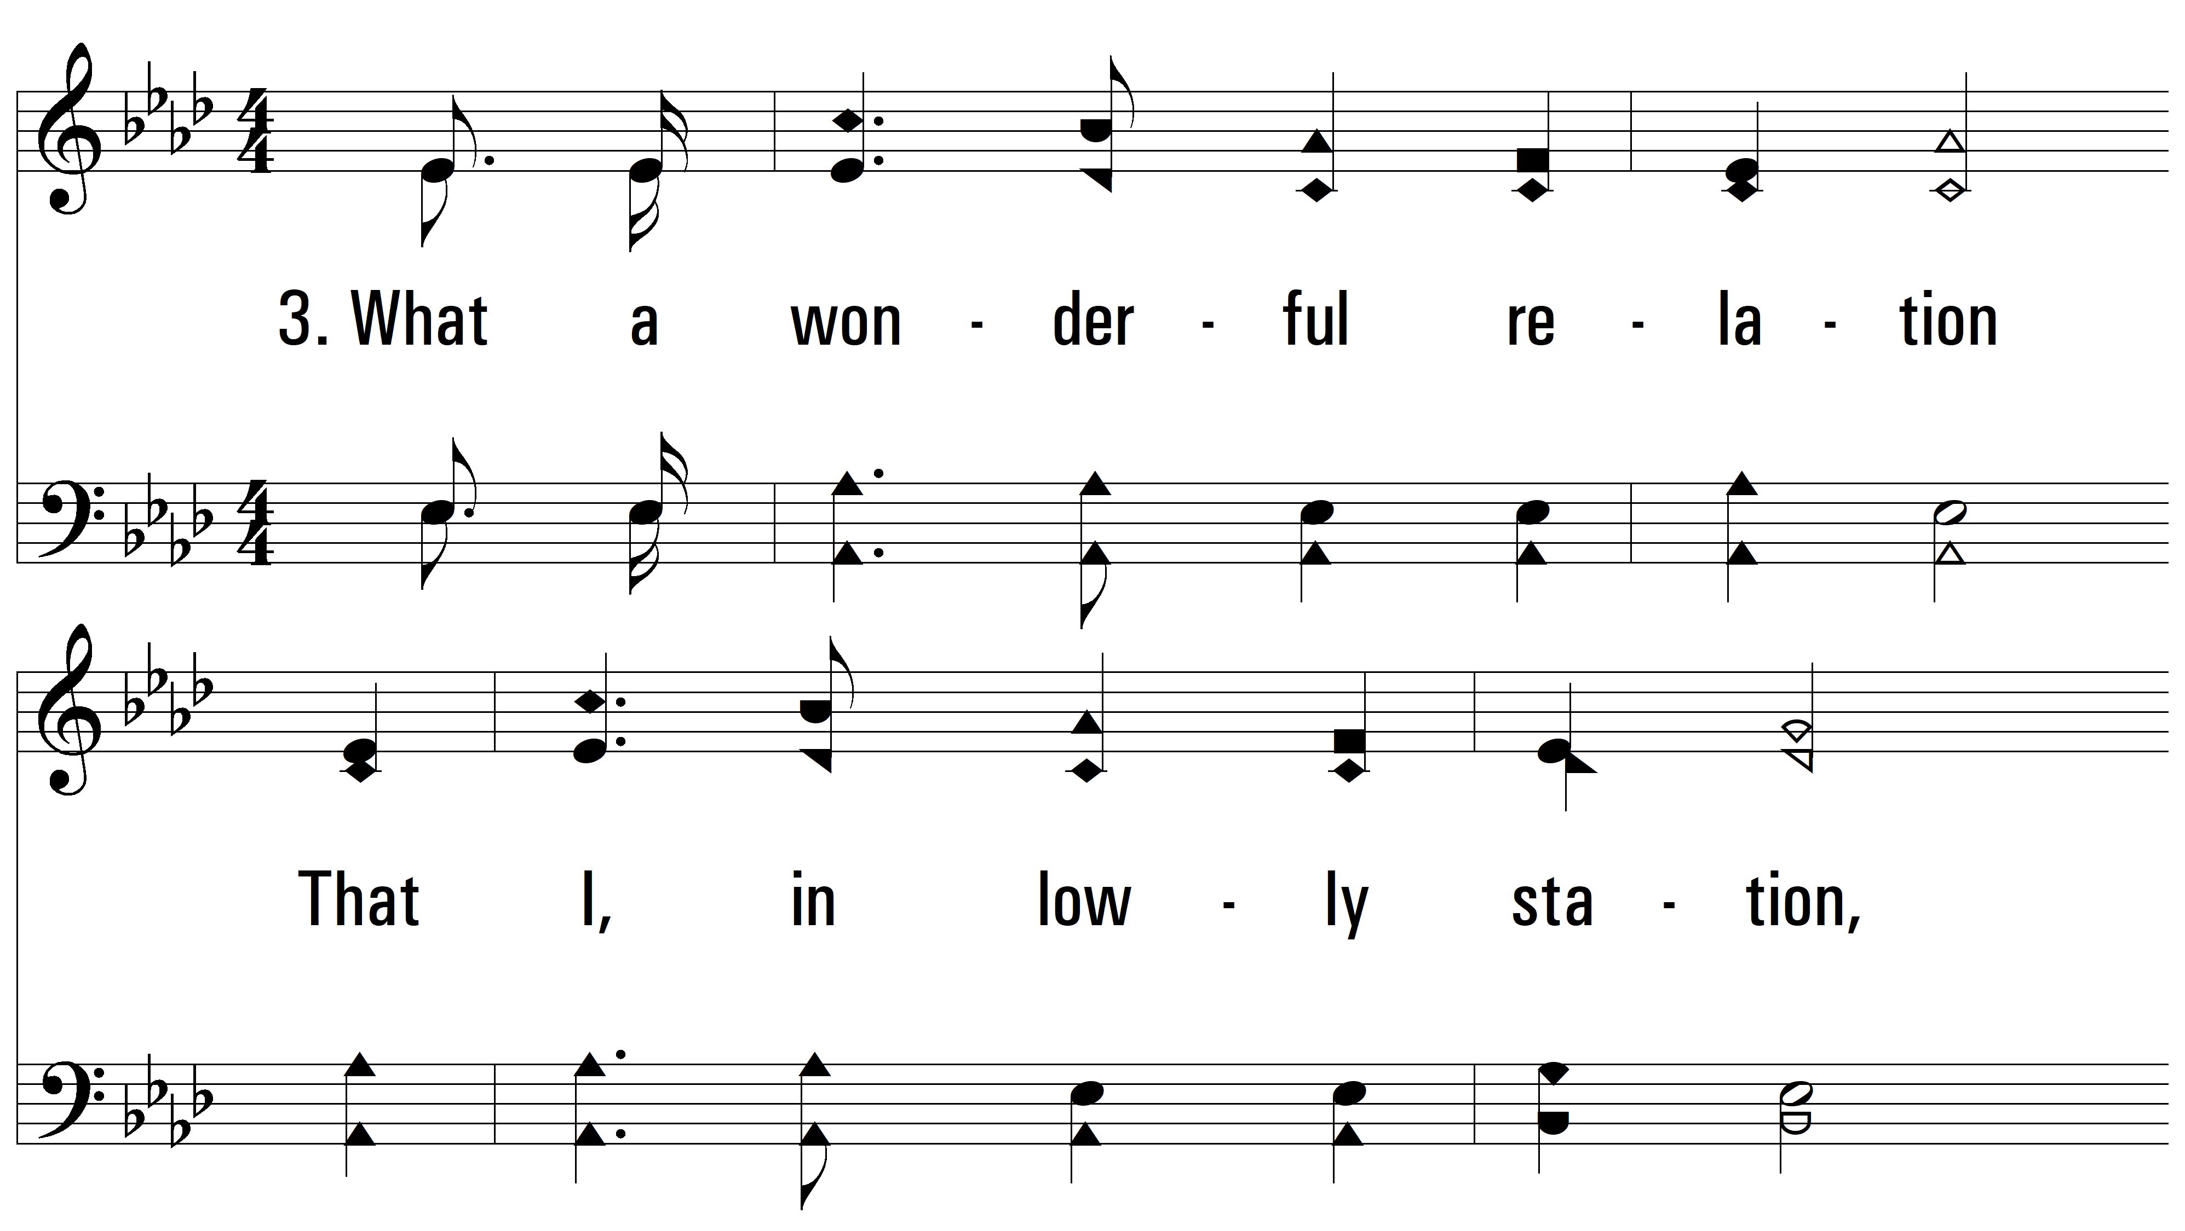
vs. 3 ~ Matchless Love

Slide 19
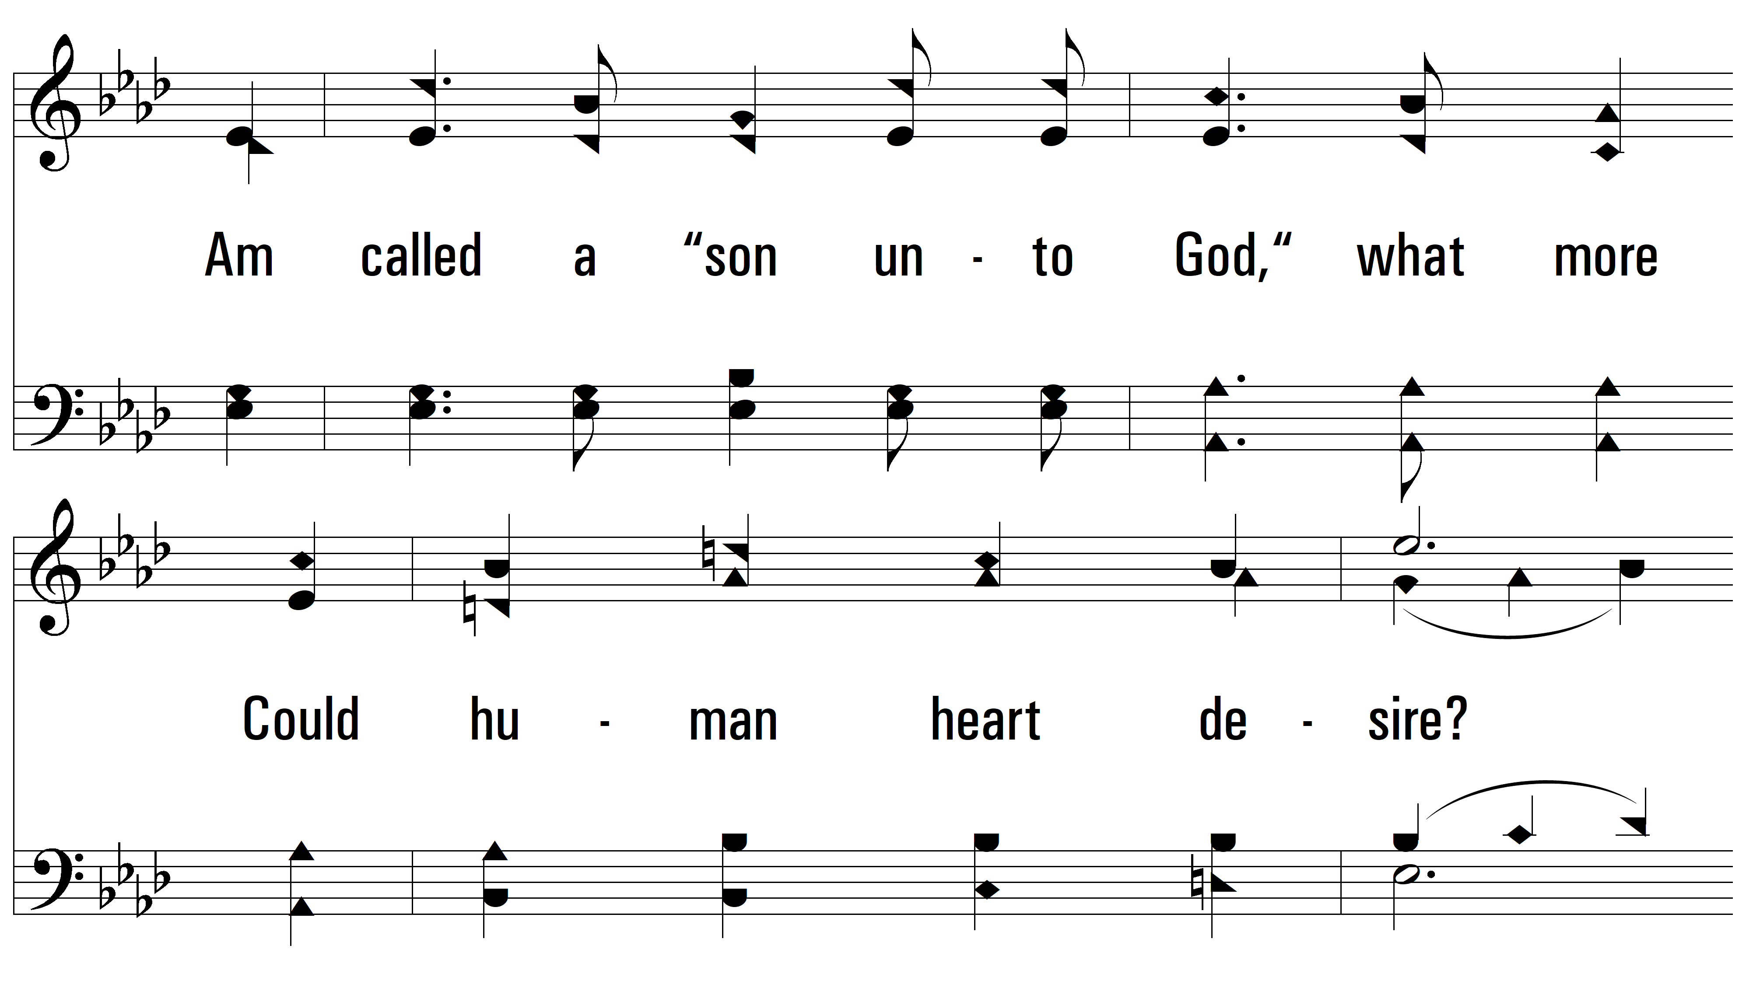
vs. 3

Slide 20
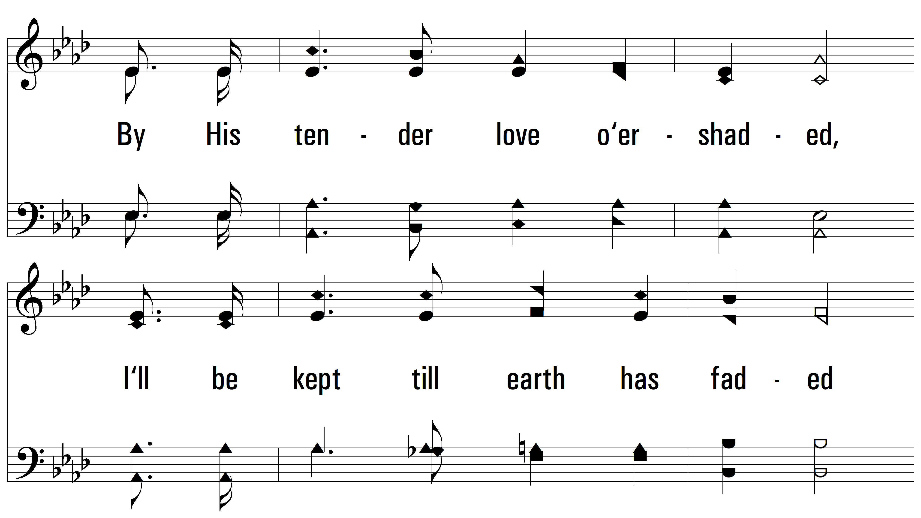
vs. 3

Slide 21
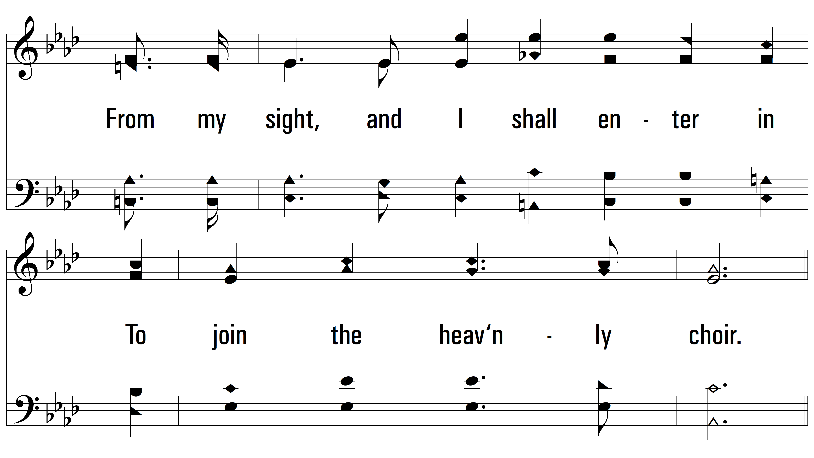
vs. 3

Slide 22
vs. 3

Slide 23
vs. 3

Slide 24
vs. 3

Slide 25
vs. 3
PDHymns.com
END

