Slide 2
Faith Of Our Fathers
ST. CATHERINE
8.8.8.8.8.8
Words: | Frederick W. Faber (1849)
Music: | Henri F. Hemy (1864), Arr. James G. Walton
3/4
A^{b}/C - MI
Verses: 3
Lead - | MI
Alto - | SOL
Tenor - | DO
Bass - | DO
PDHymns.com

Slide 3
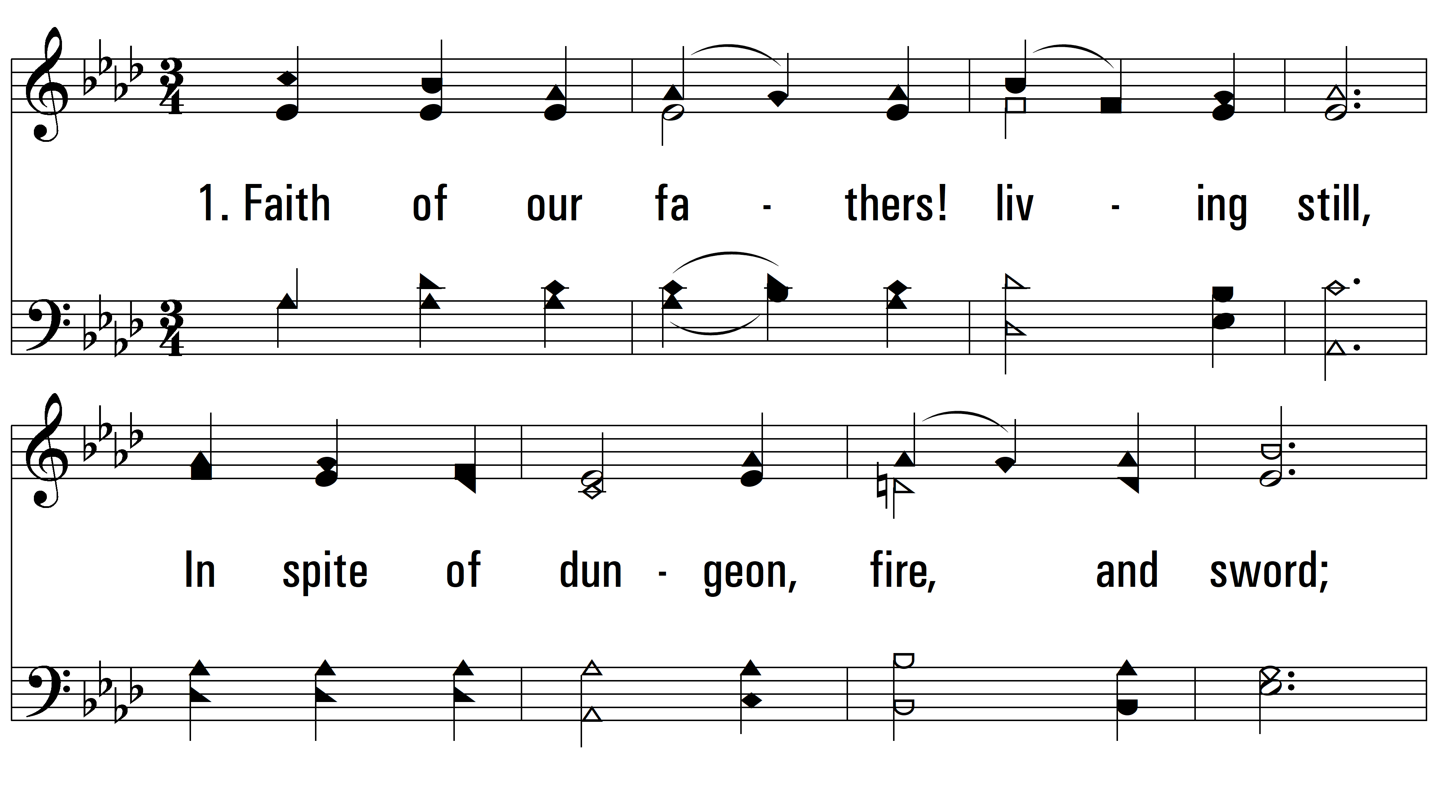
vs. 1 ~ Faith Of Our Fathers

Slide 4
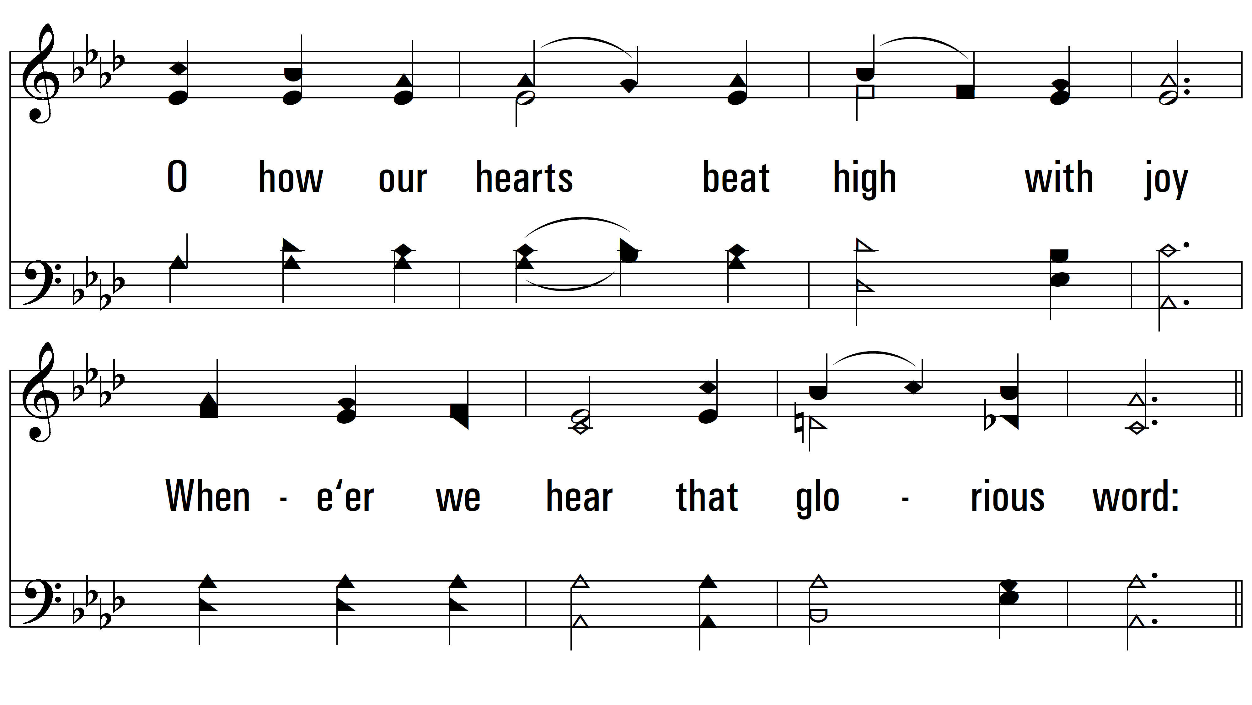
vs. 1

Slide 5
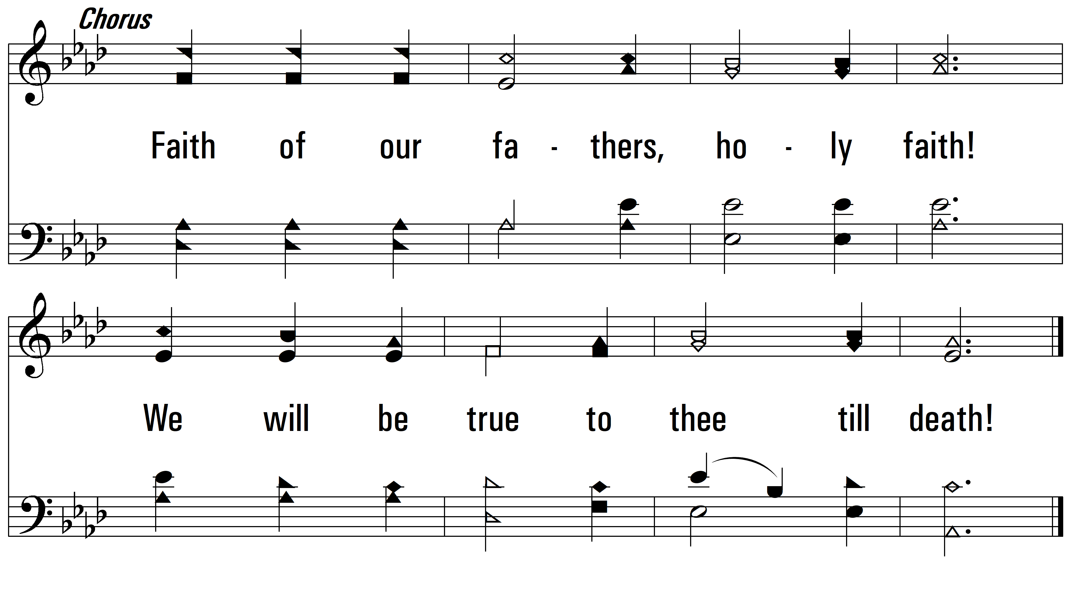
vs. 1

Slide 6
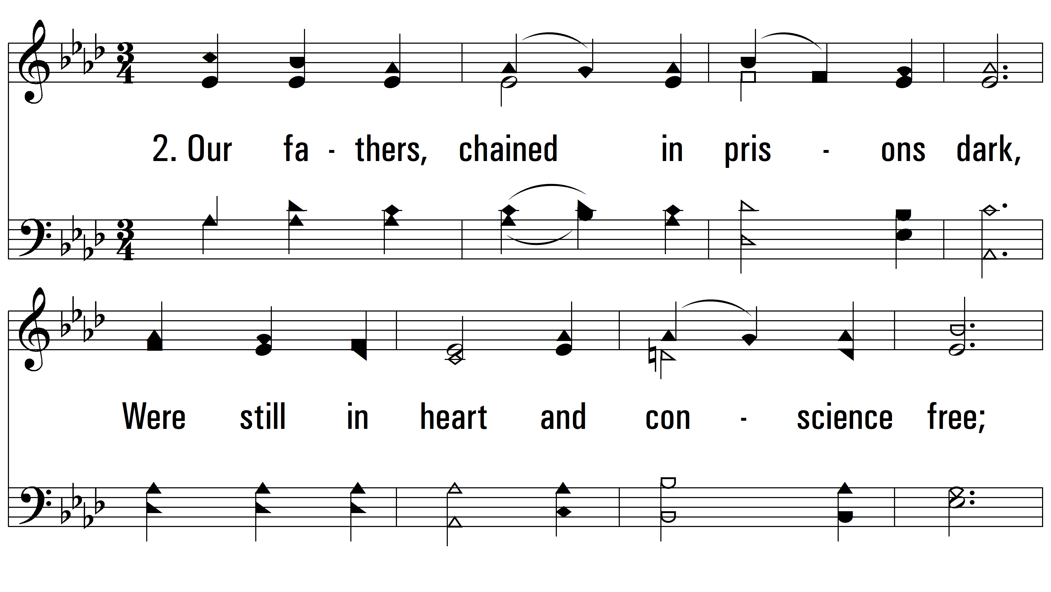
vs. 2 ~ Faith Of Our Fathers

Slide 7
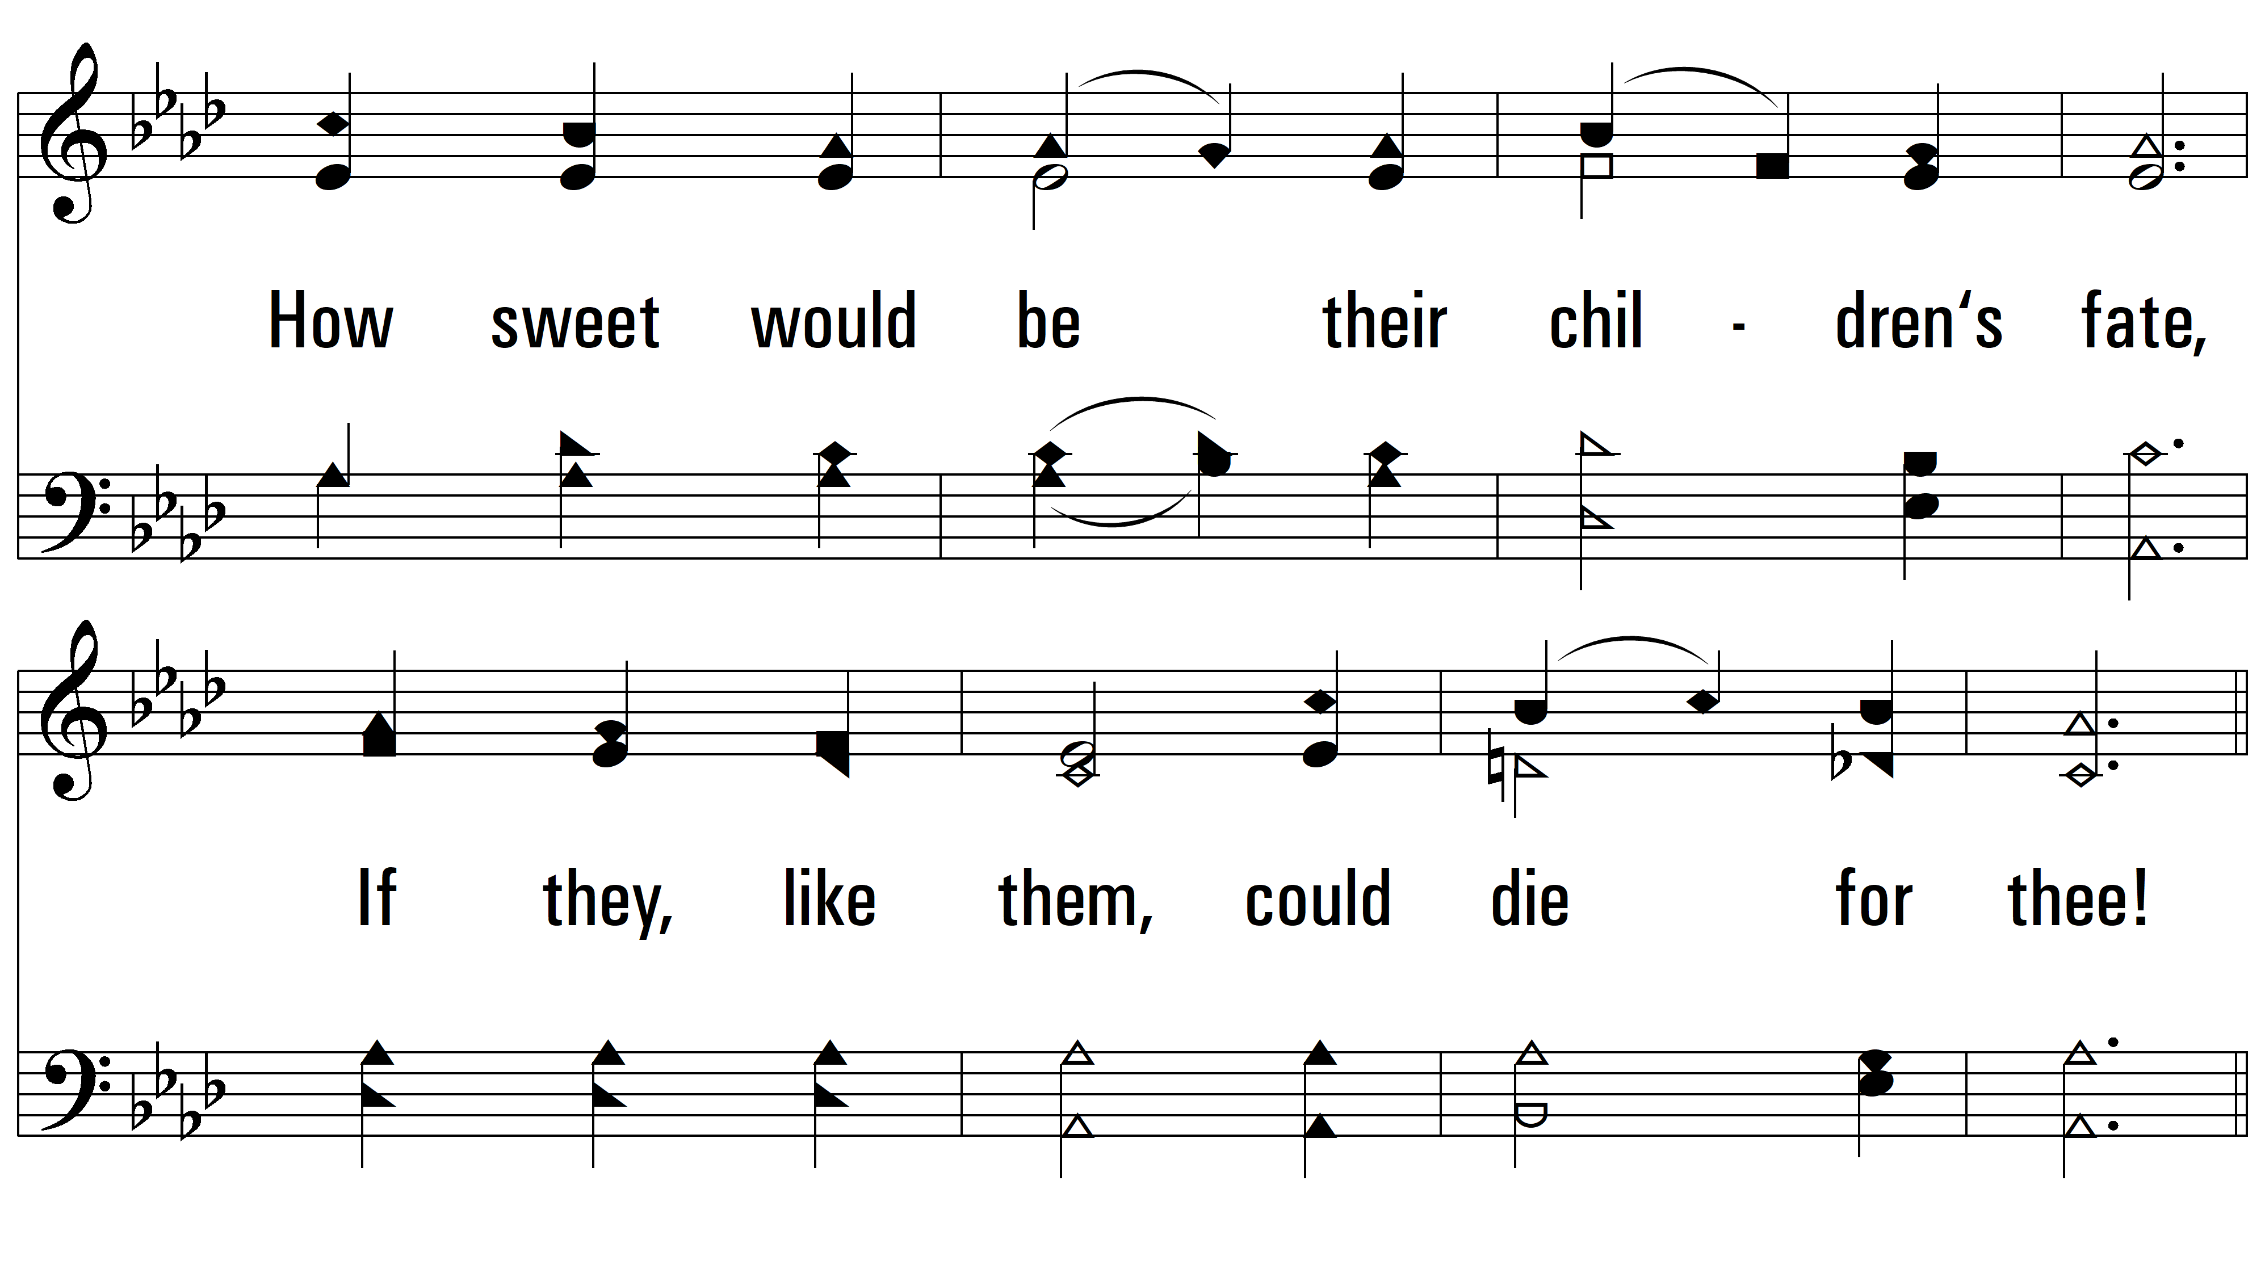
vs. 2

Slide 8
vs. 2

Slide 9
vs. 3 ~ Faith Of Our Fathers

Slide 10
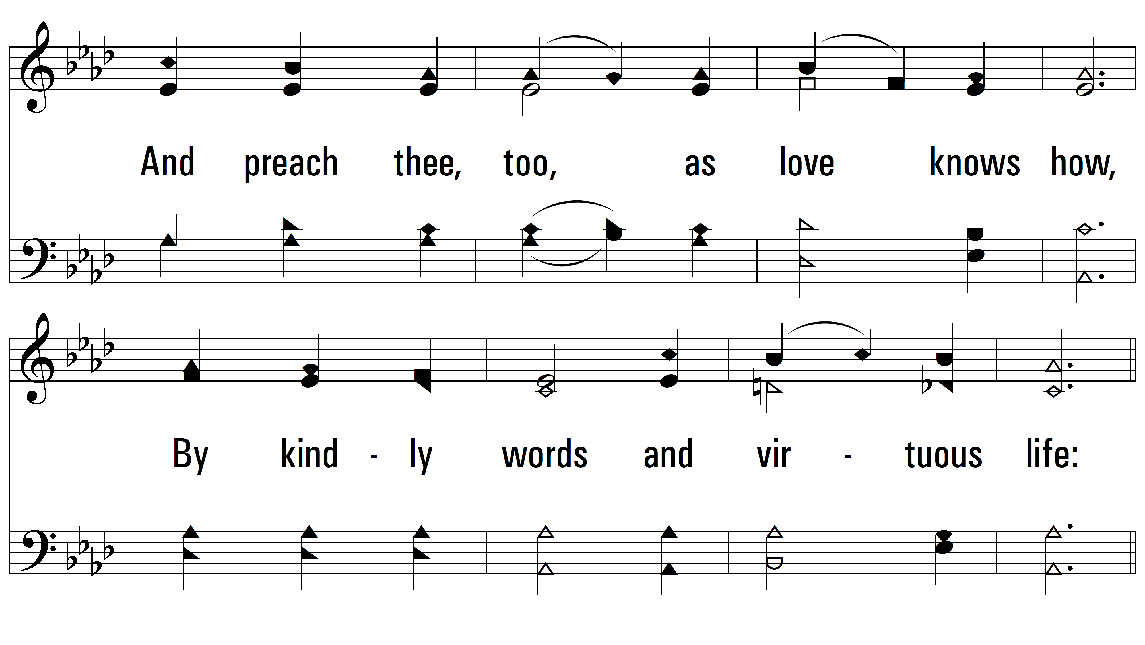
vs. 3

Slide 11
vs. 3
PDHymns.com
END

