Slide 1
Do All In The Name Of The Lord
Words: | Austin Taylor (1916)
Music: | Austin Taylor (1916)
6/8
G/D - DO
Verses: 3/Chorus
Lead - | DO
Alto - | SOL
Tenor - | MI
Bass - | DO
PDHymns.com

Slide 2
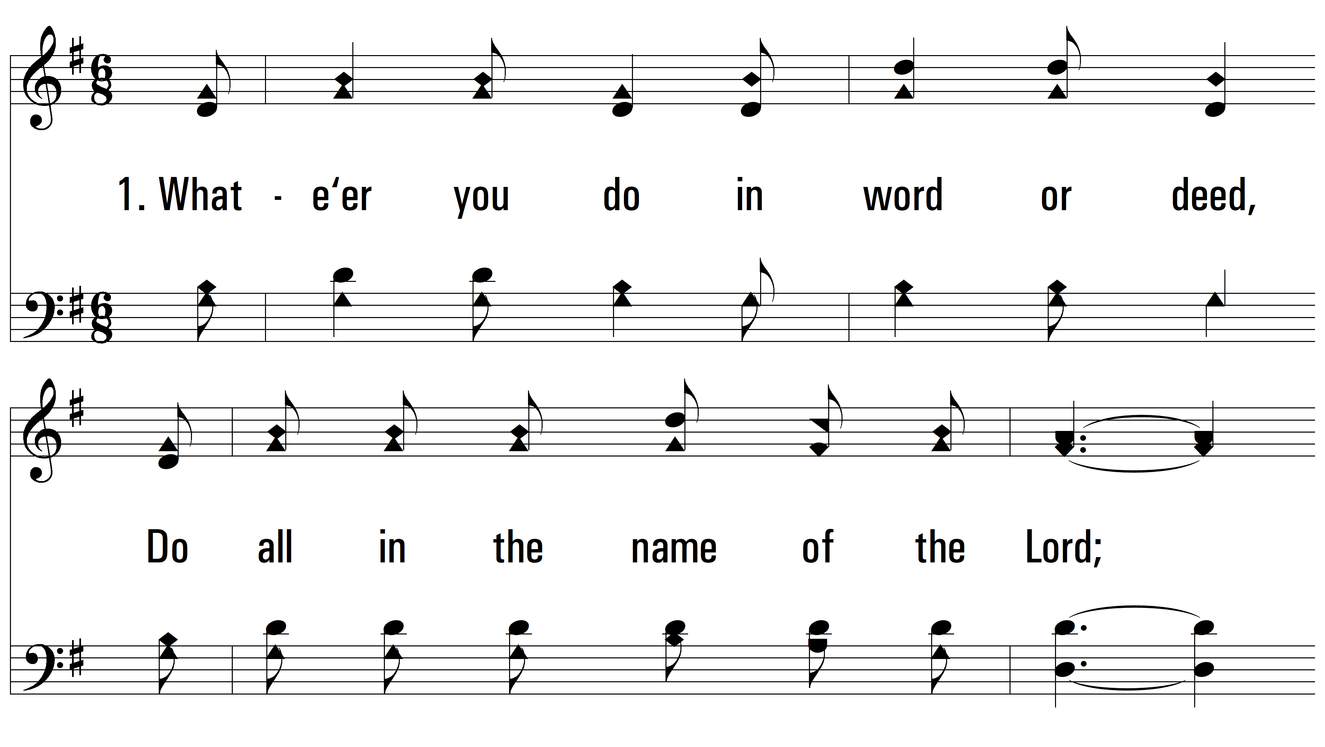
vs. 1 ~ Do All In The Name Of The Lord

Slide 3
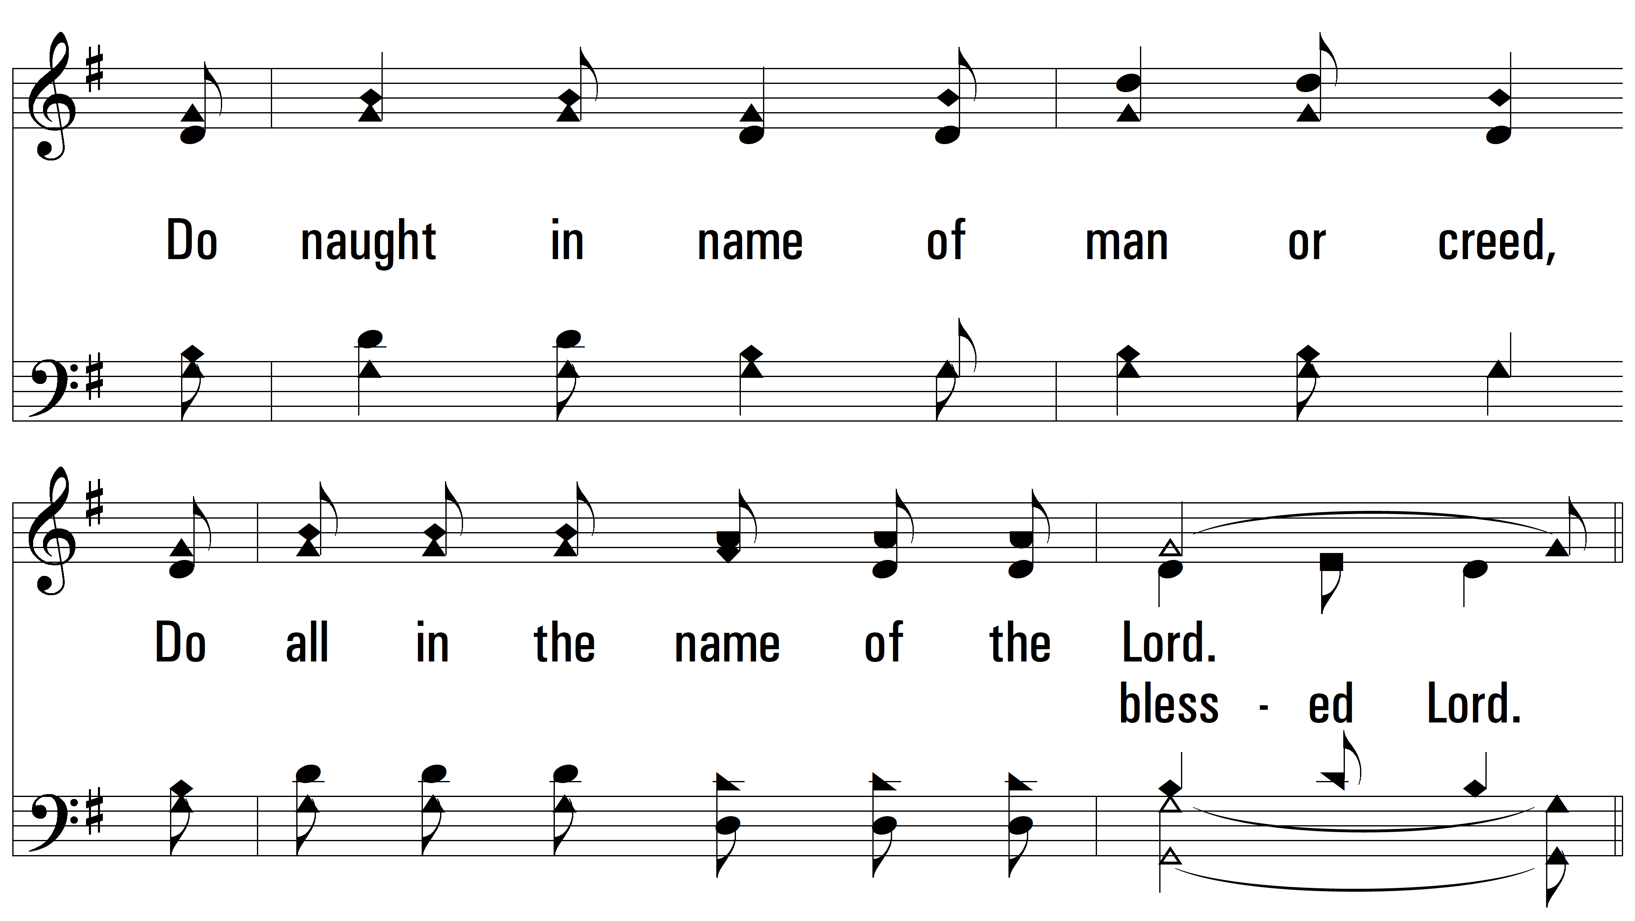
vs. 1

Slide 4
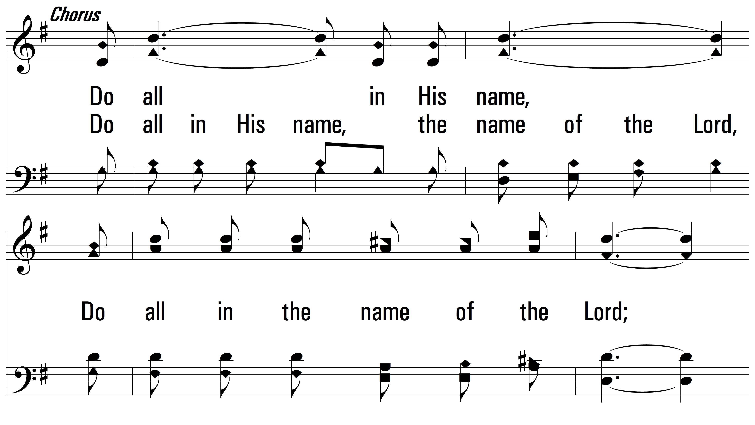
vs. 1

Slide 5
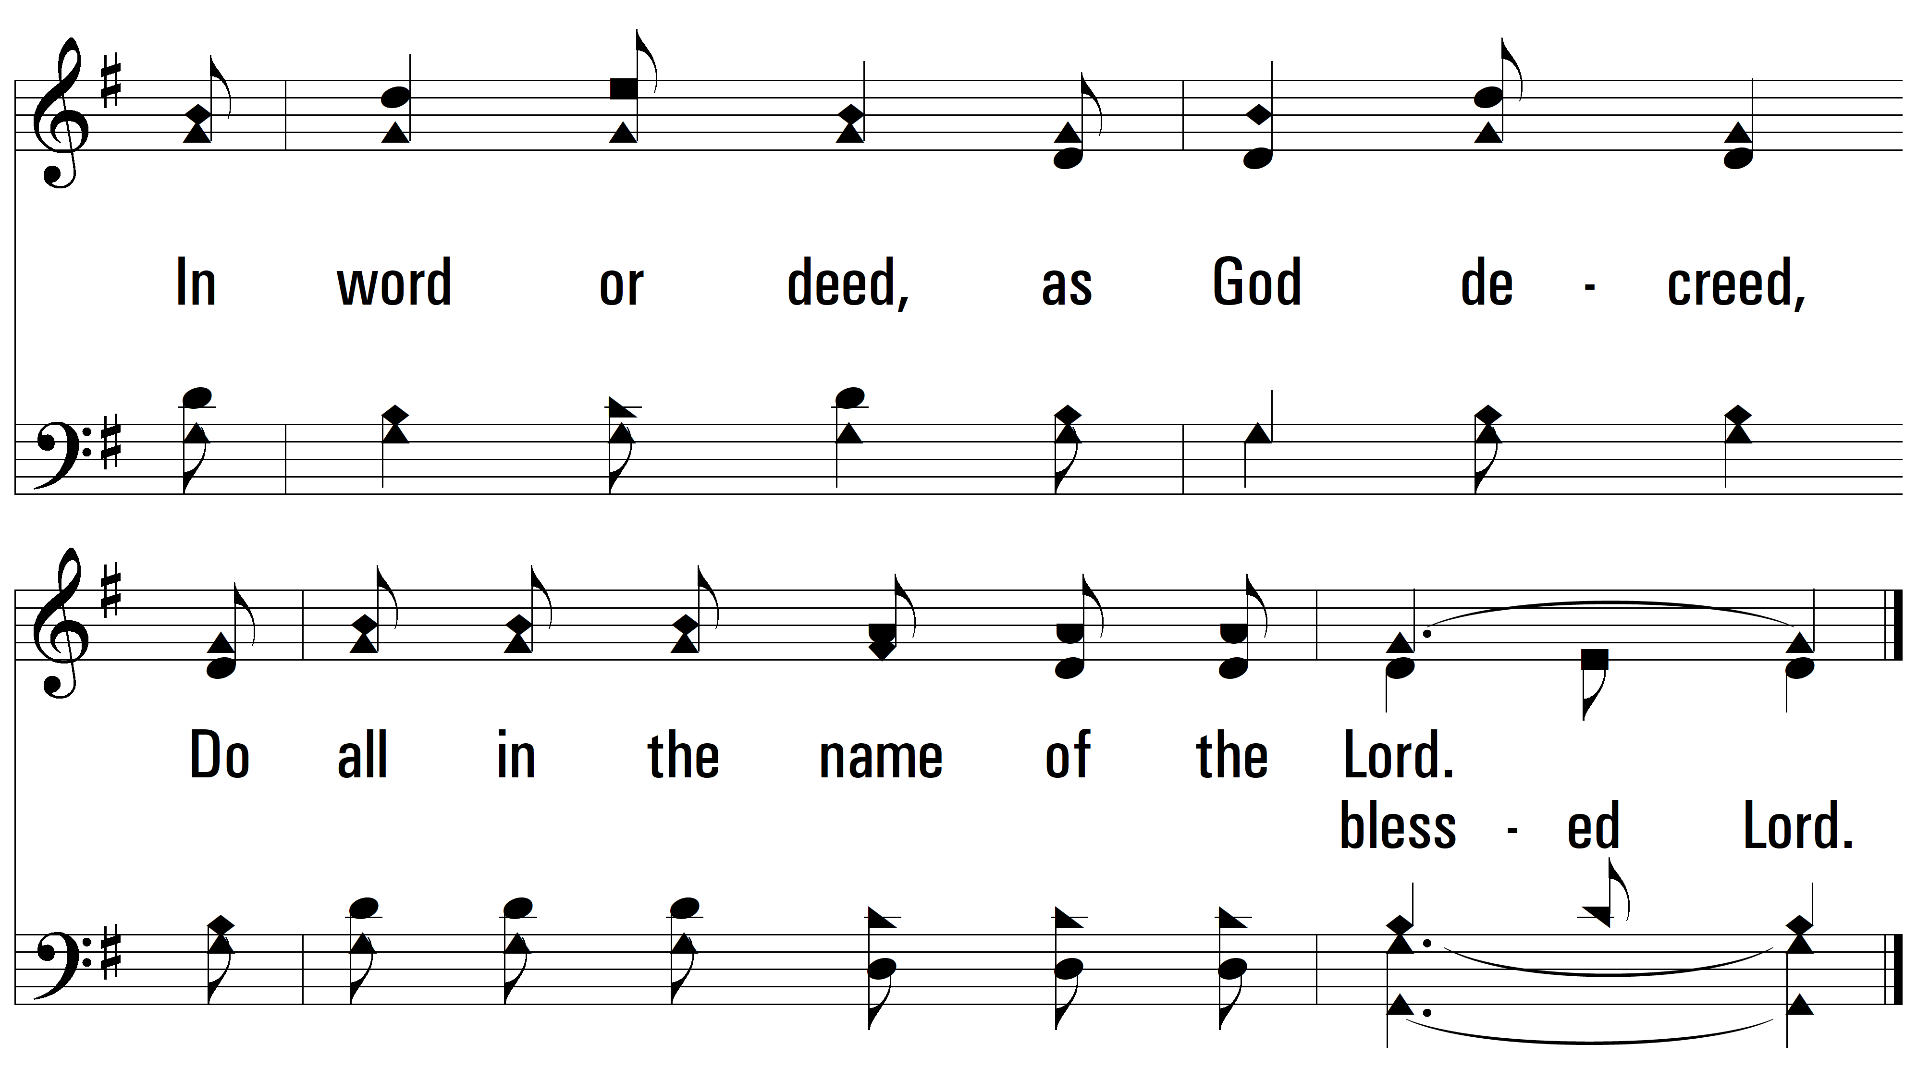
vs. 1

Slide 6
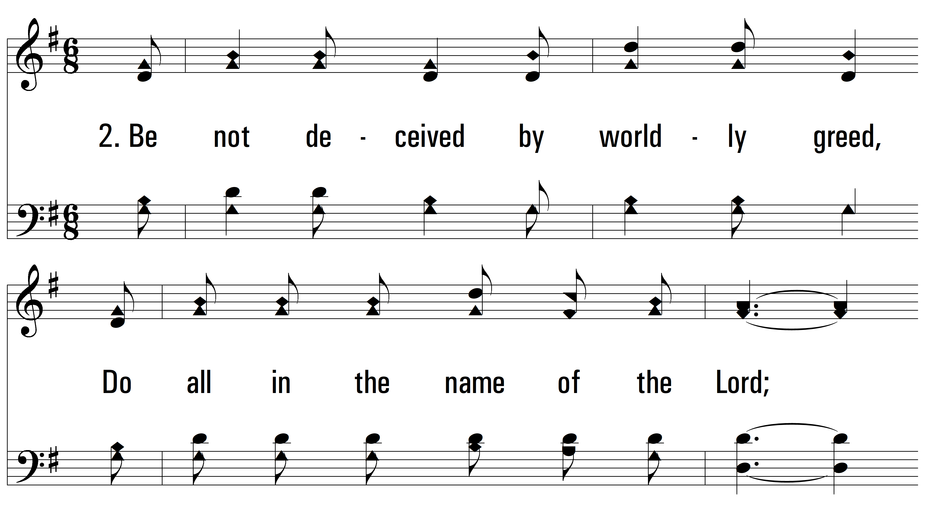
vs. 2 ~ Do All In The Name Of The Lord

Slide 7
vs. 2

Slide 8
vs. 2

Slide 9
vs. 2

Slide 10
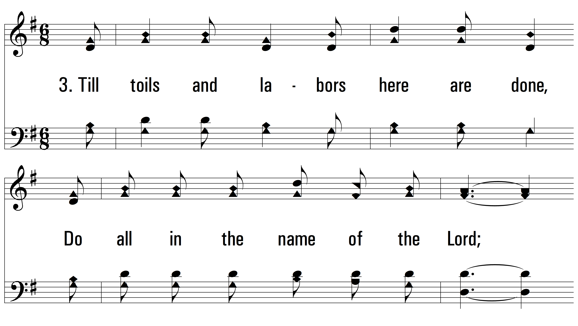
vs. 3 ~ Do All In The Name Of The Lord

Slide 11
vs. 3

Slide 12
vs. 3

Slide 13
vs. 3
PDHymns.com
END

