Slide 1
Count Your Blessings
Words: | Johnson Oatman, Jr. (1897)
Music: | Edwin O. Excell (1897)
2/4
E^{b}/G - MI
Verses: 3/Chorus
Lead - | MI
Alto - | DO
Tenor - | SOL
Bass - | DO
PDHymns.com

Slide 2
vs. 1 ~ Count Your Blessings

Slide 3
vs. 1

Slide 4
vs. 1

Slide 5
vs. 1

Slide 6
vs. 2 ~ Count Your Blessings

Slide 7
vs. 2

Slide 8
vs. 2

Slide 9
vs. 2

Slide 10
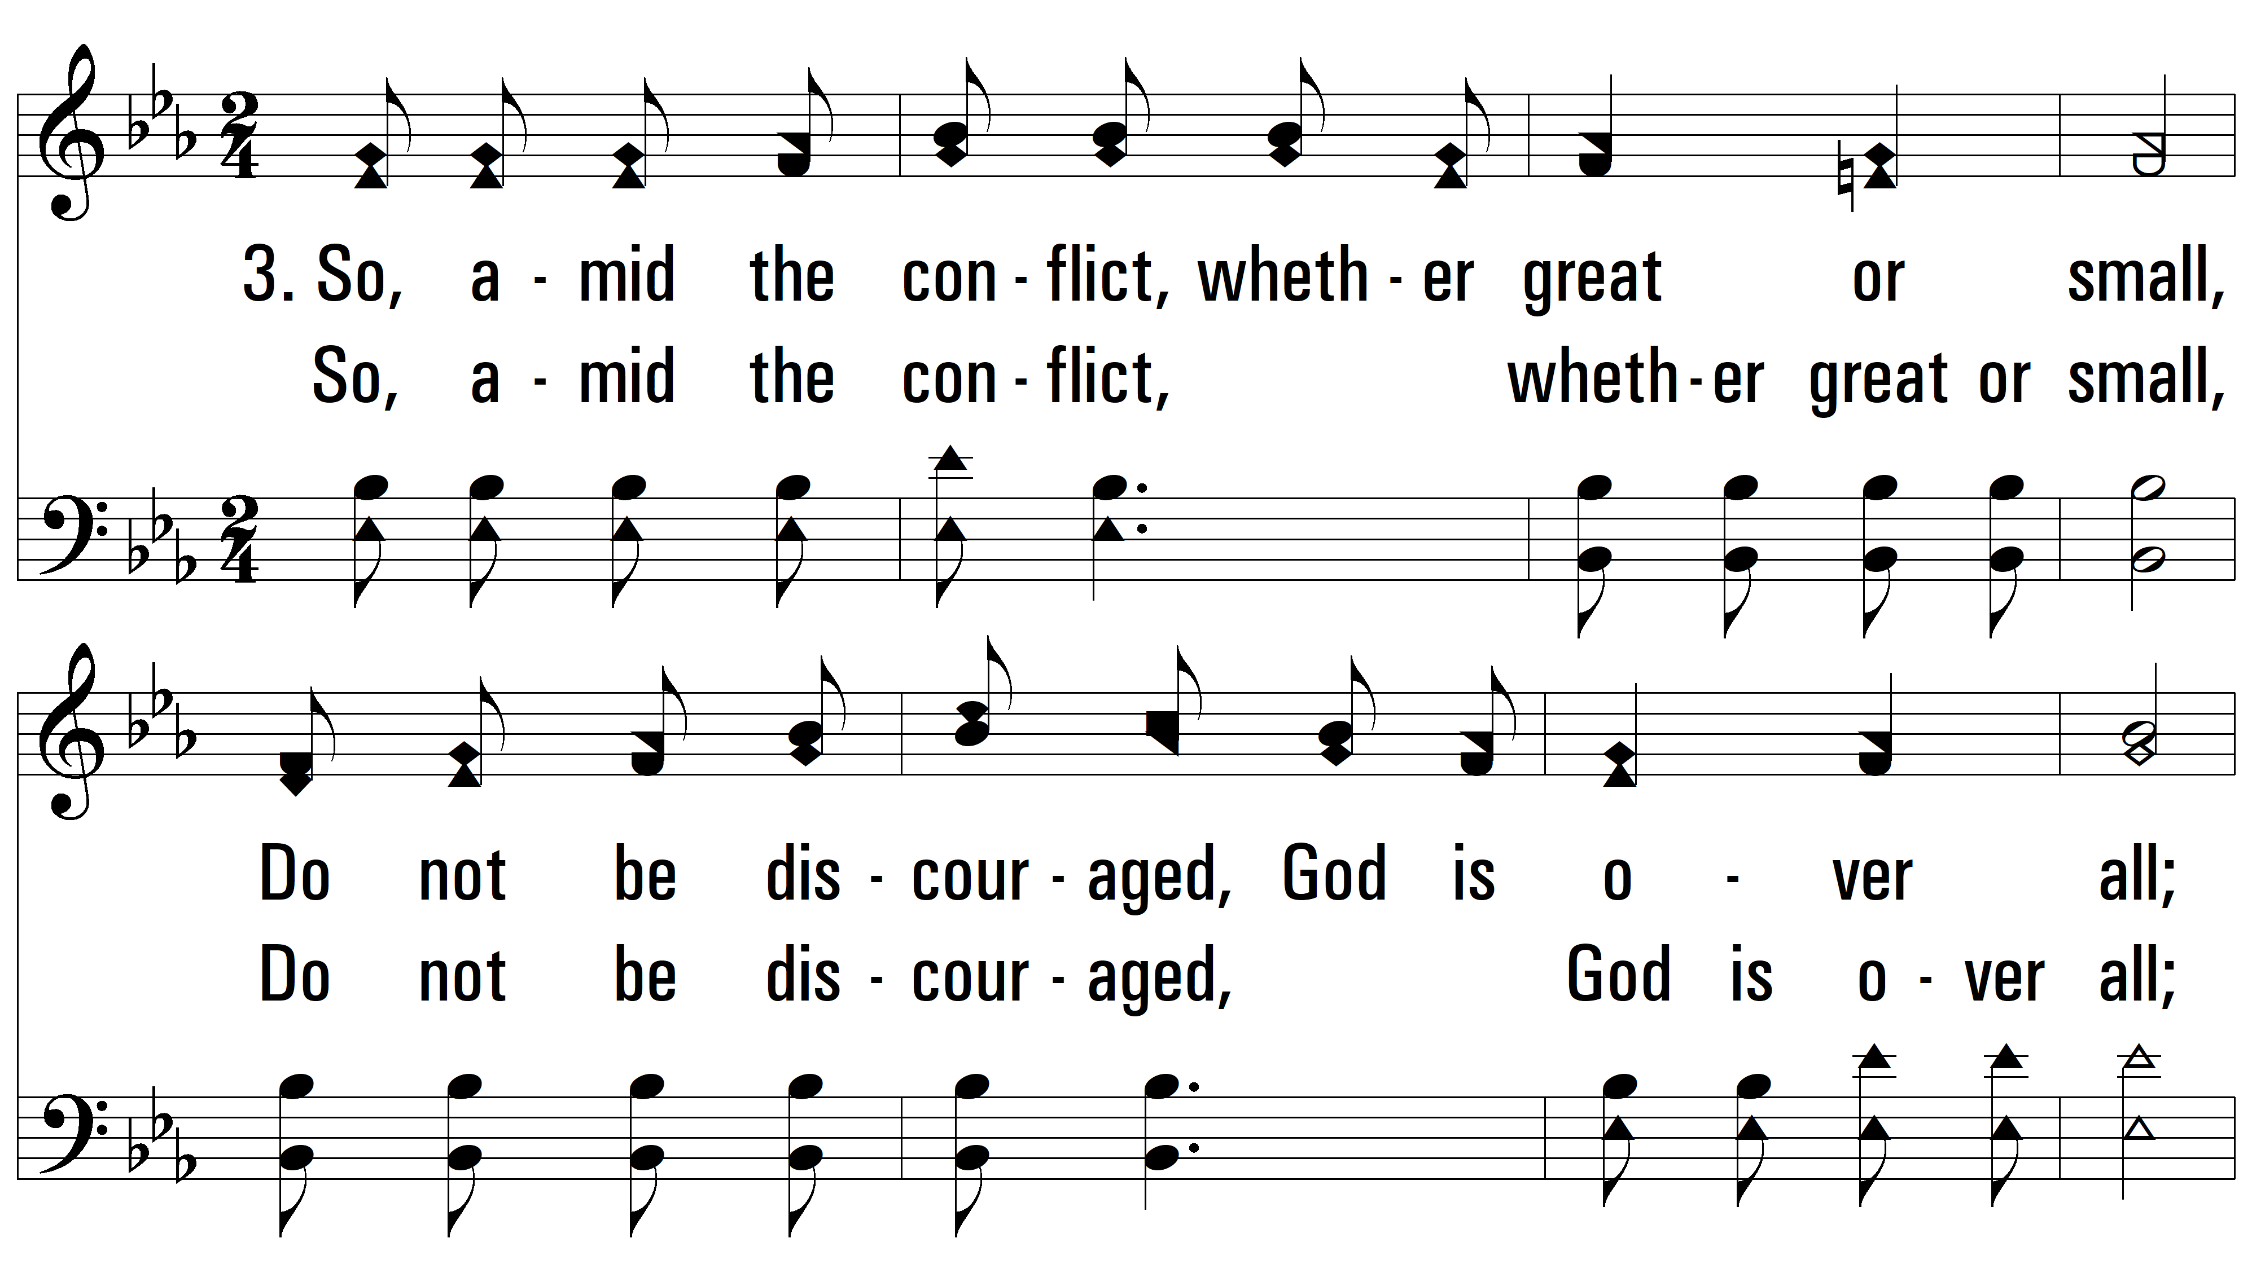
vs. 3 ~ Count Your Blessings

Slide 11
vs. 3

Slide 12
vs. 3

Slide 13
vs. 3
PDHymns.com
END

