Slide 1
Christ The Lord Has Risen Today
WORGAN
7.7.7.7
Words: | Charles Welsey (1739)
Music: | Walsh’s Lyra Davidica (1708) Arr. Arnold Complete Psalmodist (1741)
4/4
D^{b}/D^{b} - DO
Verses: 4
Lead - | DO
Alto - | DO
Tenor - | MI
Bass - | DO
PDHymns.com

Slide 2
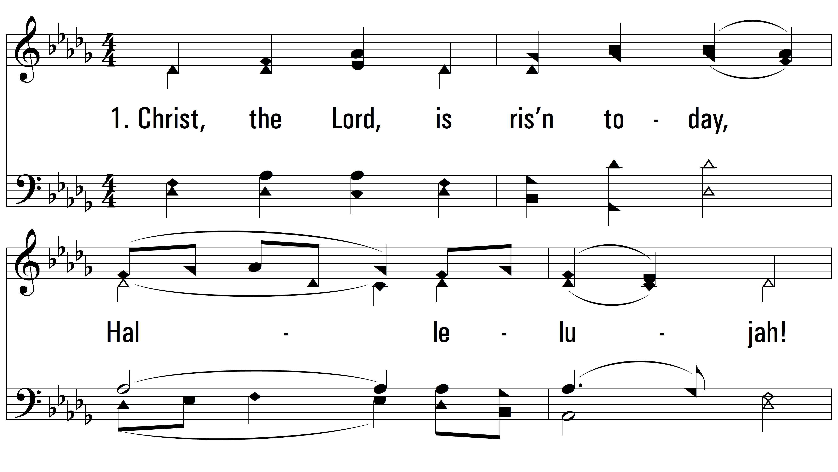
vs. 1 ~ Christ The Lord Has Risen Today

Slide 3
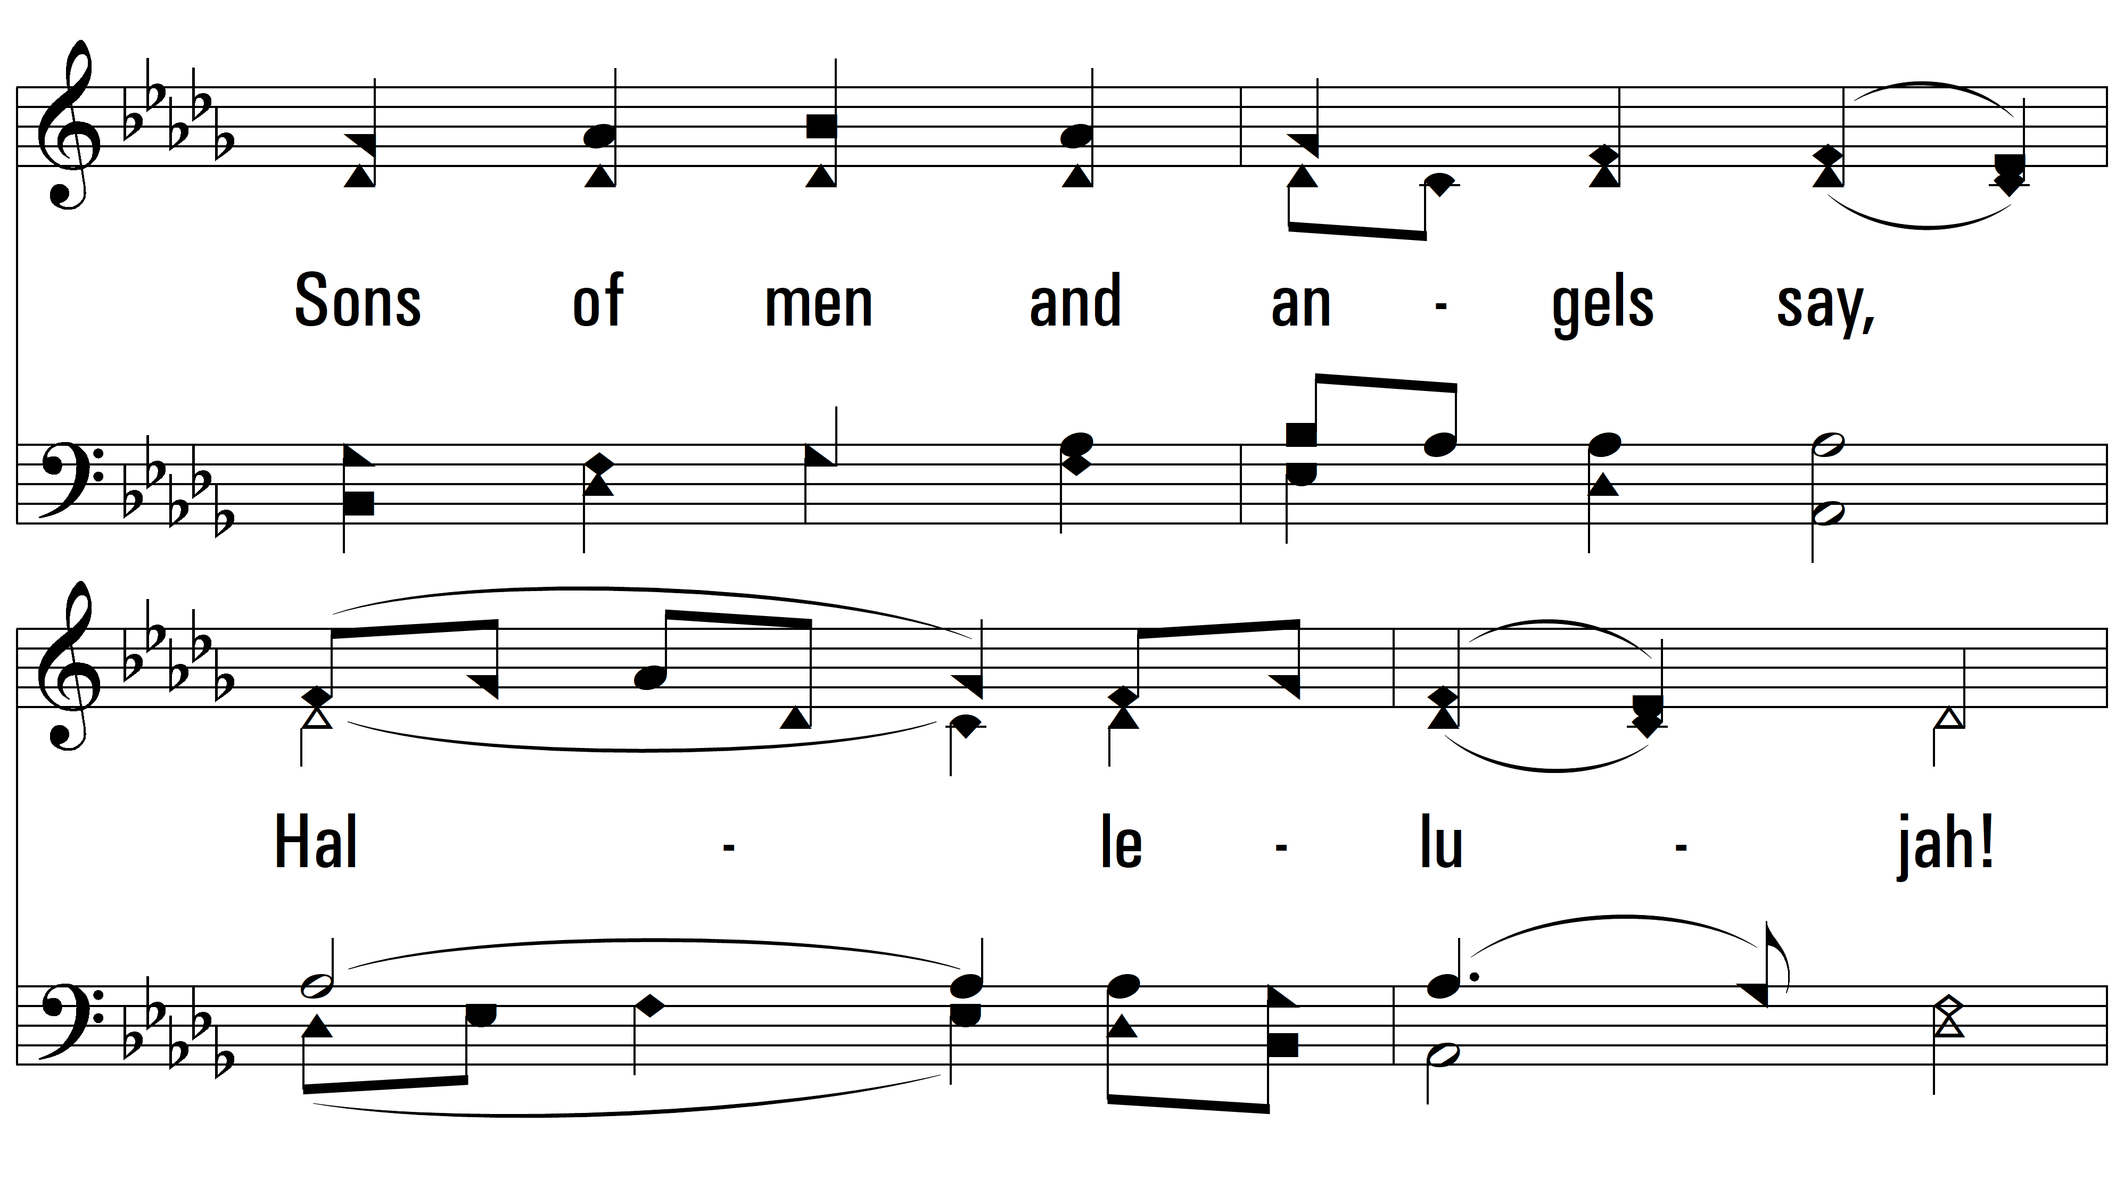
vs. 1

Slide 4
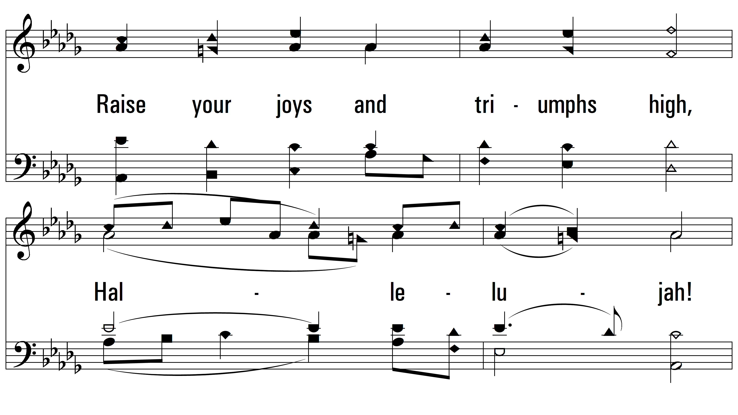
vs. 1

Slide 5
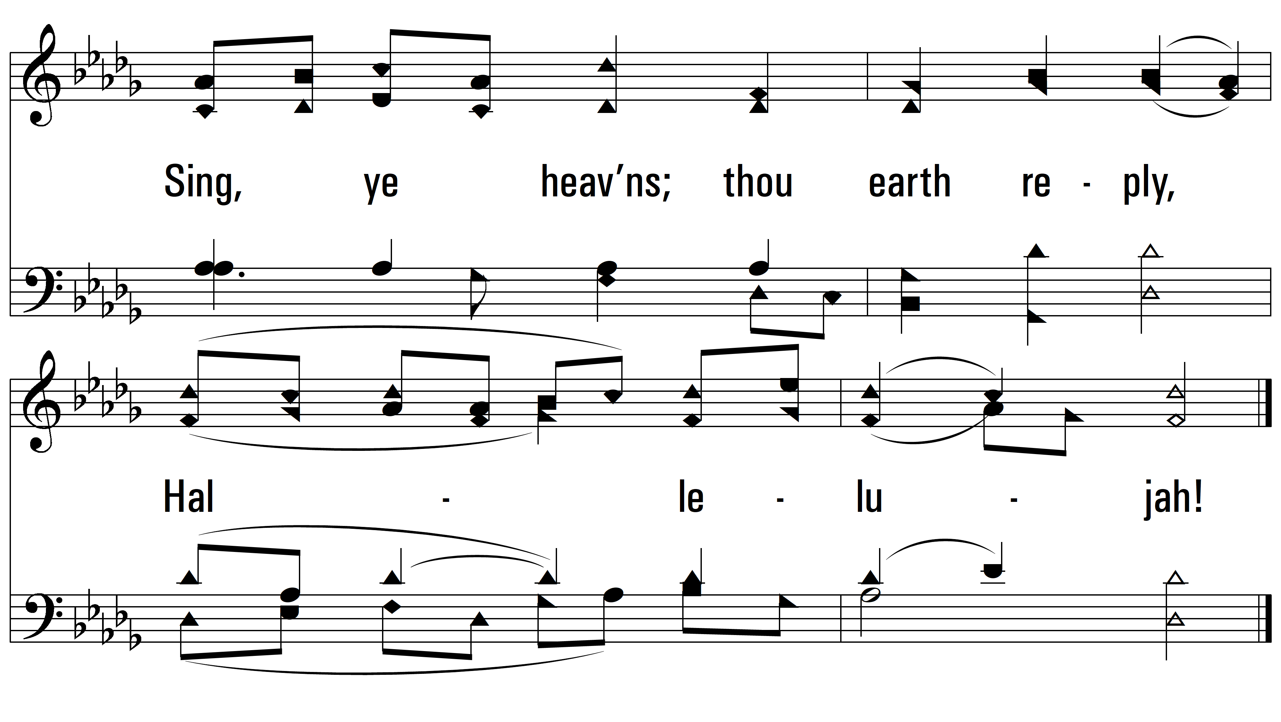
vs. 1

Slide 6
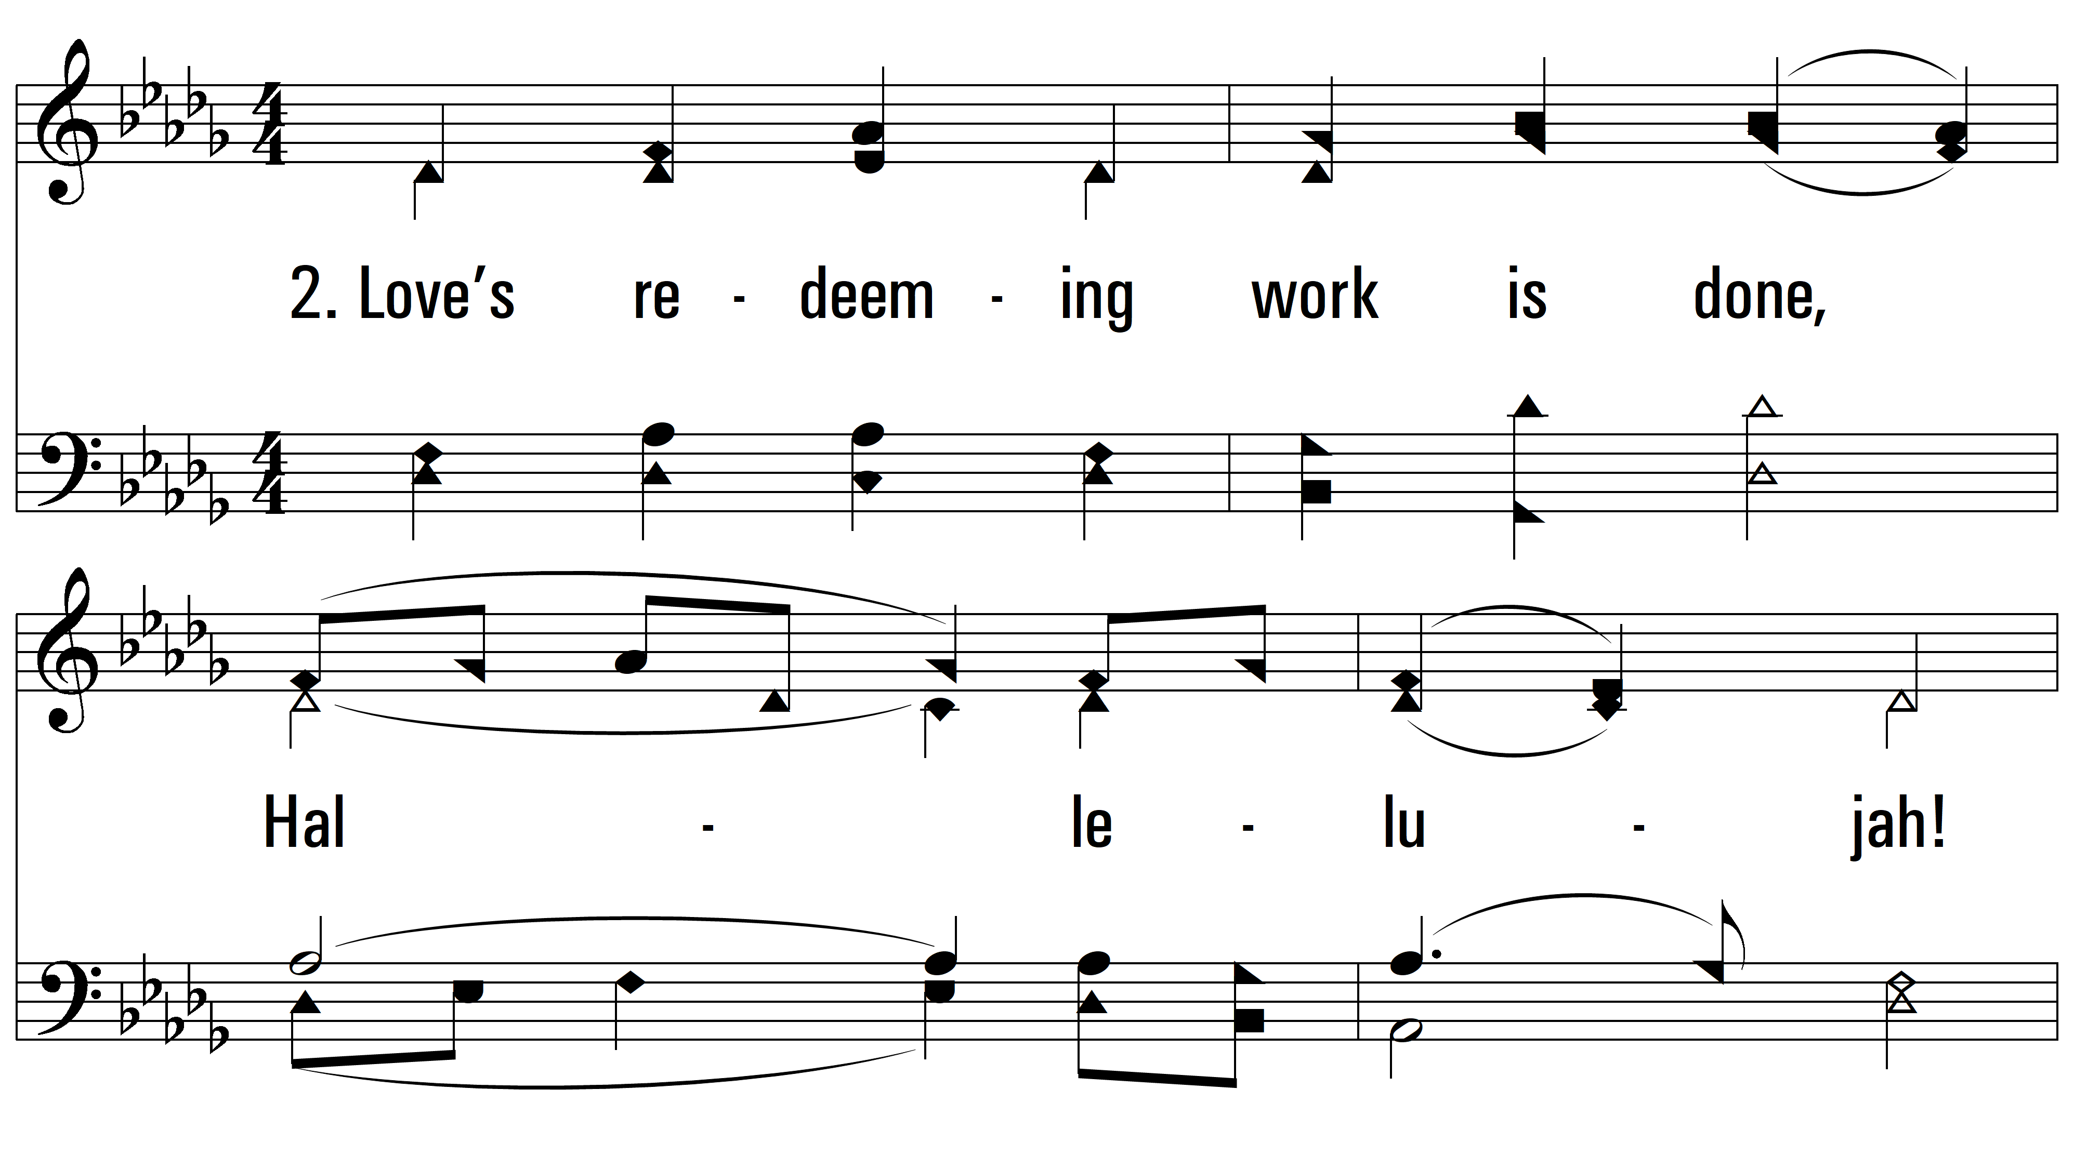
vs. 2 ~ Christ The Lord Has Risen Today

Slide 7
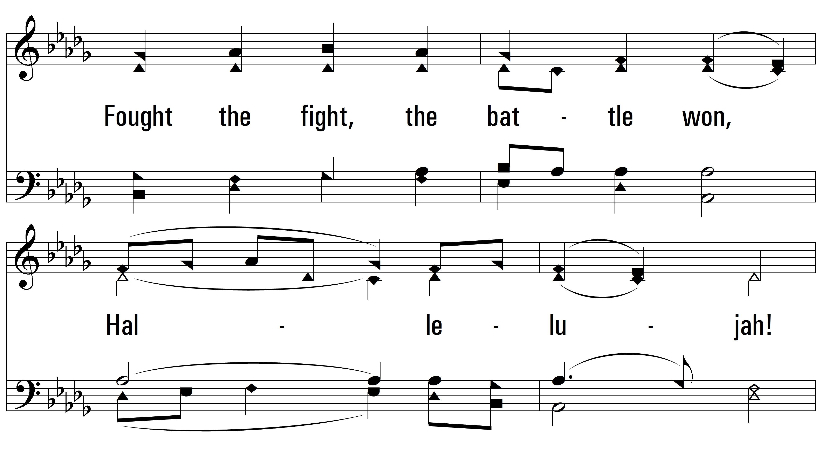
vs. 2

Slide 8
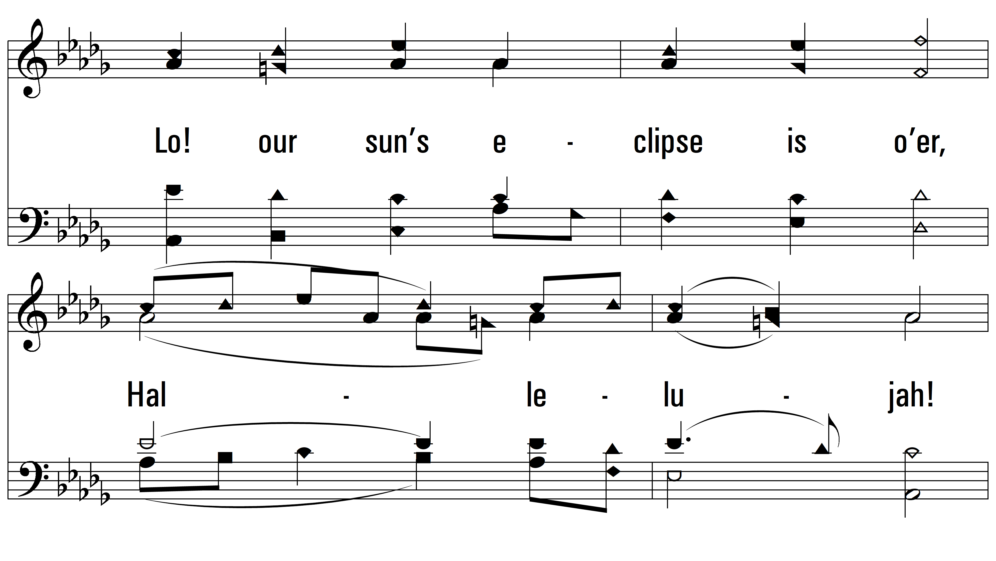
vs. 2

Slide 9
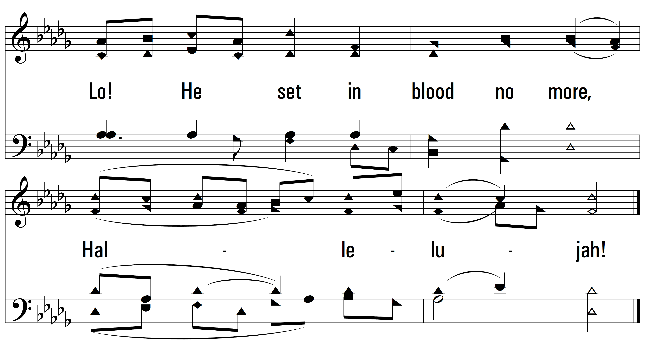
vs. 2

Slide 10
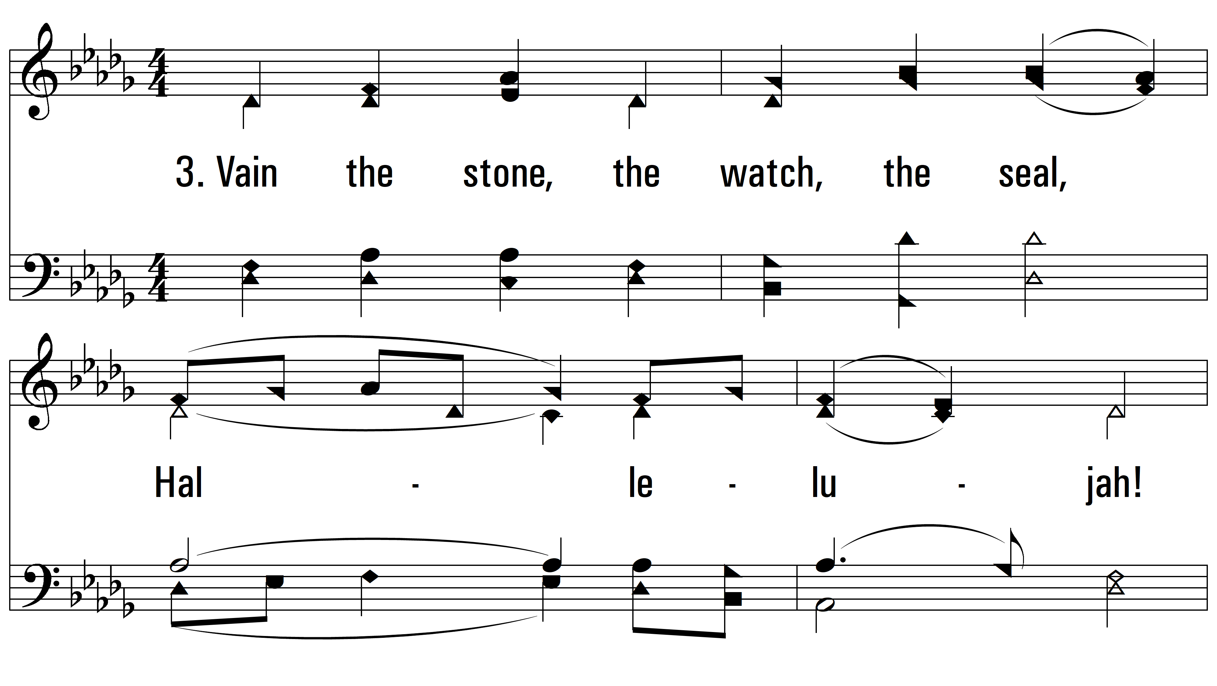
vs. 3 ~ Christ The Lord Has Risen Today

Slide 11
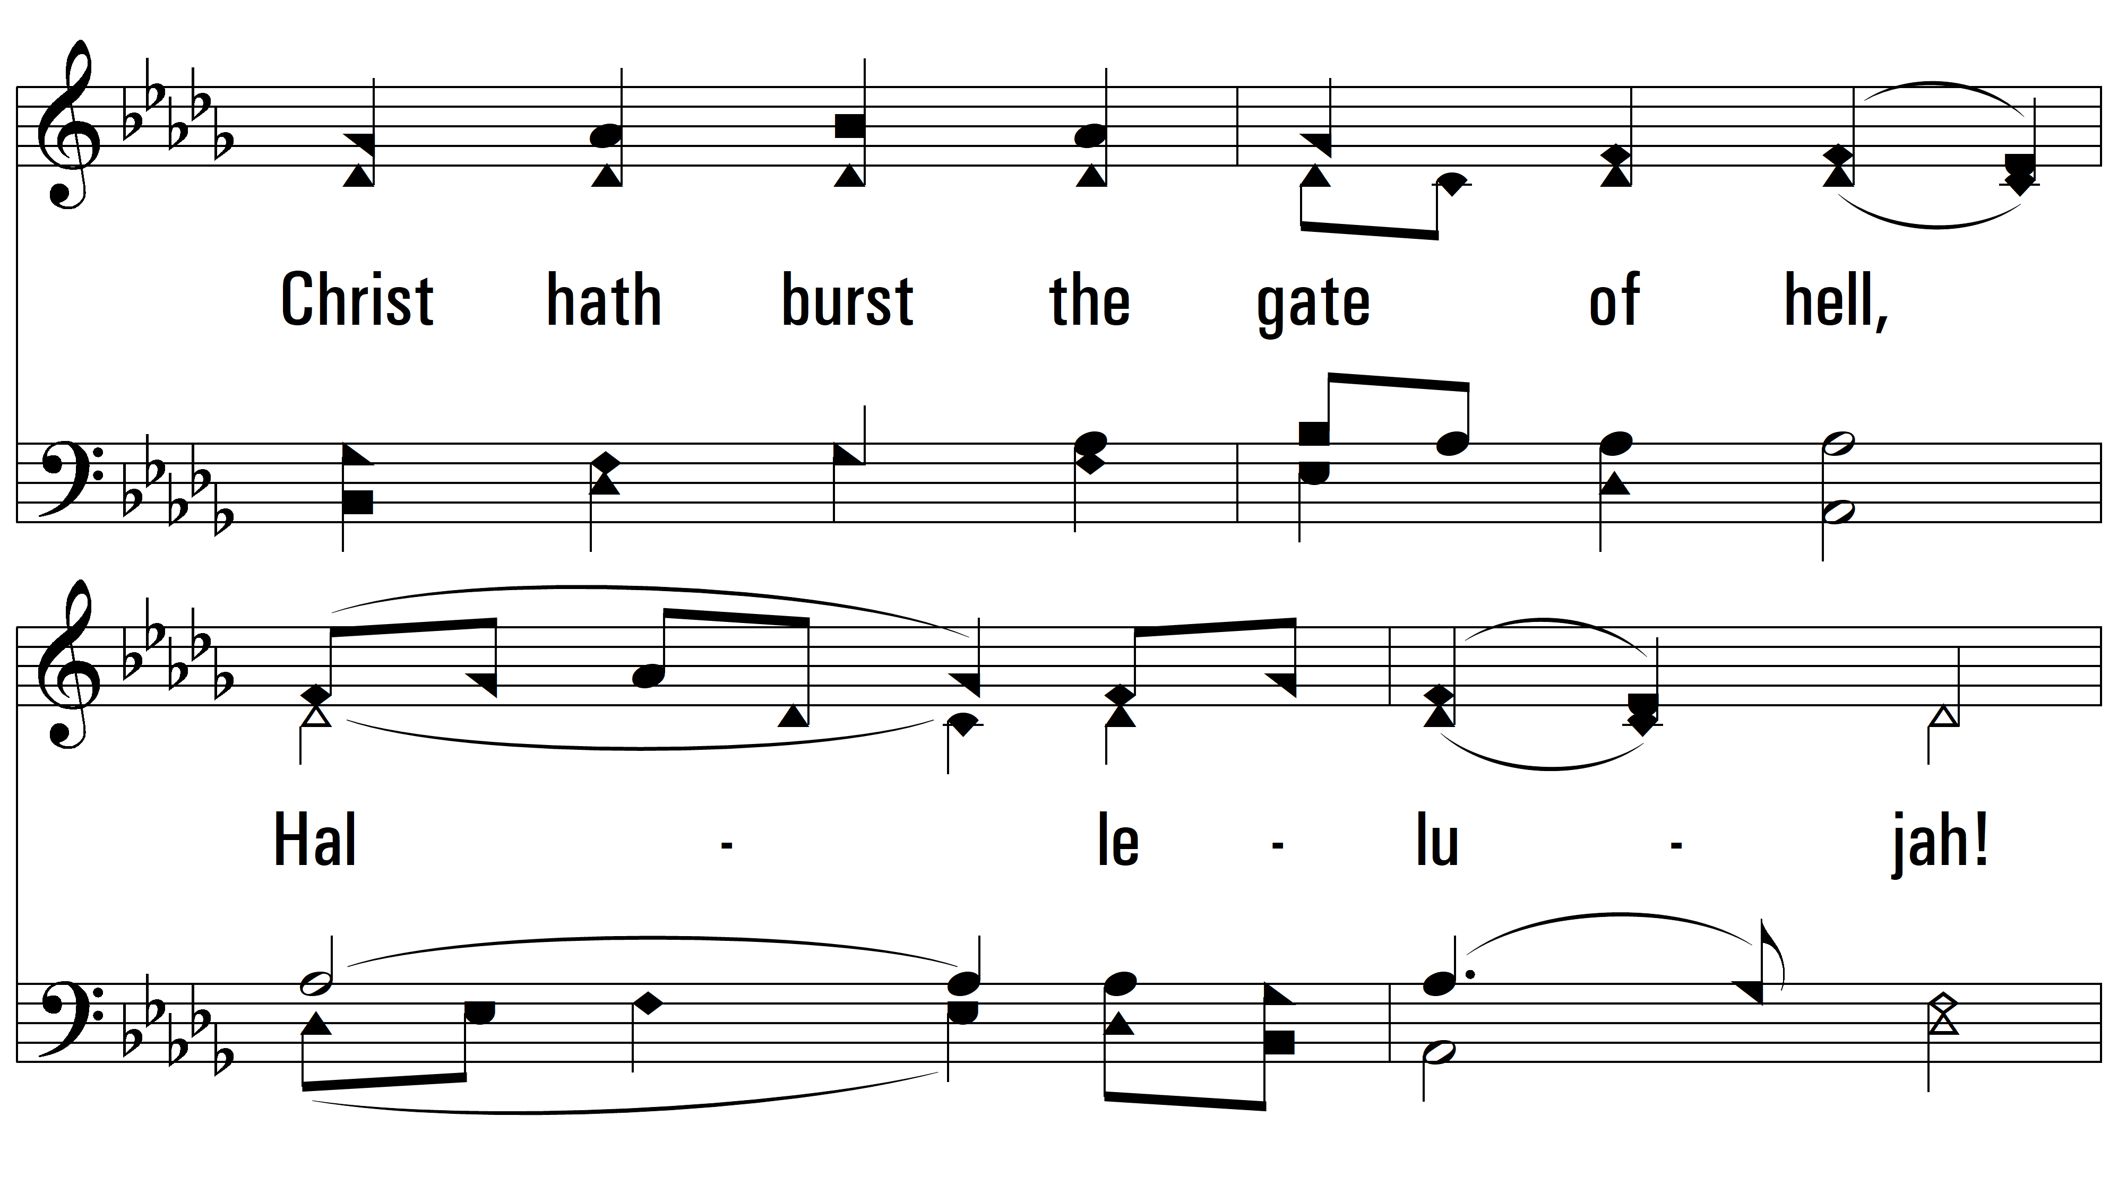
vs. 3

Slide 12
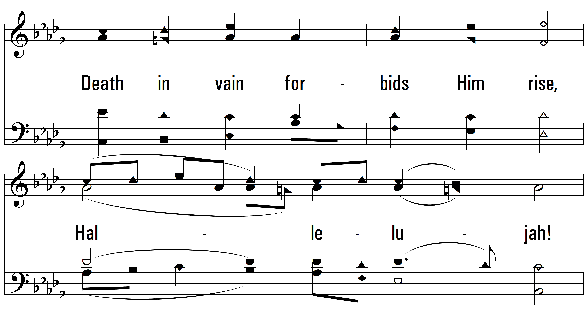
vs. 3

Slide 13
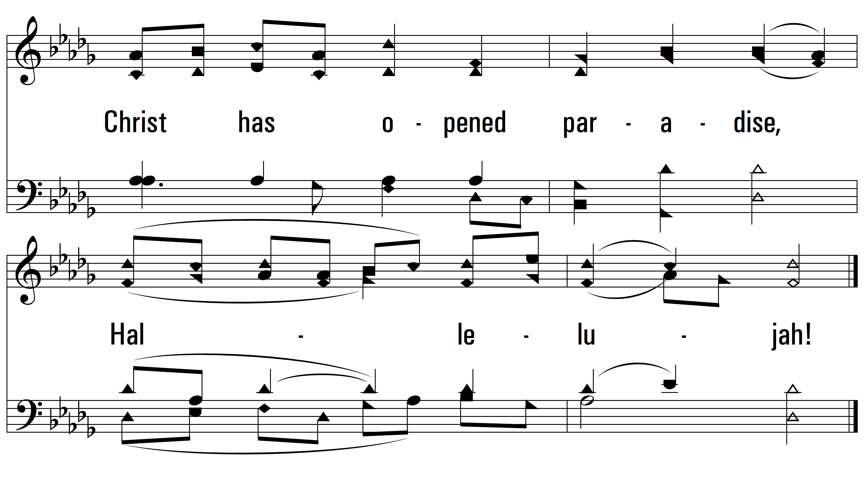
vs. 3

Slide 14
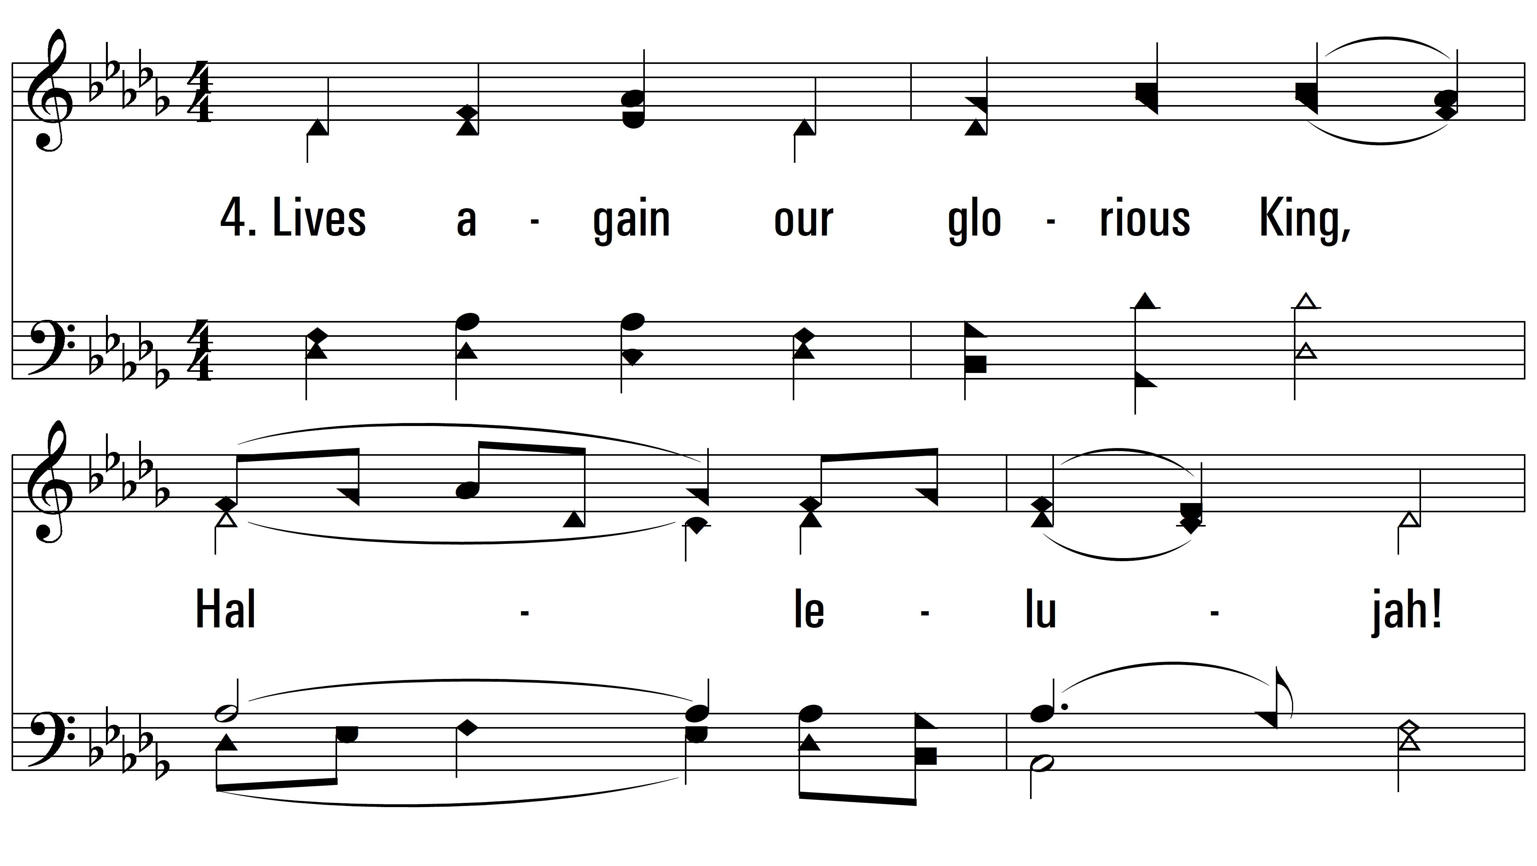
vs. 4 ~ Christ The Lord Has Risen Today

Slide 15
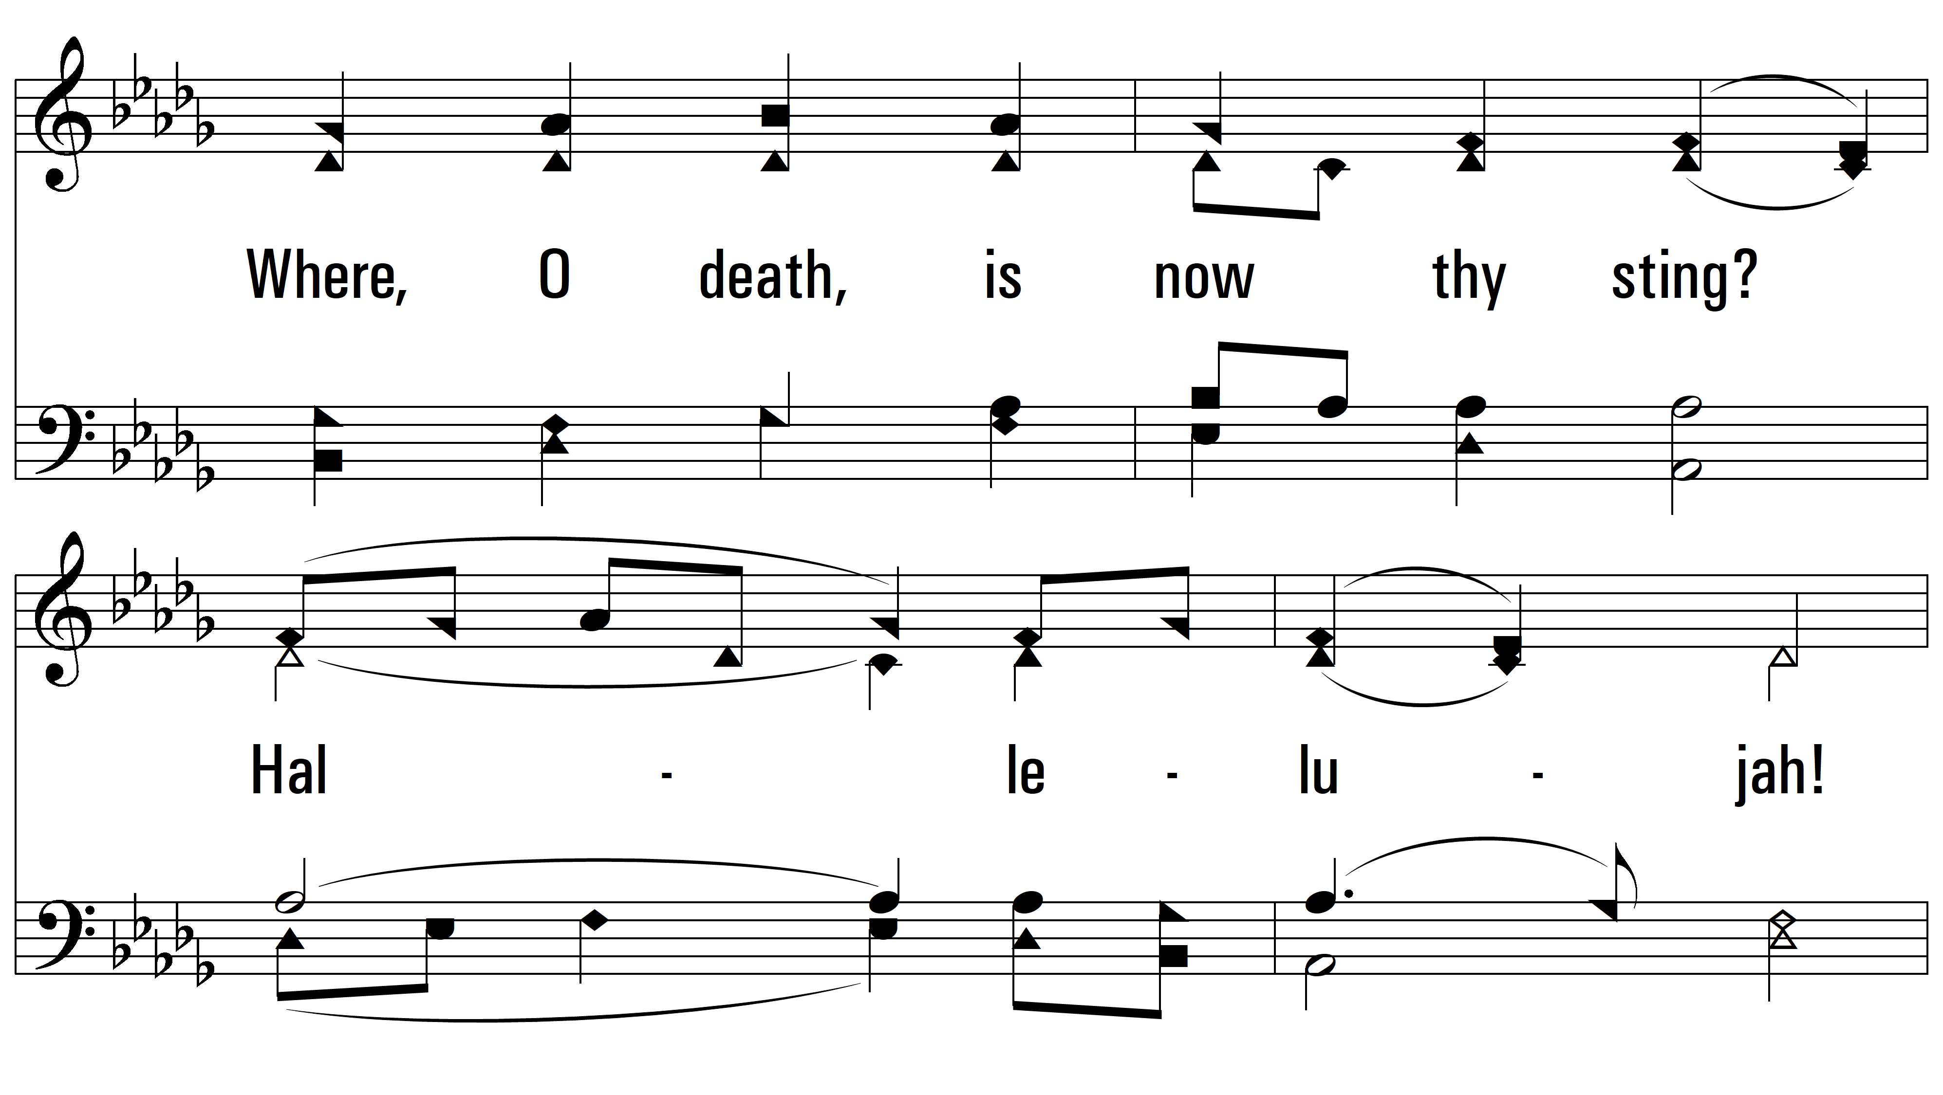
vs. 4

Slide 16
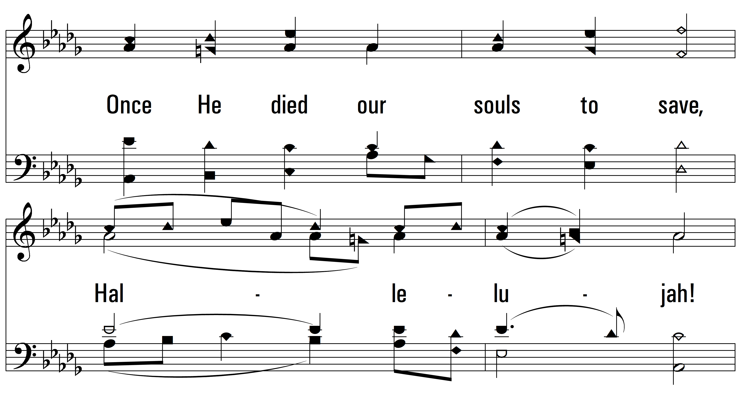
vs. 4

Slide 17
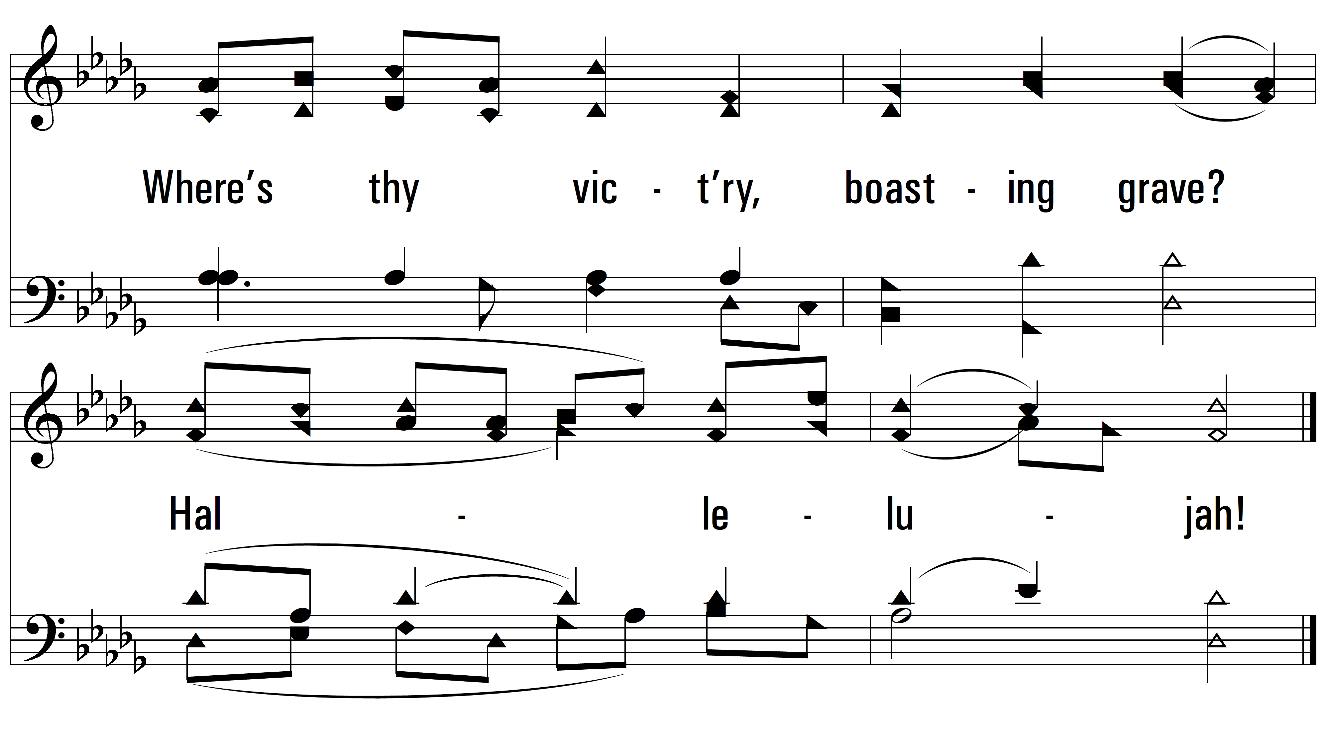
vs. 4
PDHymns.com
END

