Slide 1
All Hail The Power Of Jesus’ Name
CORONATION
CM
Words: | Edward Perronet (1780), Adapt. John Rippon (1787)
Music: | Oliver Holden (1793)
4/4
G/D - SOL
Verses: 4
Lead - | SOL
Alto - | MI
Tenor - | DO
Bass - | DO
PDHymns.com

Slide 2
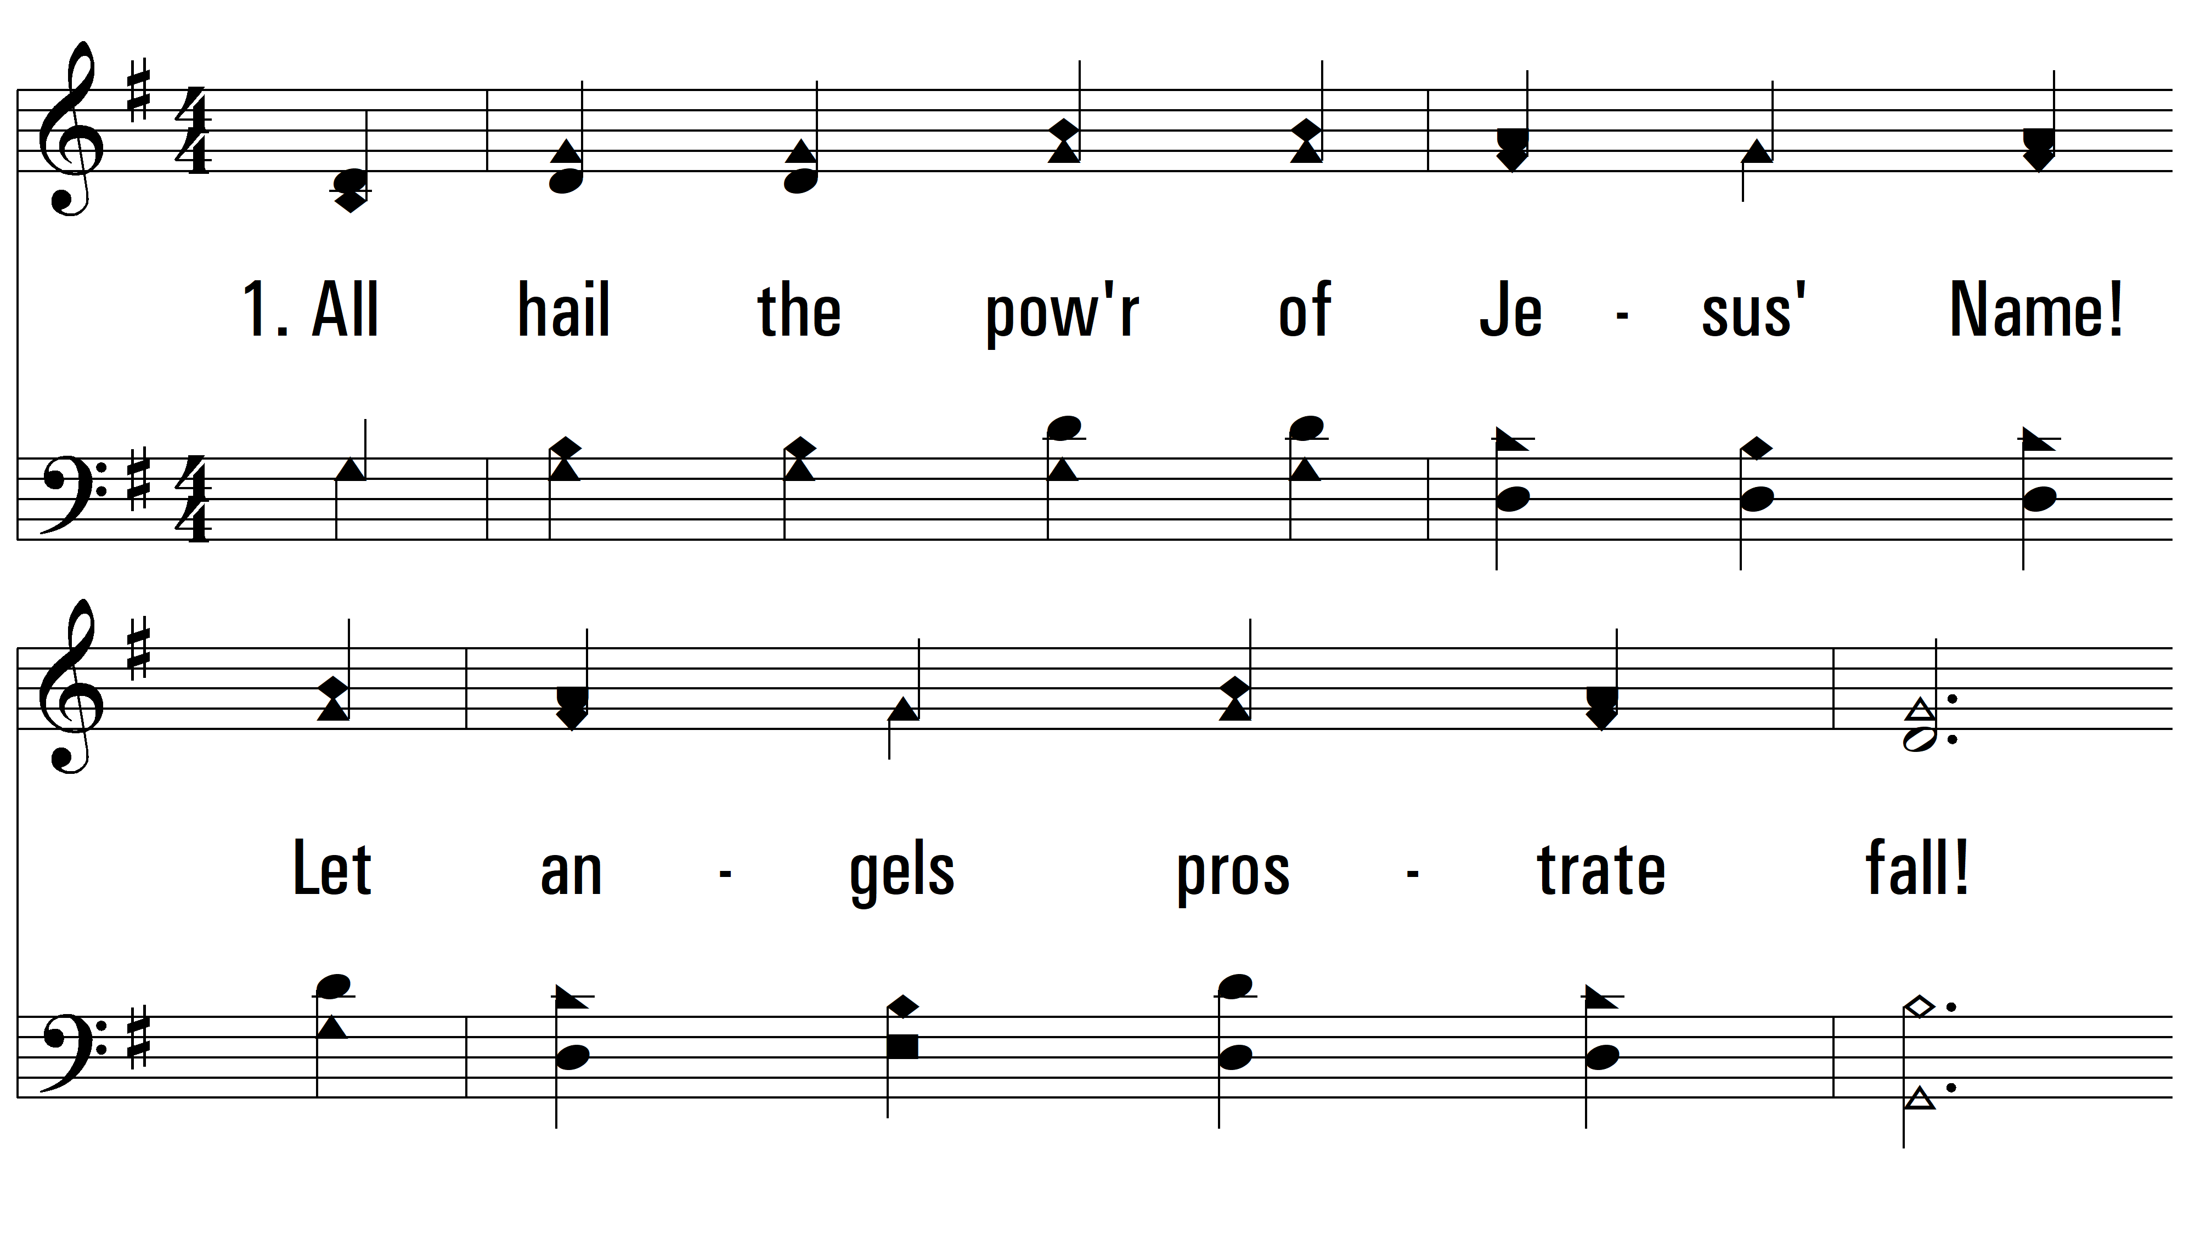
vs. 1 ~ All Hail The Power Of Jesus’ Name

Slide 3
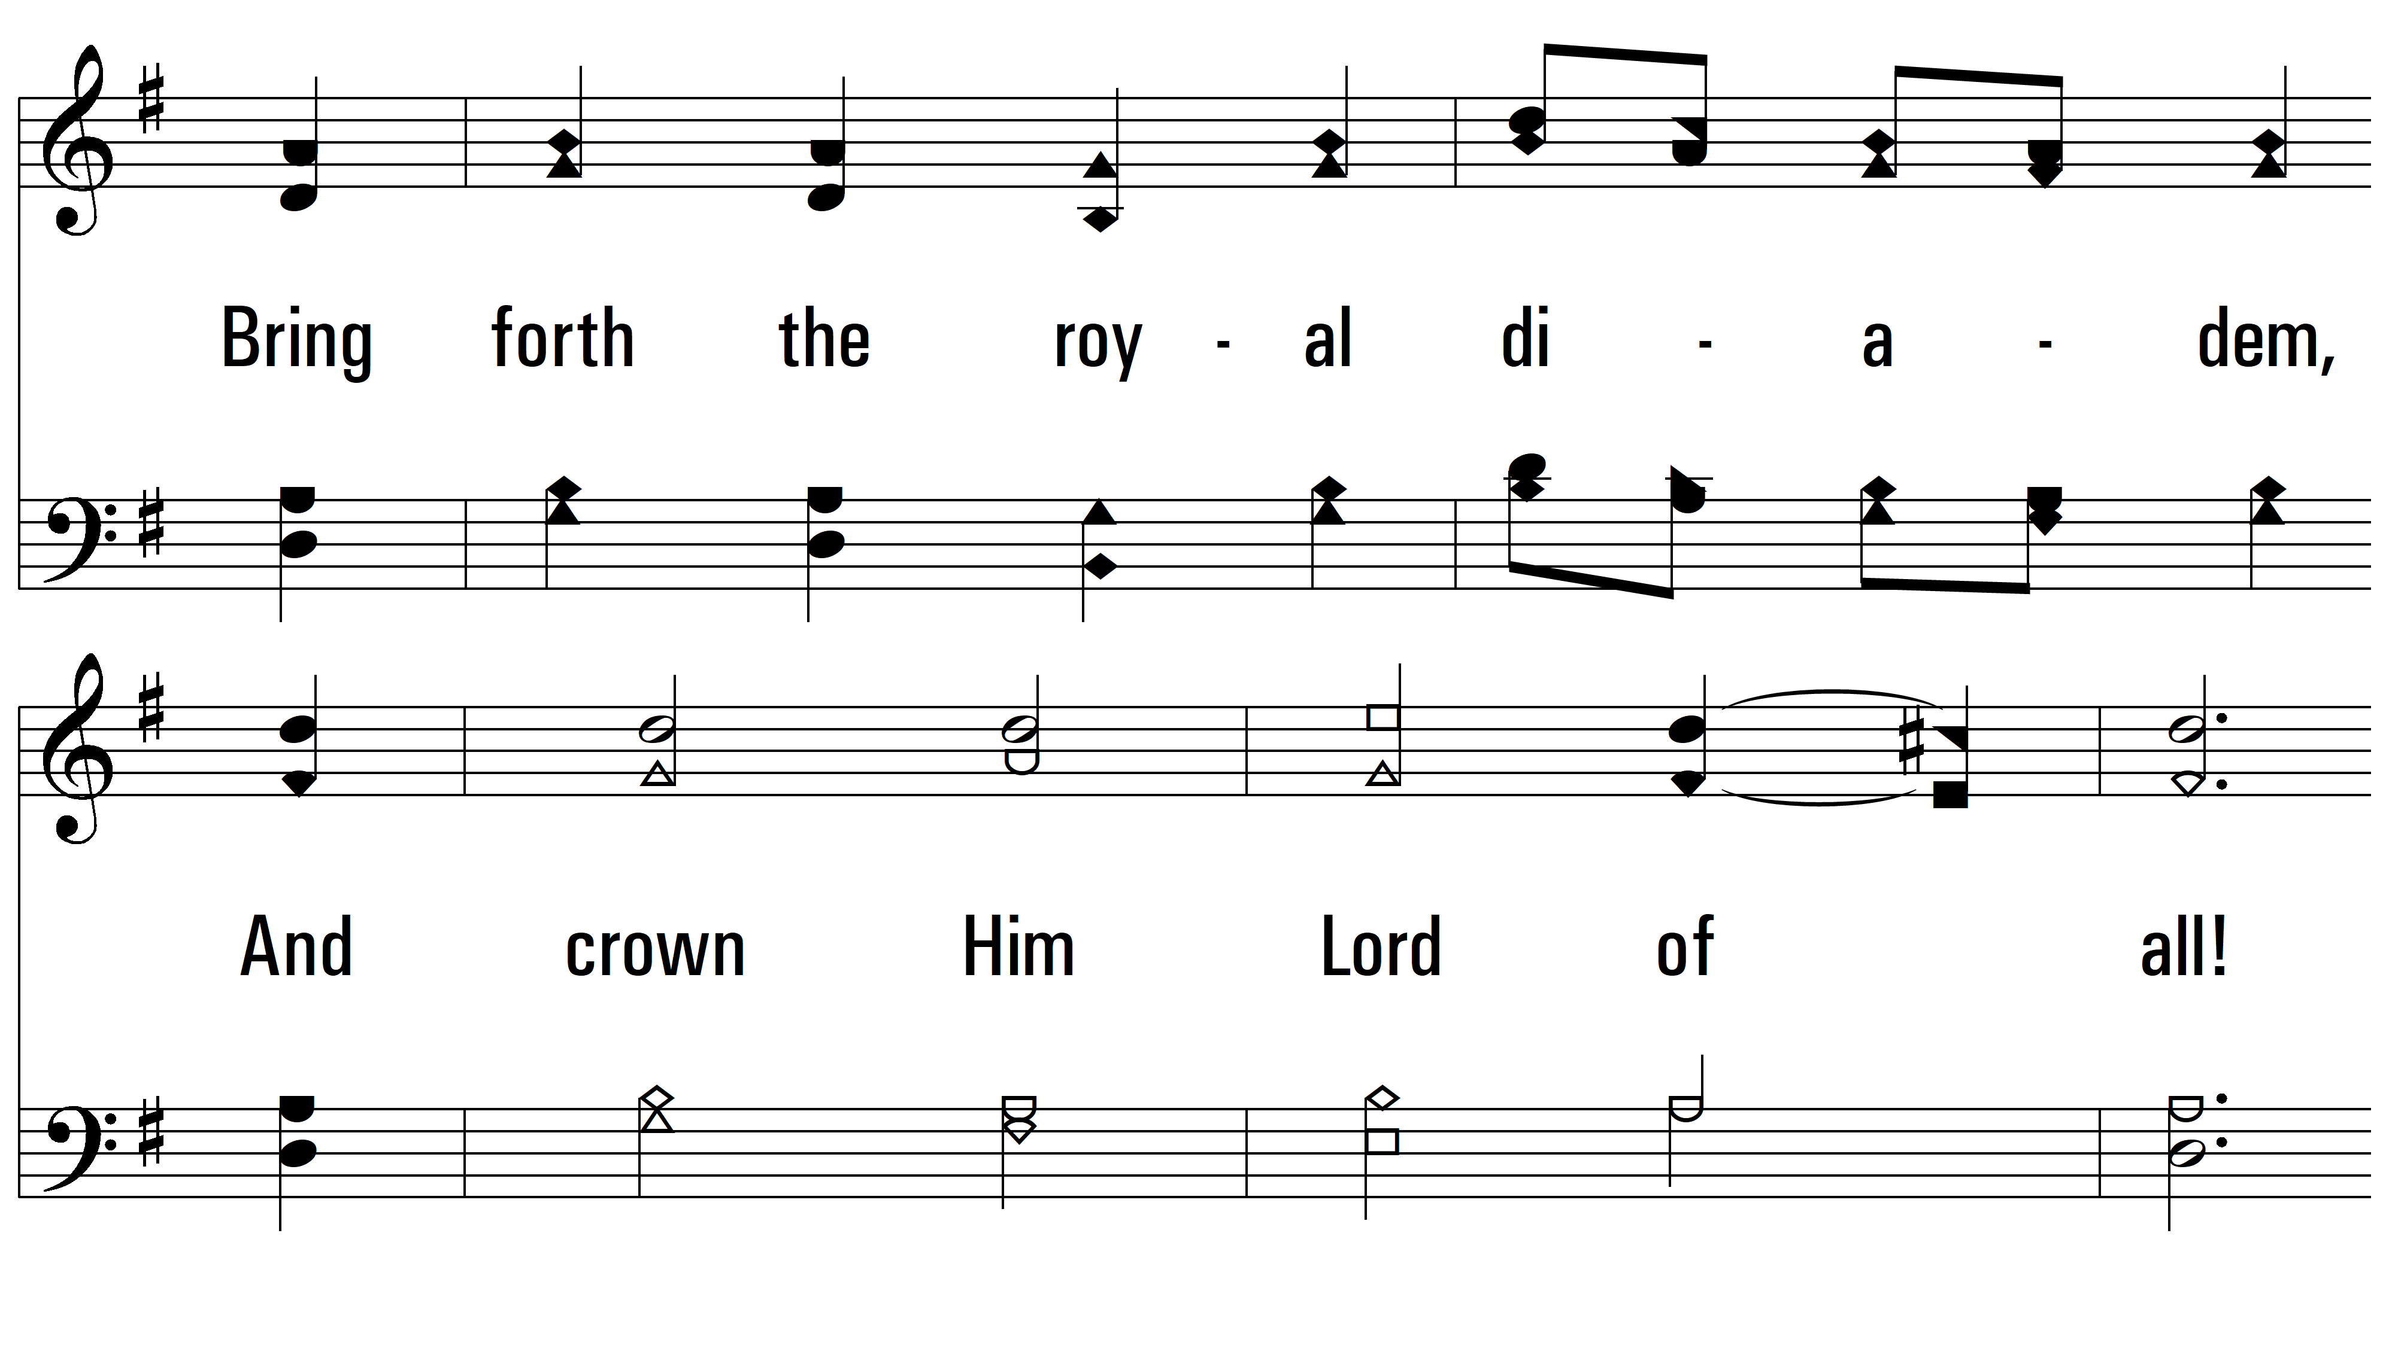
vs. 1

Slide 4
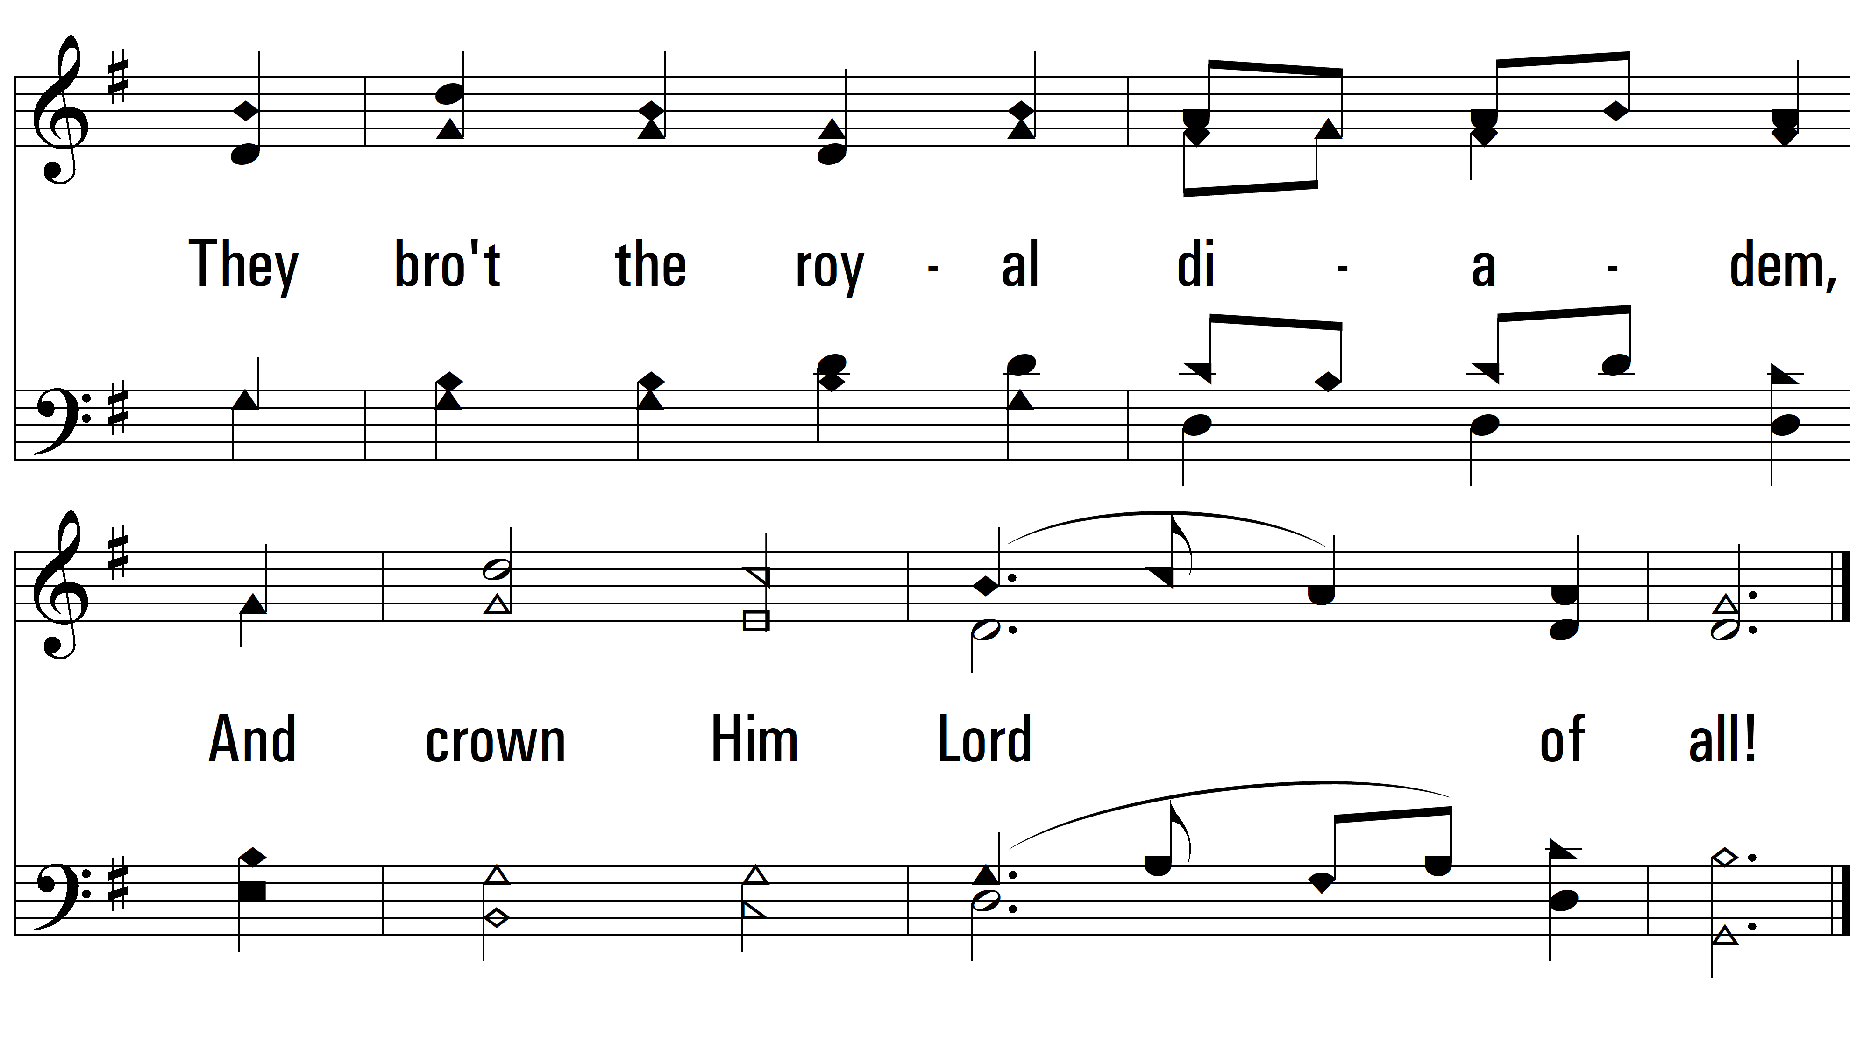
vs. 1

Slide 5
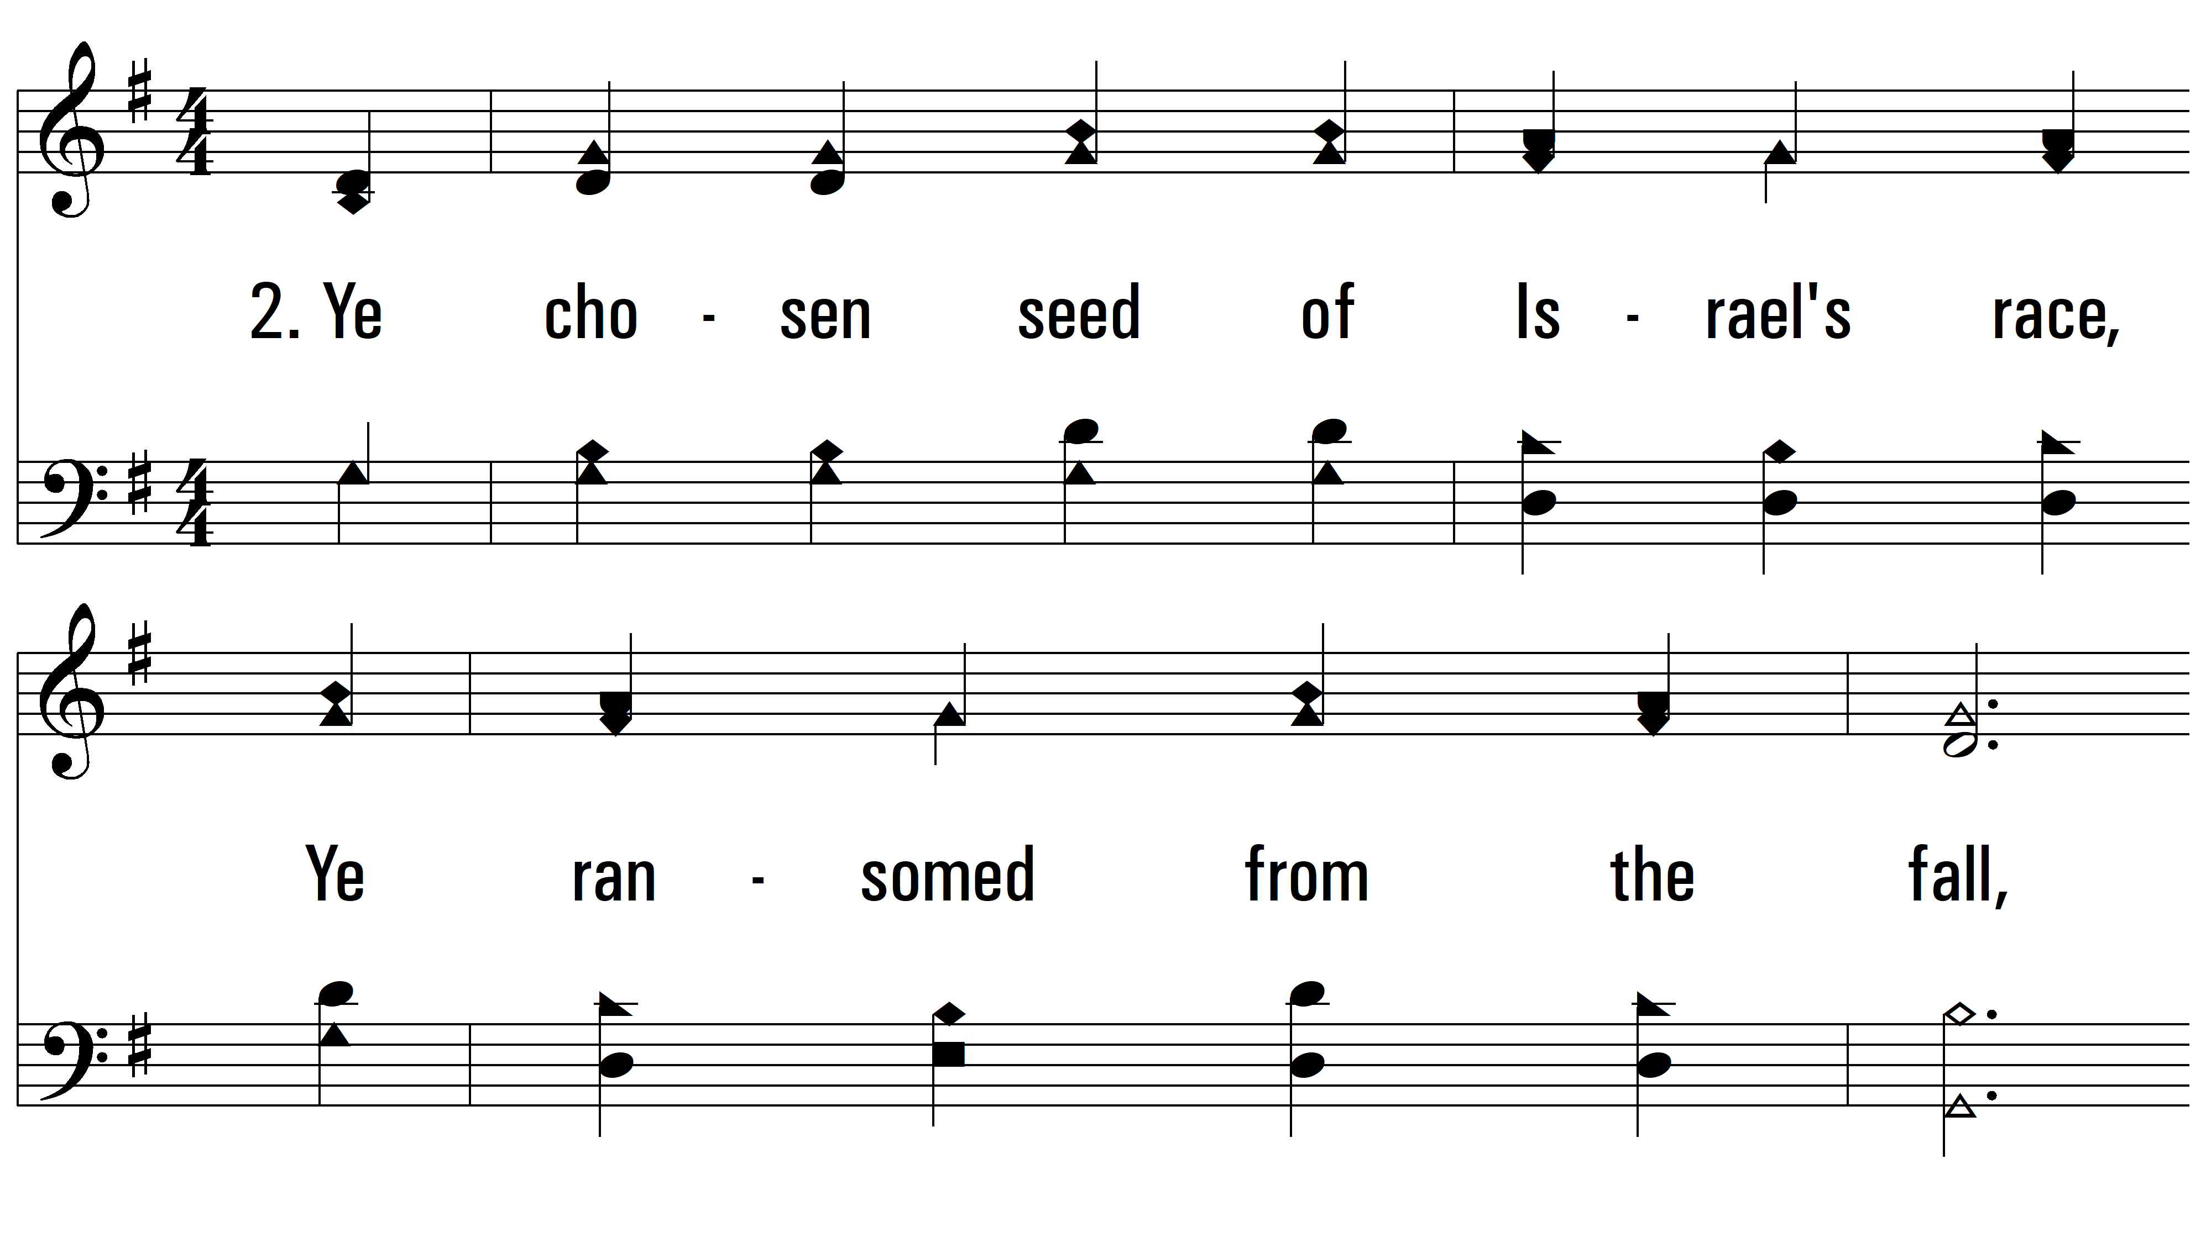
vs. 2 ~ All Hail The Power Of Jesus’ Name

Slide 6
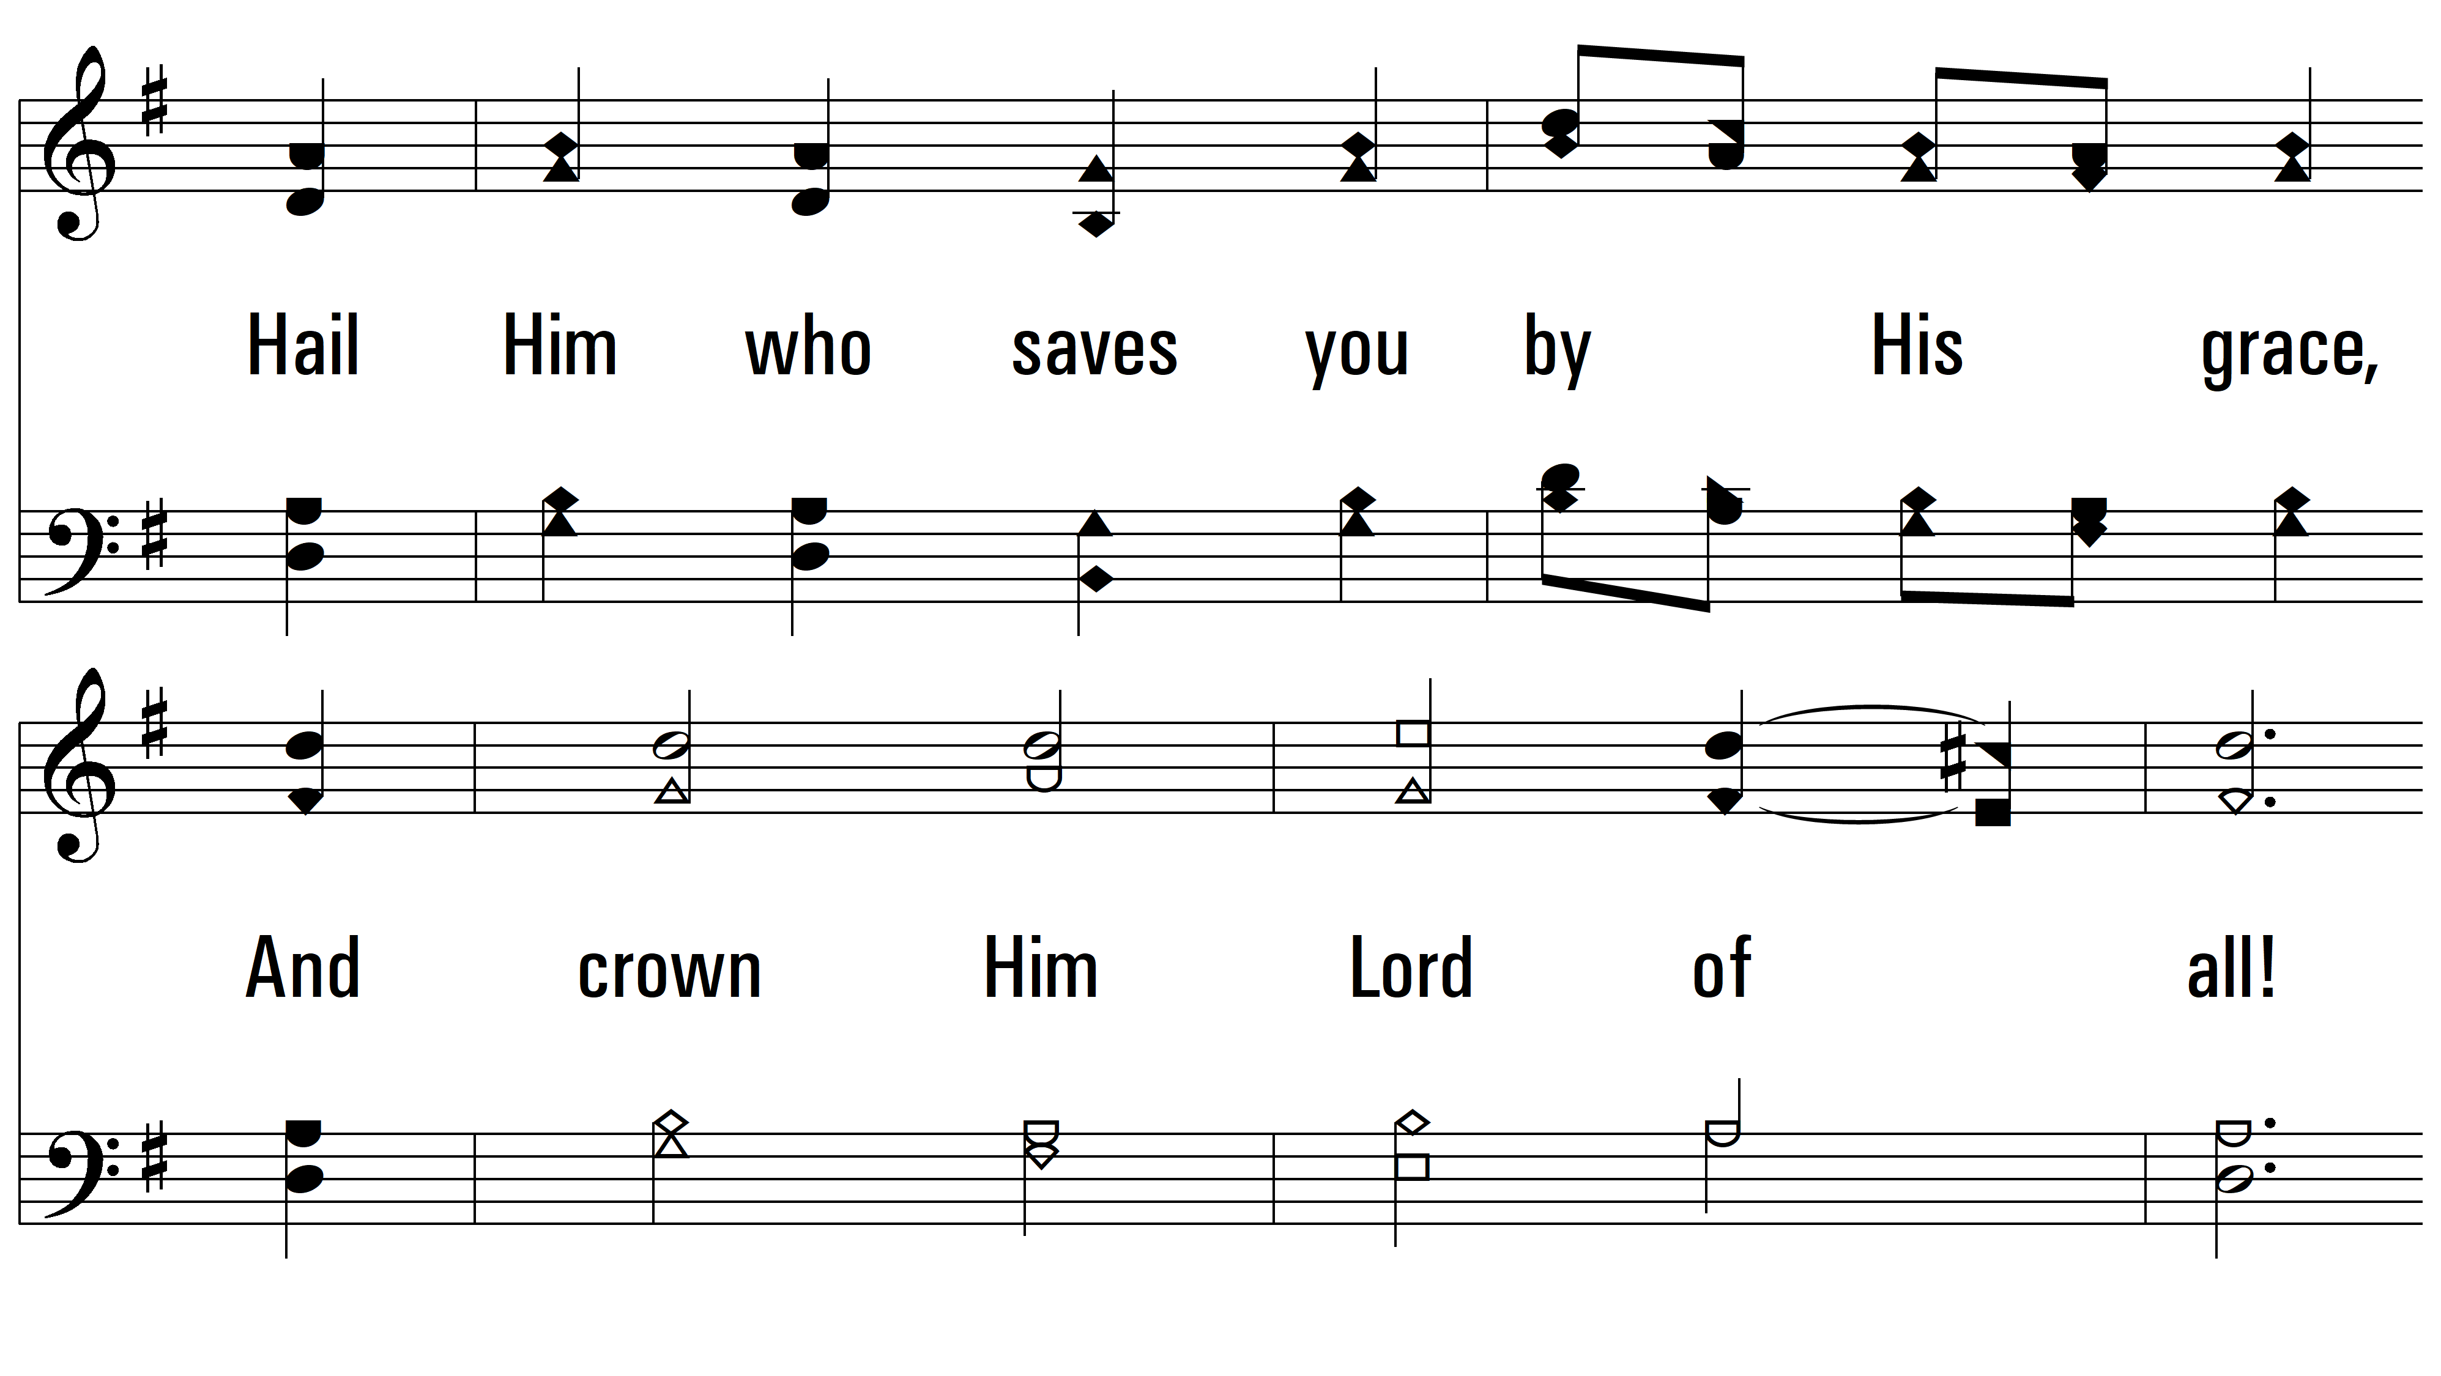
vs. 2

Slide 7
vs. 2

Slide 8
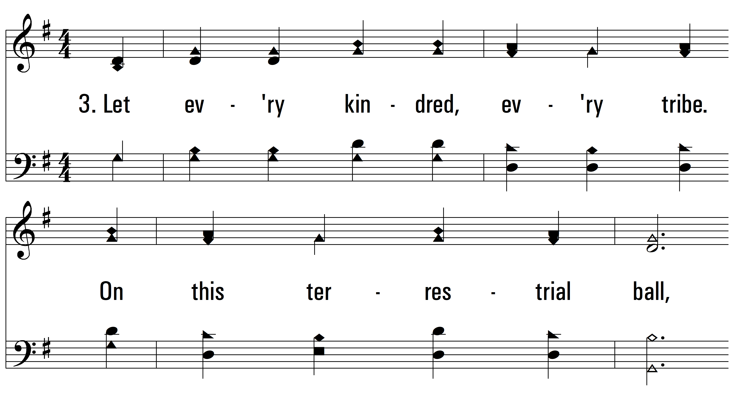
vs. 3 ~ All Hail The Power Of Jesus’ Name

Slide 9
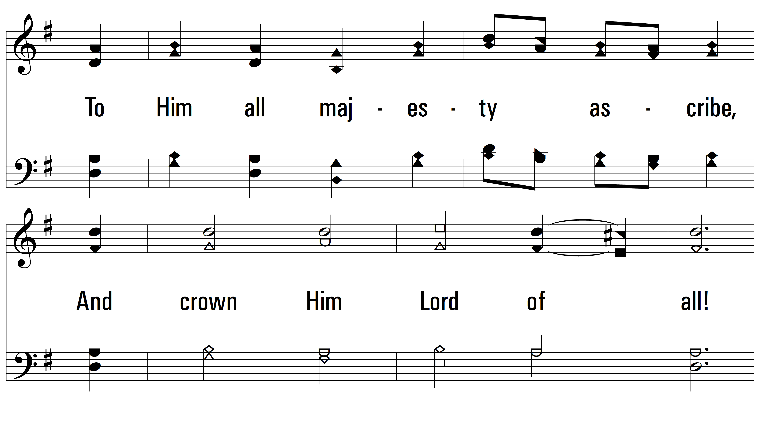
vs. 3

Slide 10
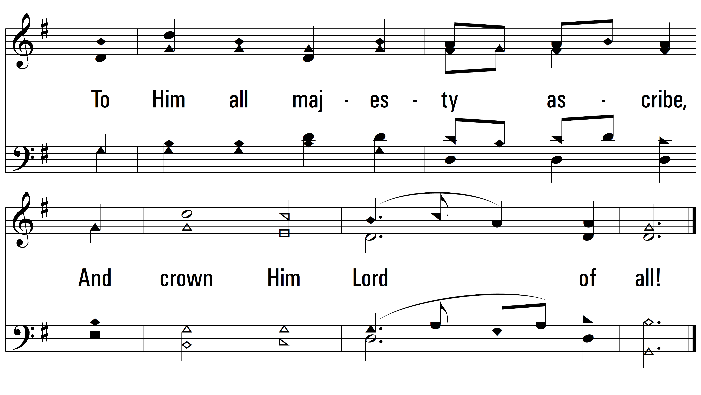
vs. 3

Slide 11
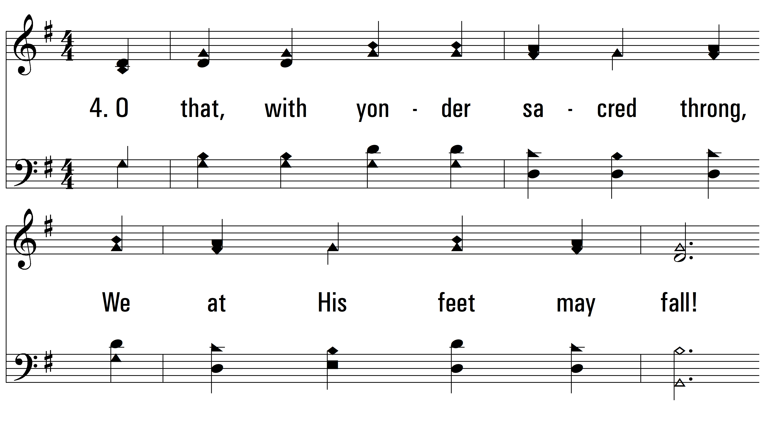
vs. 4 ~ All Hail The Power Of Jesus’ Name

Slide 12
vs. 4

Slide 13
vs. 4
PDHymns.com
END

