Slide 1
All Hail The Power Of Jesus’ Name
DIADEM
CM
Words: | Edward Perronet, 1779, St. 4, John Rippon, 1787
Music: | James Ellor, 1838
3/4
B^{b}/F - SOL
Verses: 3/Chorus
Lead - | SOL
Alto - | MI
Tenor - | DO
Bass - | DO
PDHymns.com

Slide 2
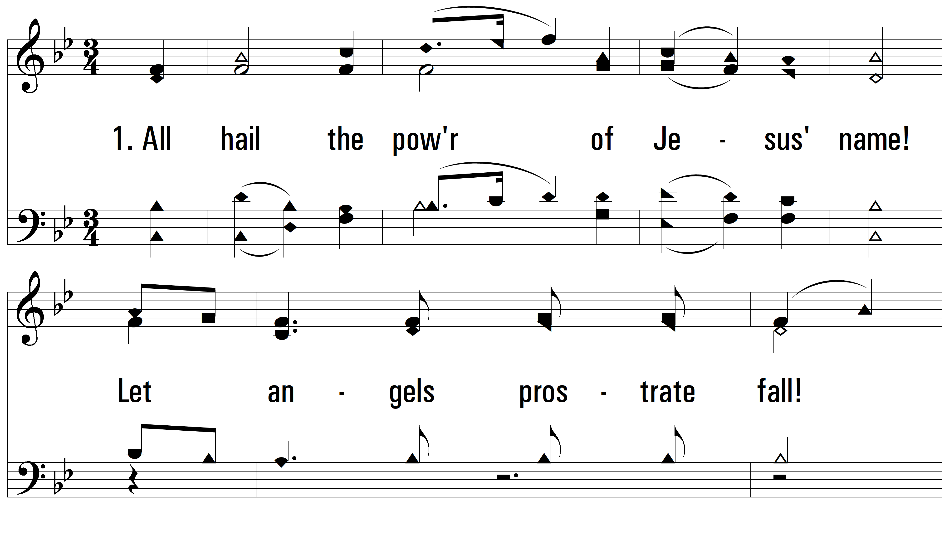
vs. 1 ~ All Hail The Power Of Jesus’ Name

Slide 3
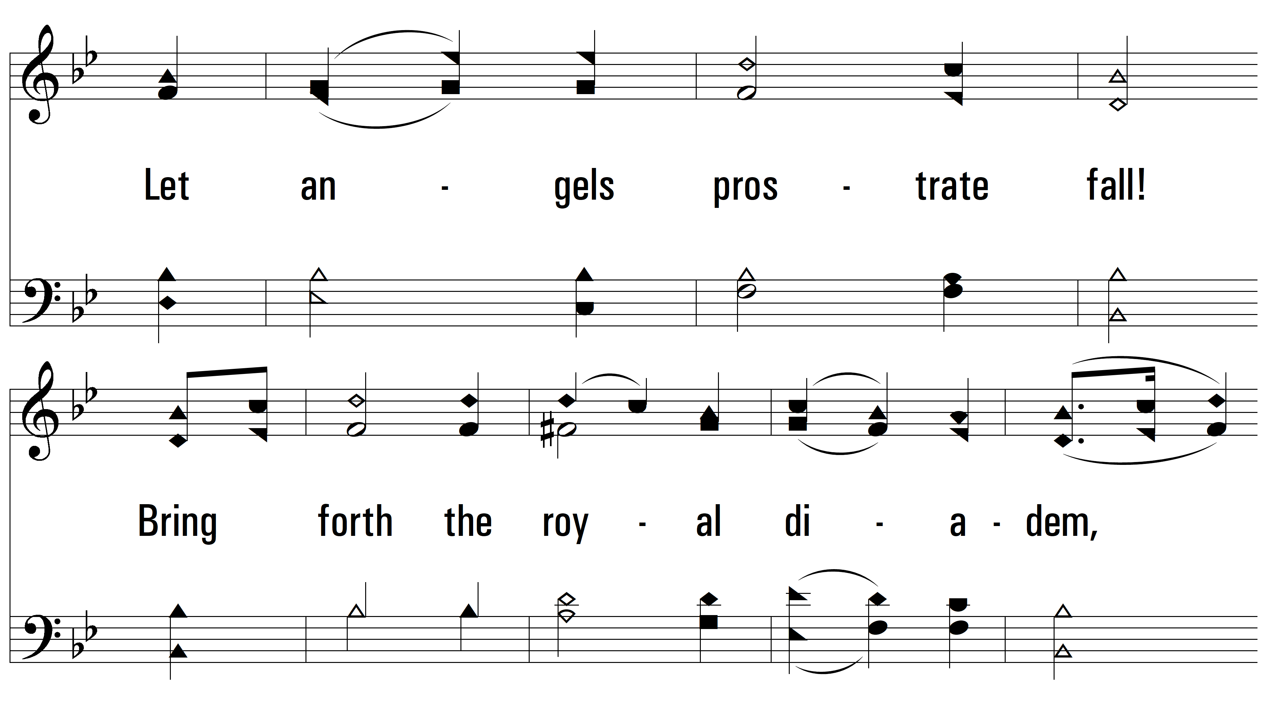
vs. 1

Slide 4
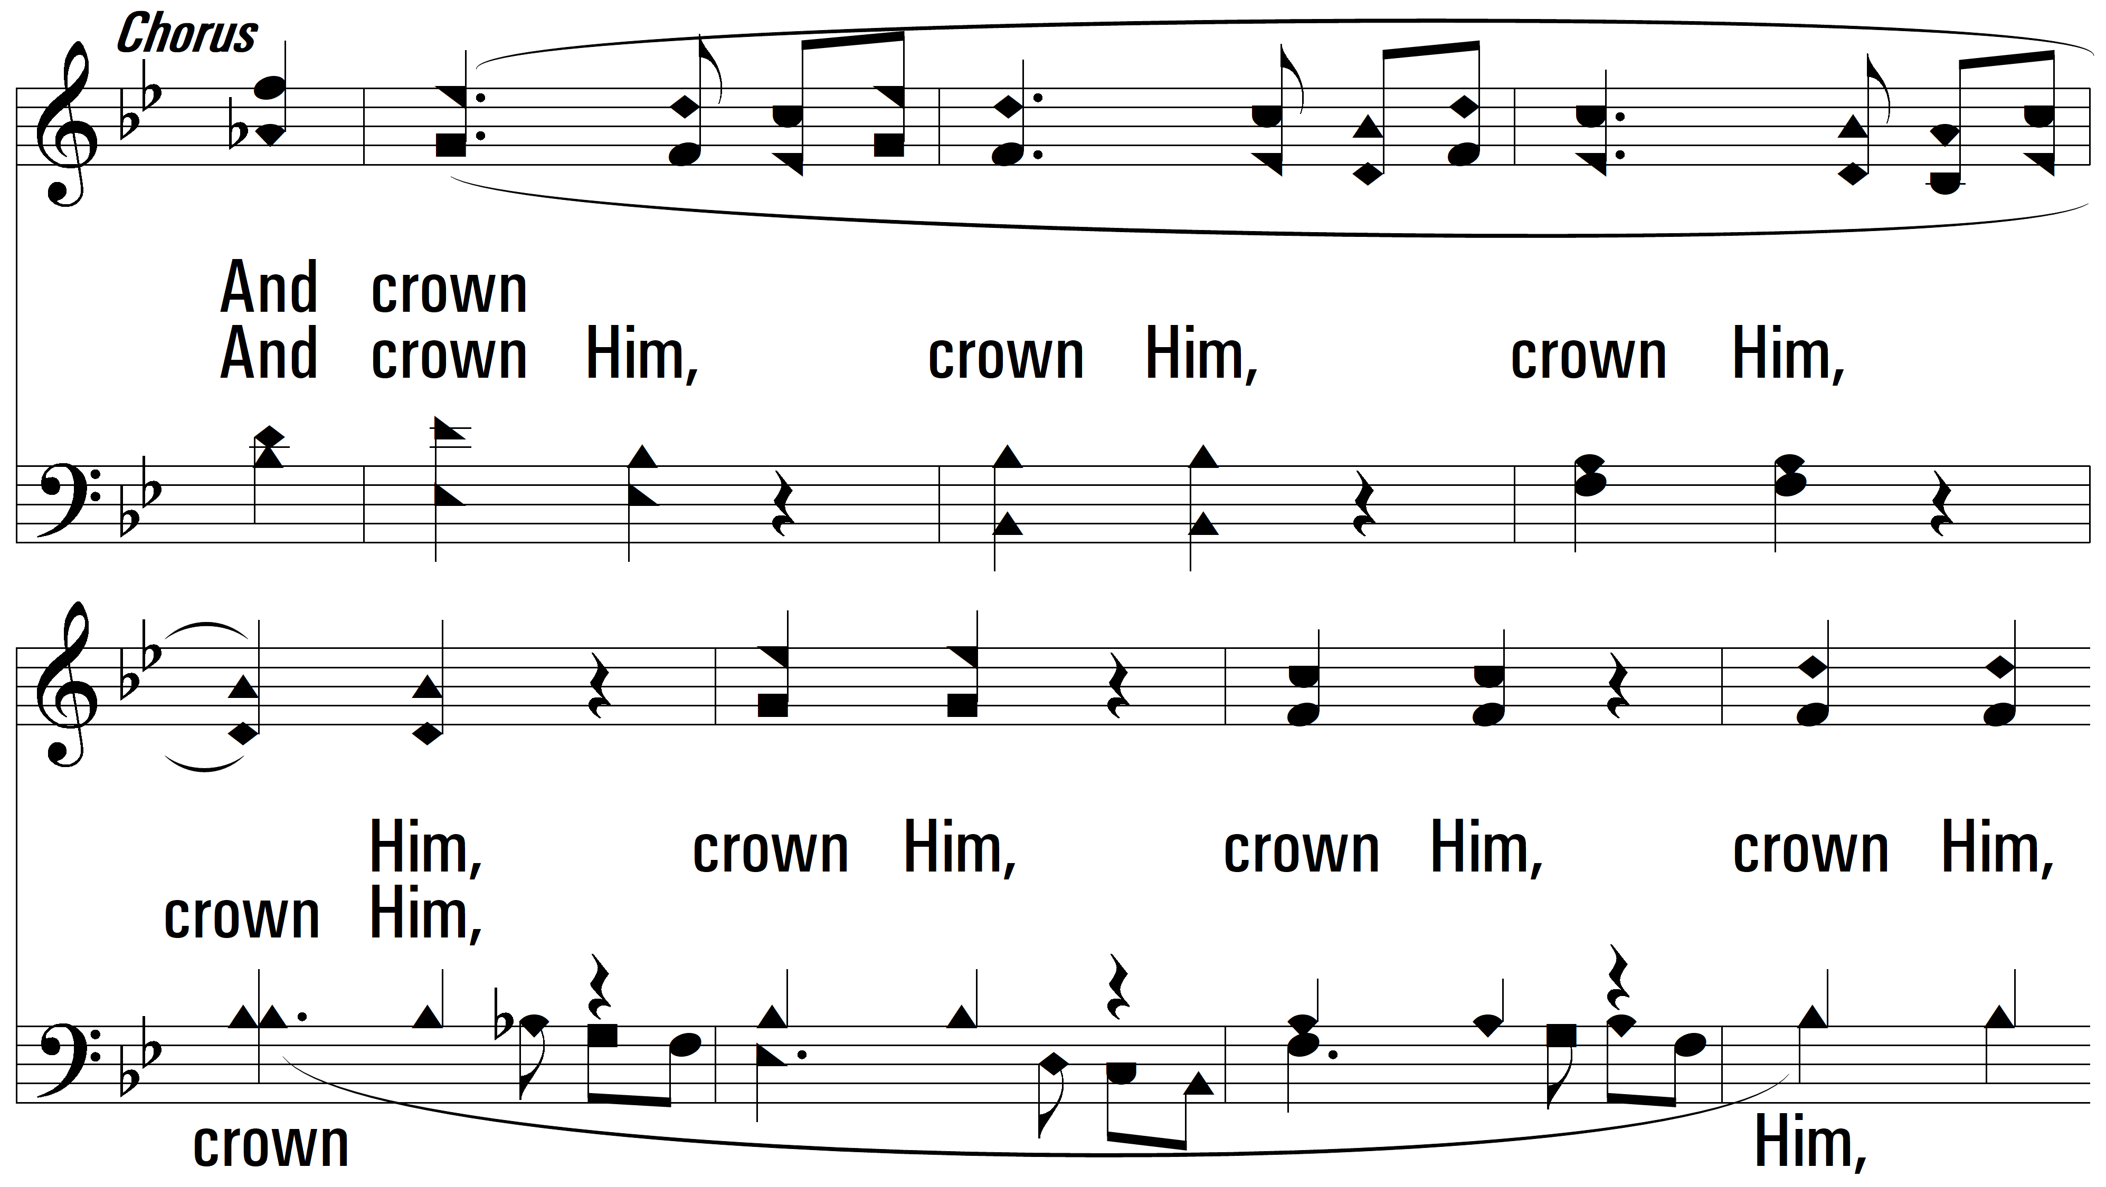
vs. 1

Slide 5
vs. 1

Slide 6
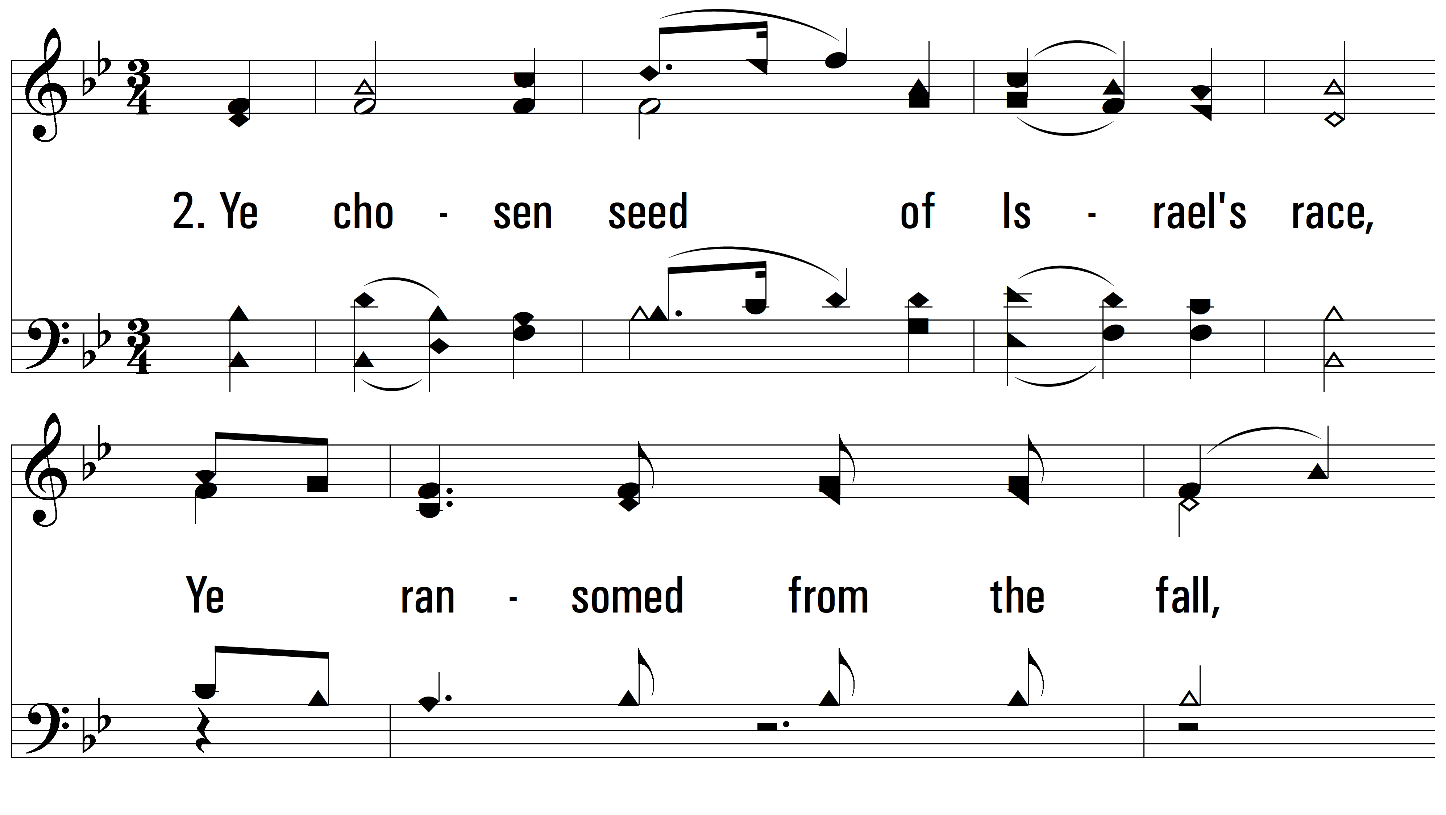
vs. 2 ~ All Hail The Power Of Jesus’ Name

Slide 7
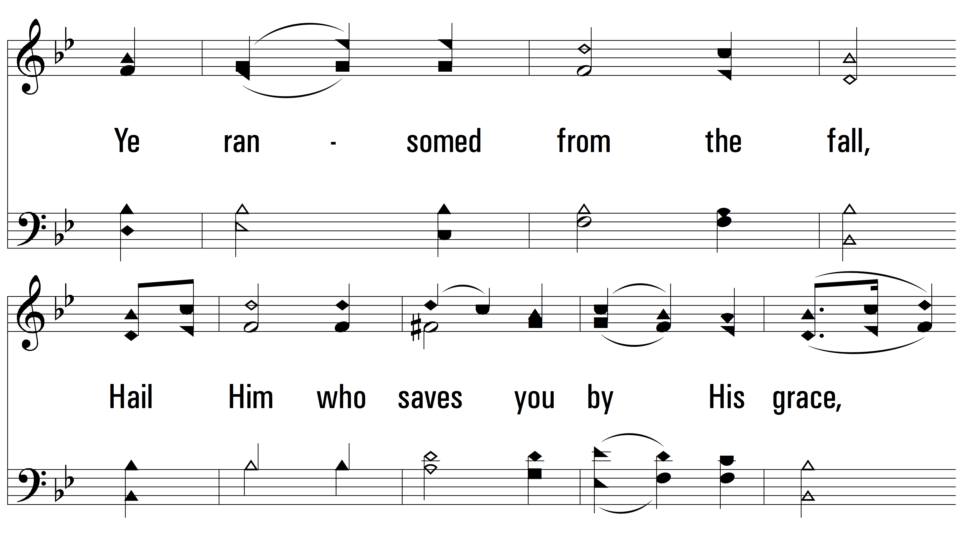
vs. 2

Slide 8
vs. 2

Slide 9
vs. 2

Slide 10
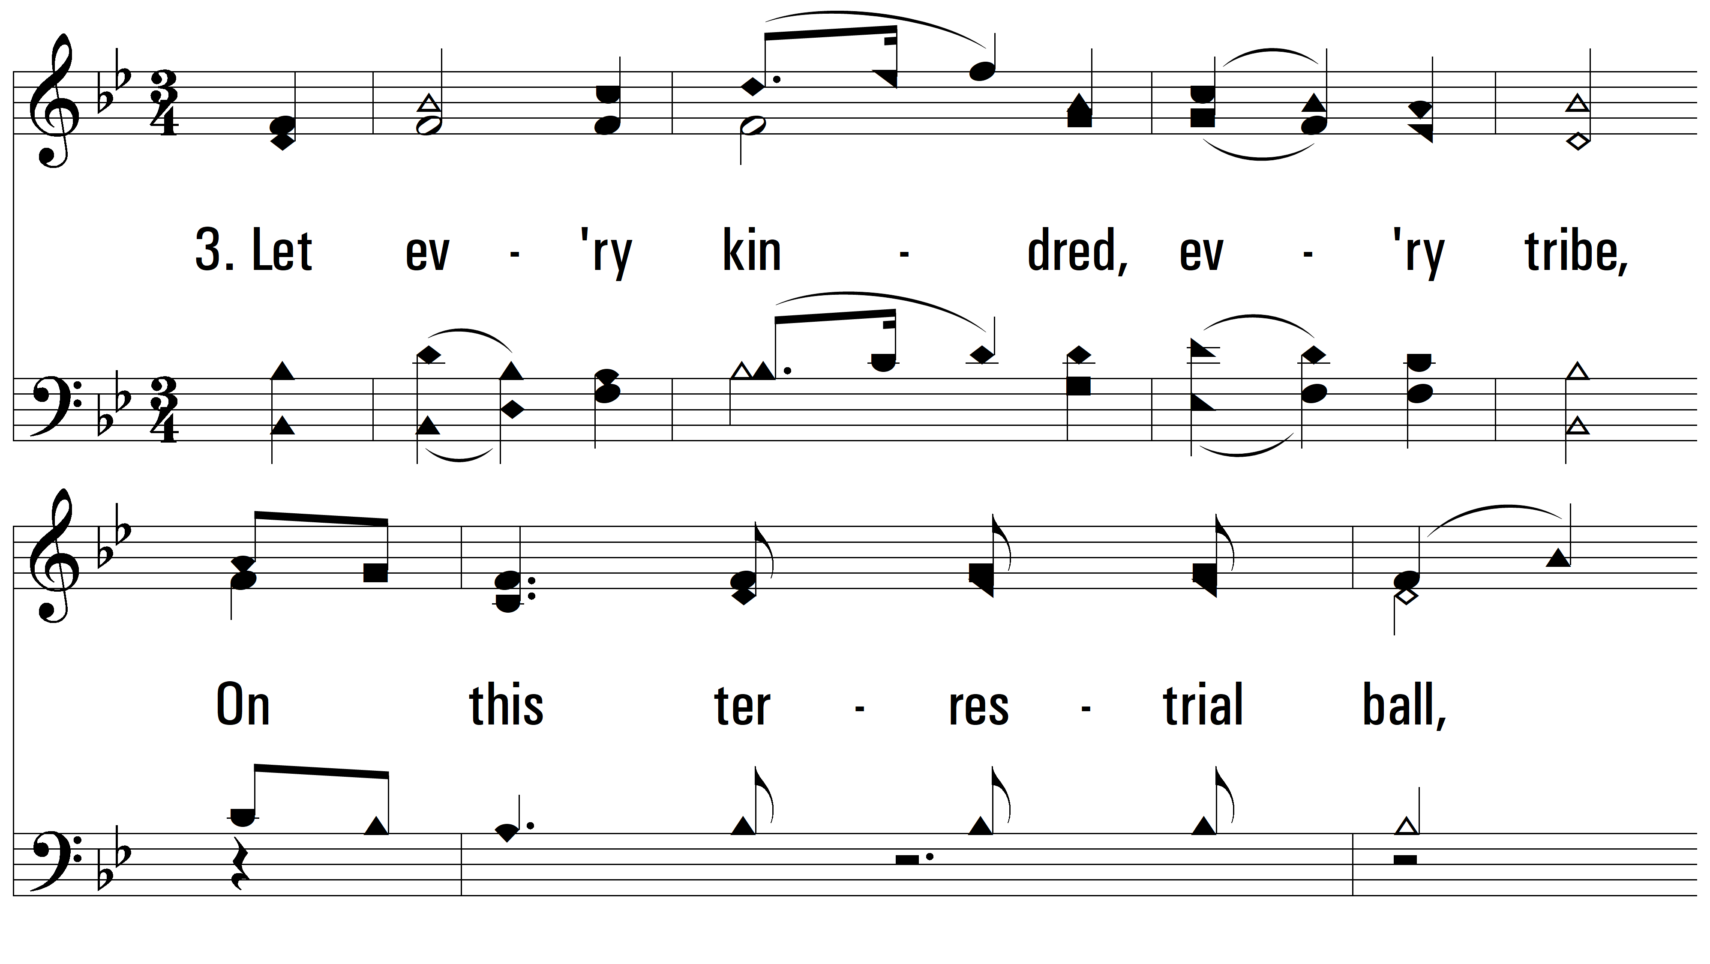
vs. 3 ~ All Hail The Power Of Jesus’ Name

Slide 11
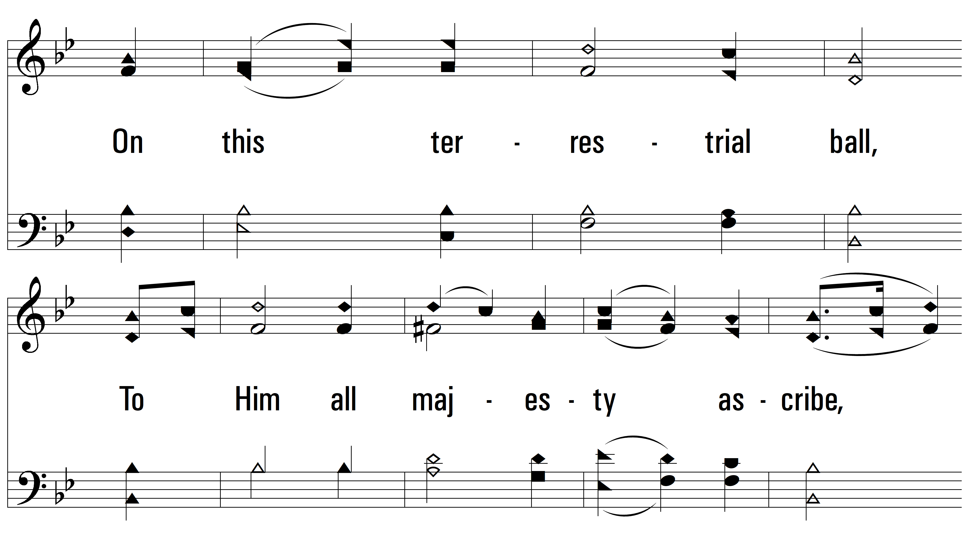
vs. 3

Slide 12
vs. 3

Slide 13
vs. 3

Slide 14
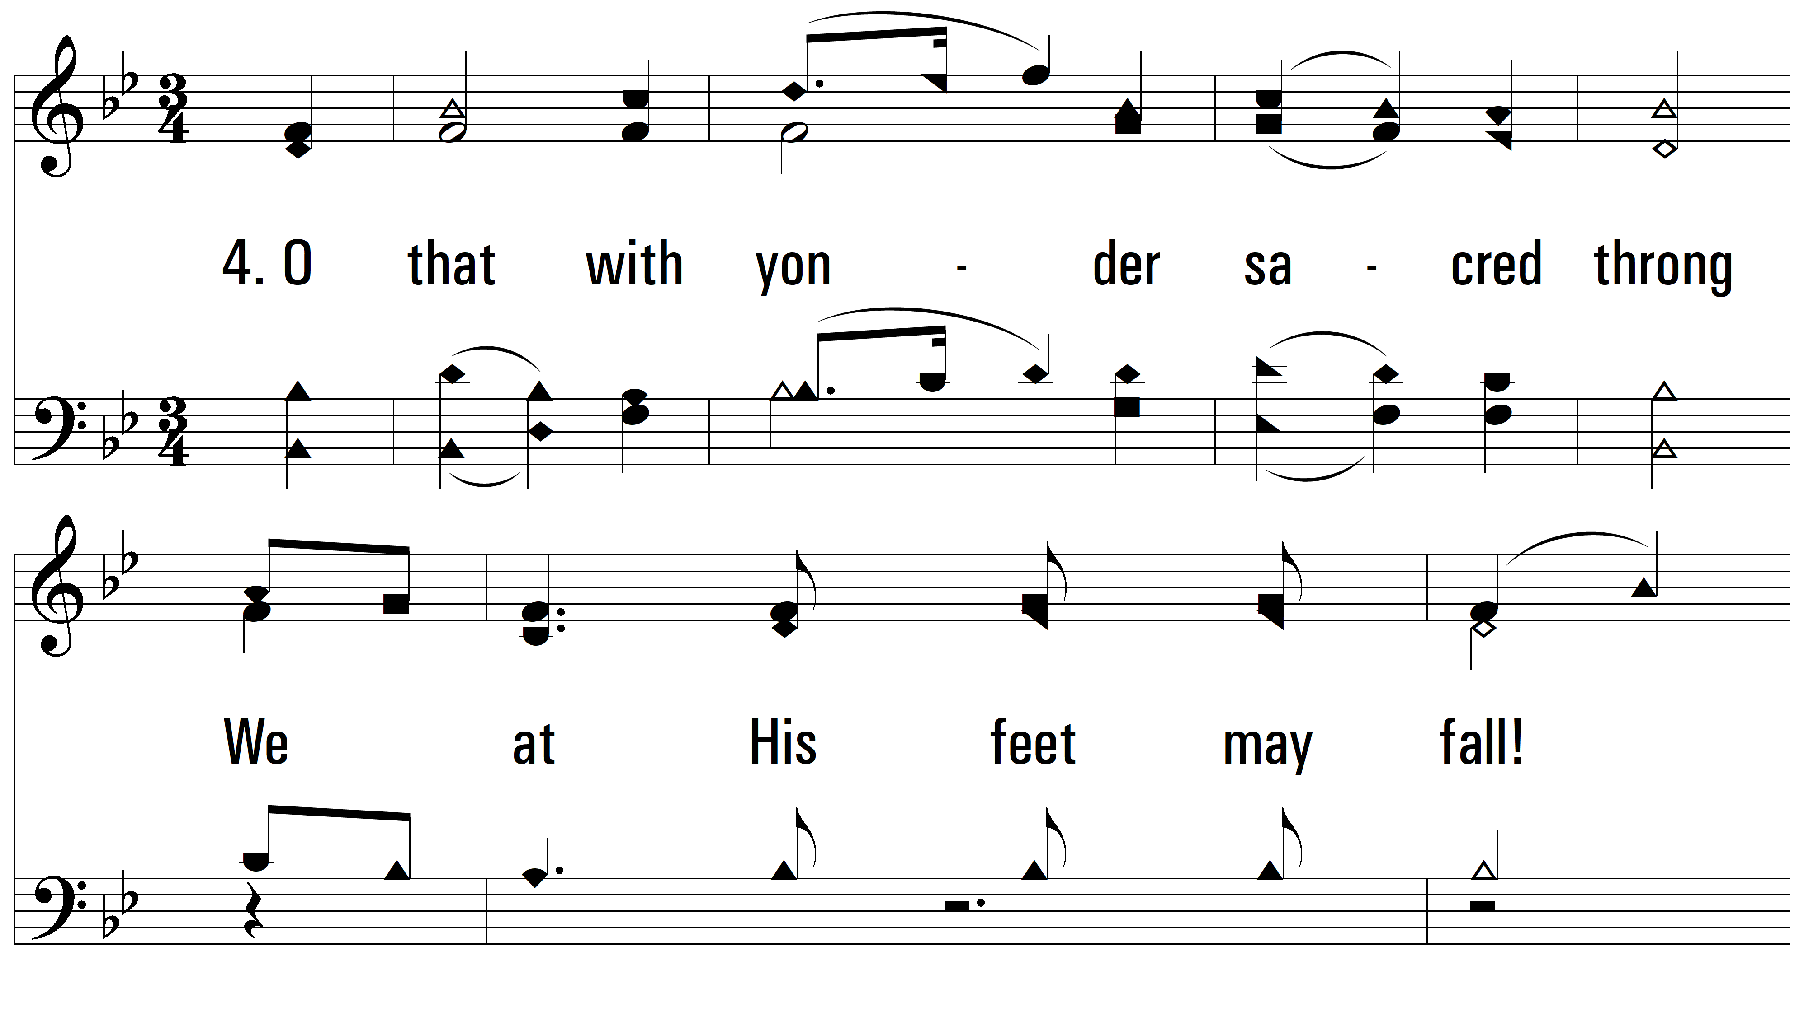
vs. 4 ~ All Hail The Power Of Jesus’ Name

Slide 15
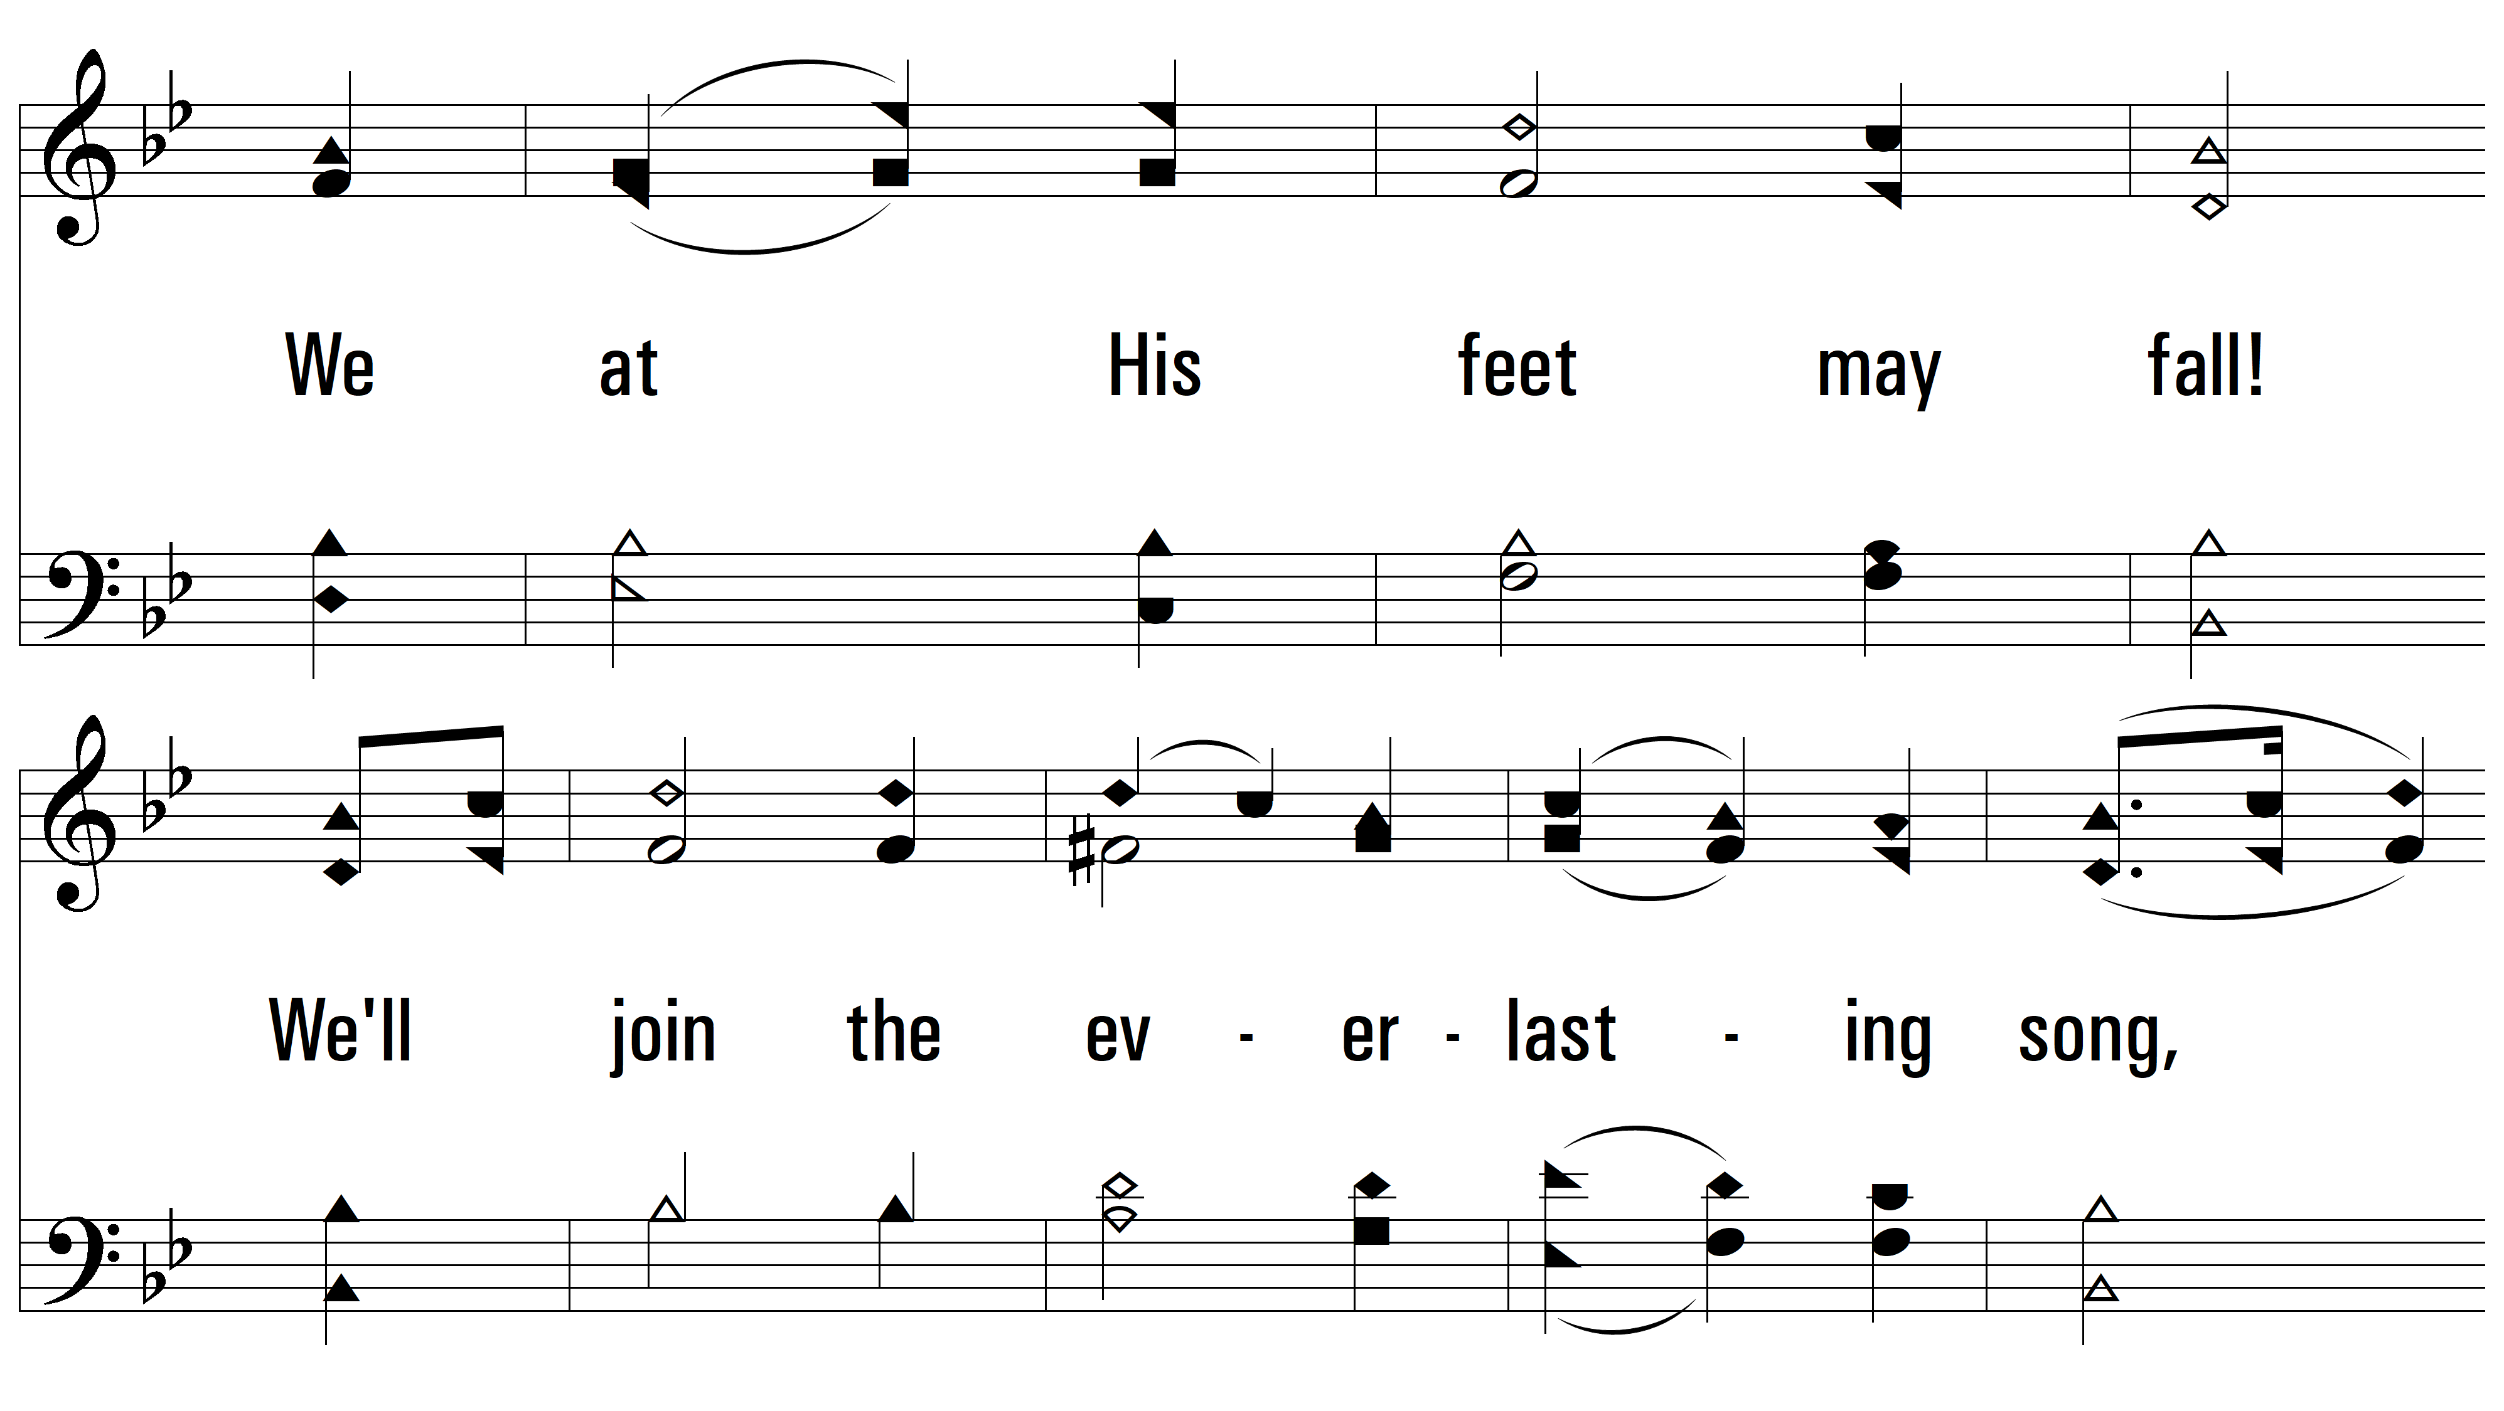
vs. 4

Slide 16
vs. 4

Slide 17
vs. 4
PDHymns.com
END

