Slide 1
A Soul Winner For Jesus
Words: | J. W. Ferrill (1907)
Music: | J. W. Ferrill (1907)
4/4
B^{b}/F - SOL
Verses: 3/Chorus
Lead - | SOL
Alto - | MI
Tenor - | DO
Bass - | DO
PDHymns.com

Slide 2
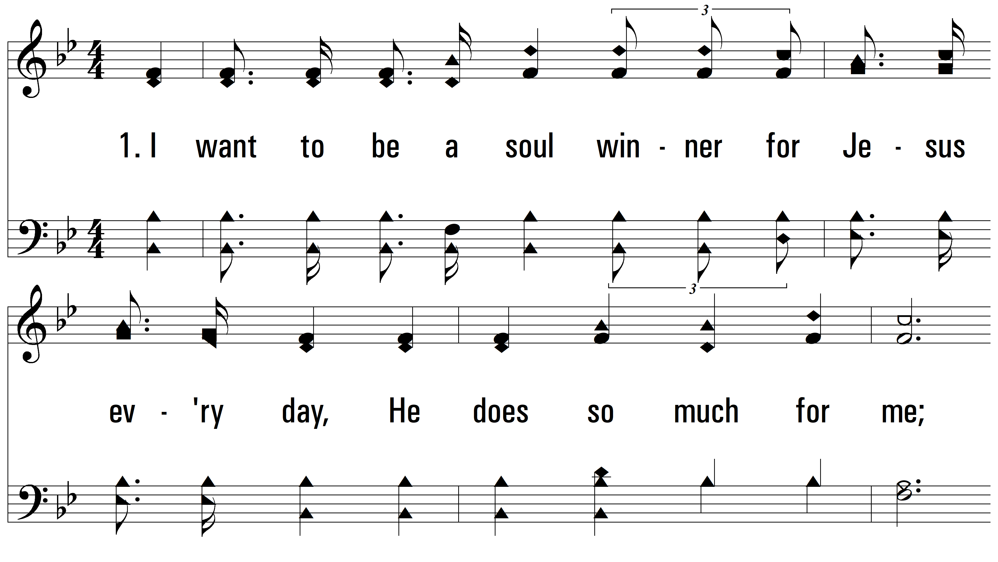
vs. 1 ~ A Soul Winner For Jesus

Slide 3
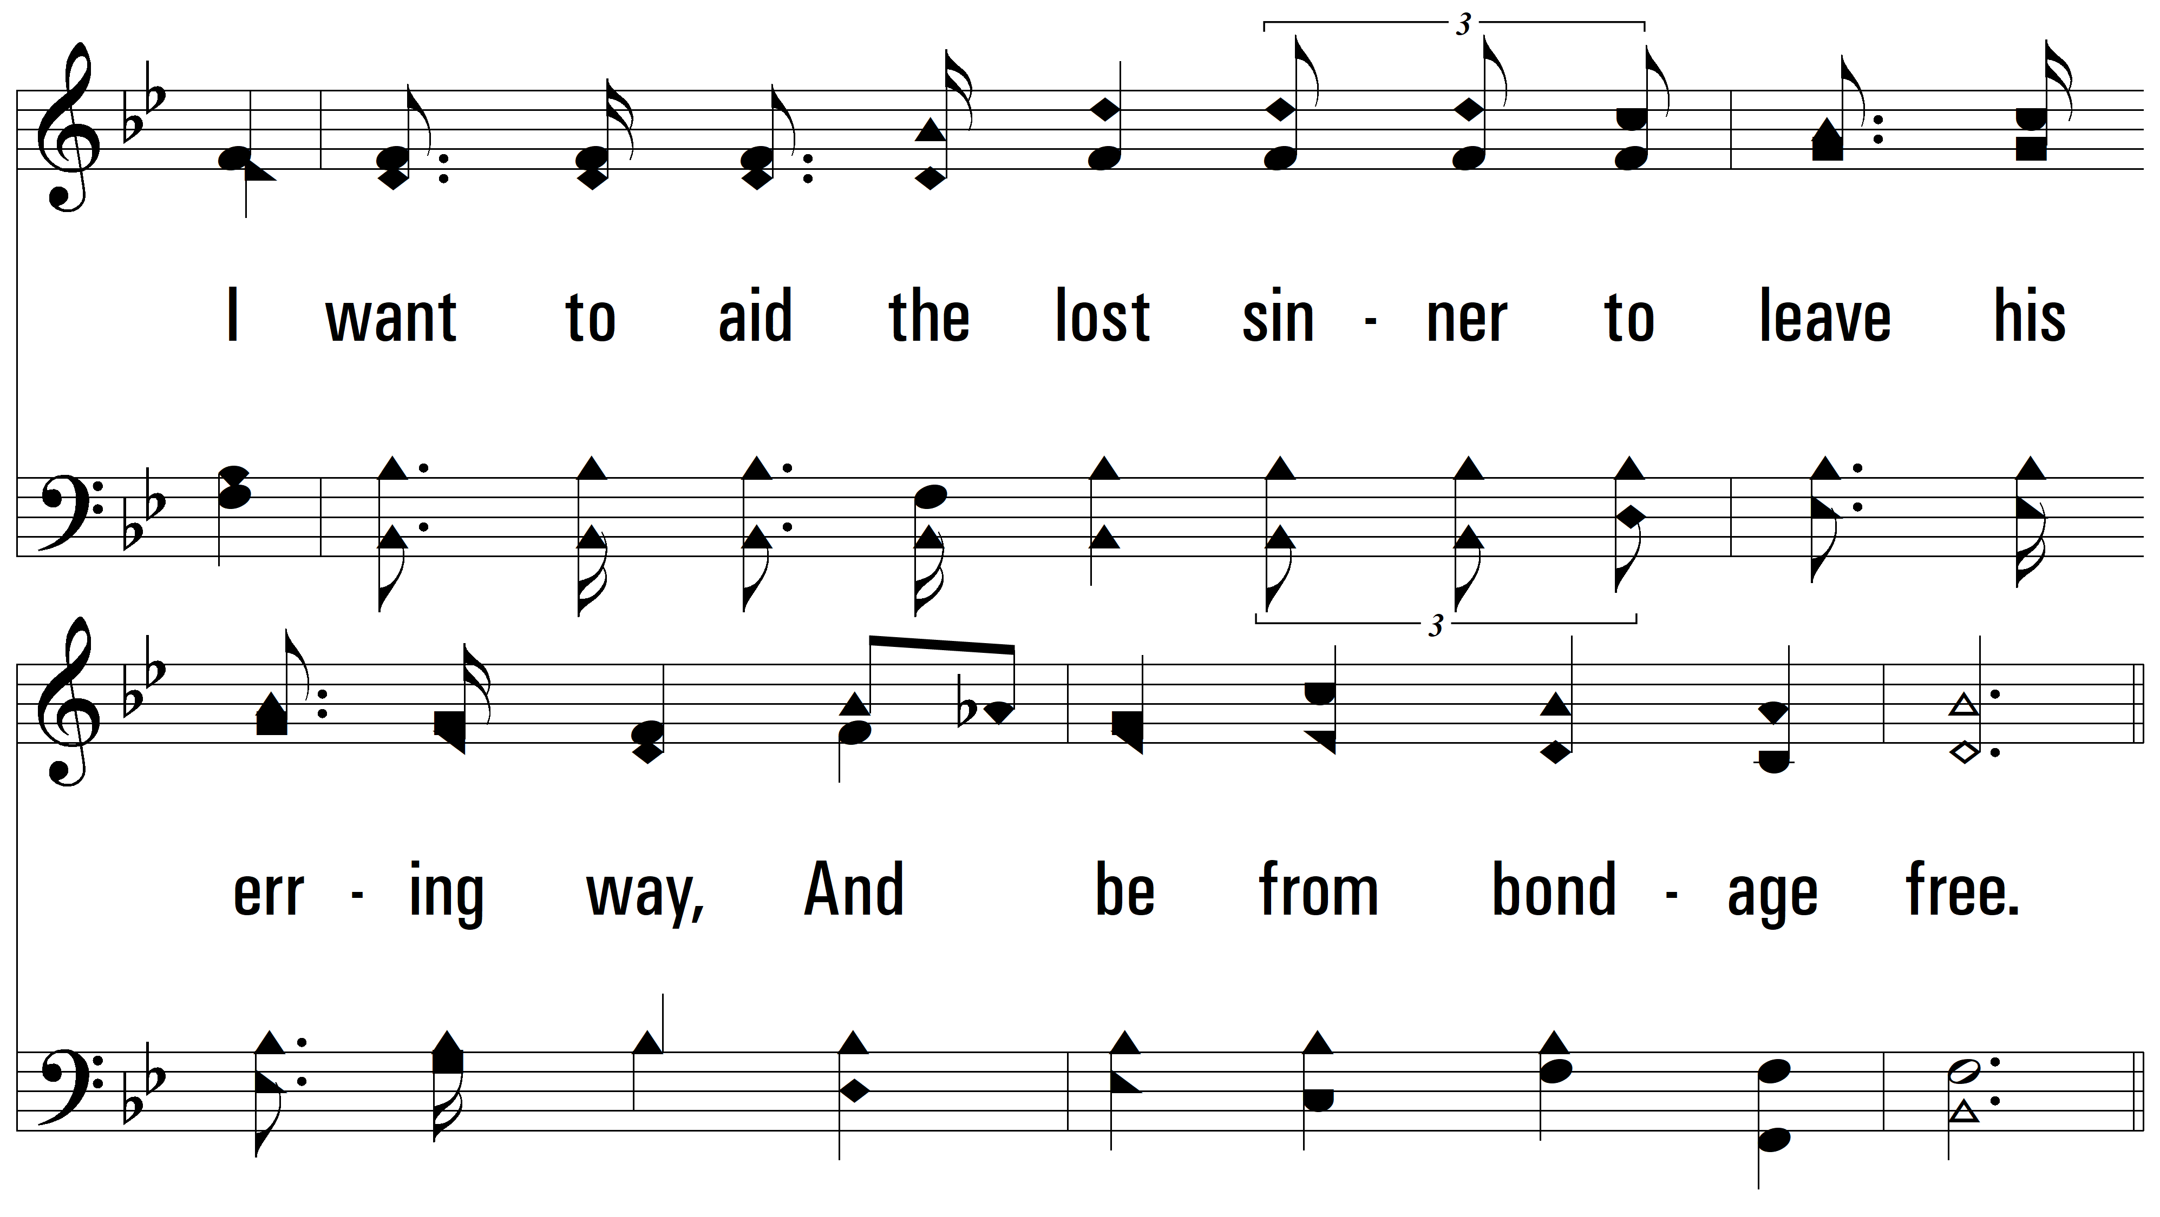
vs. 1

Slide 4
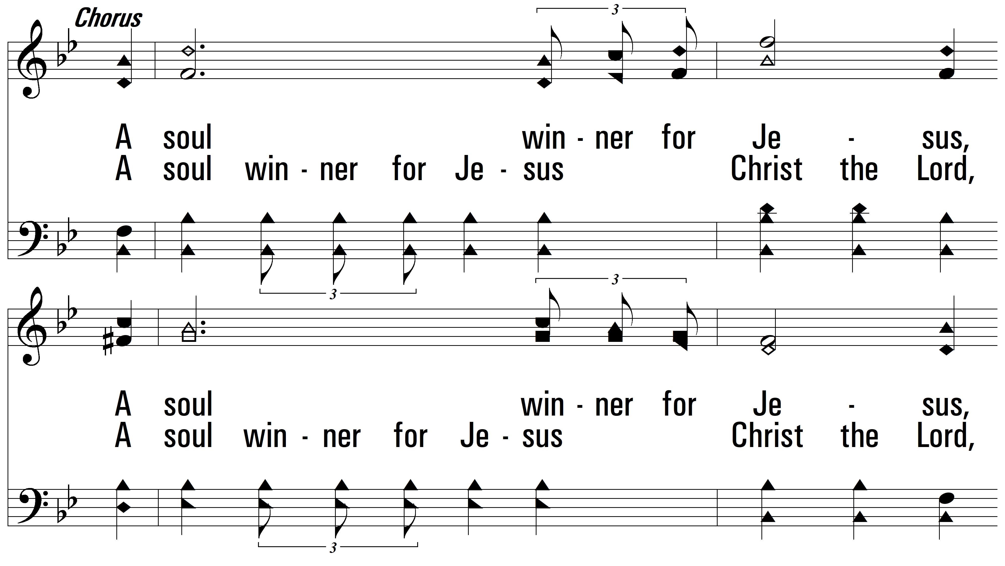
vs. 1

Slide 5
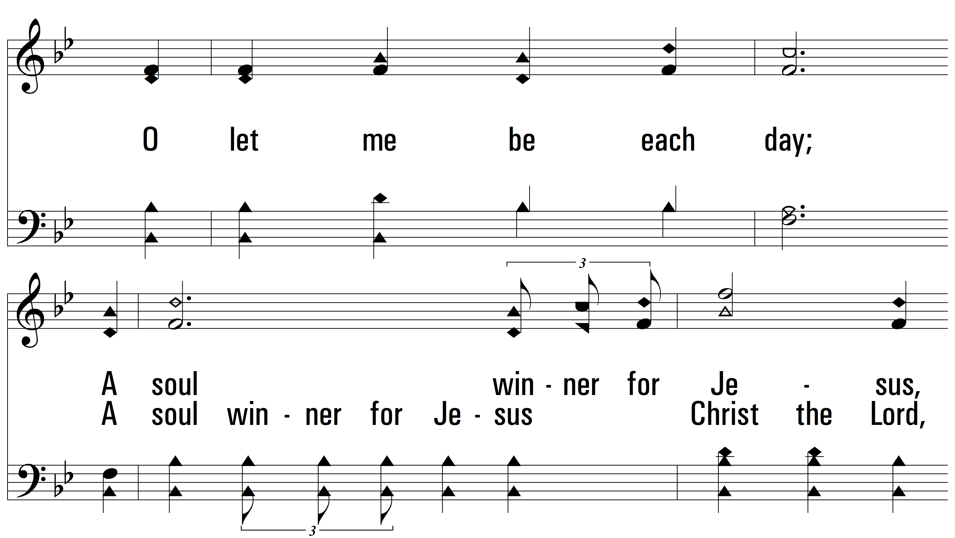
vs. 1

Slide 6
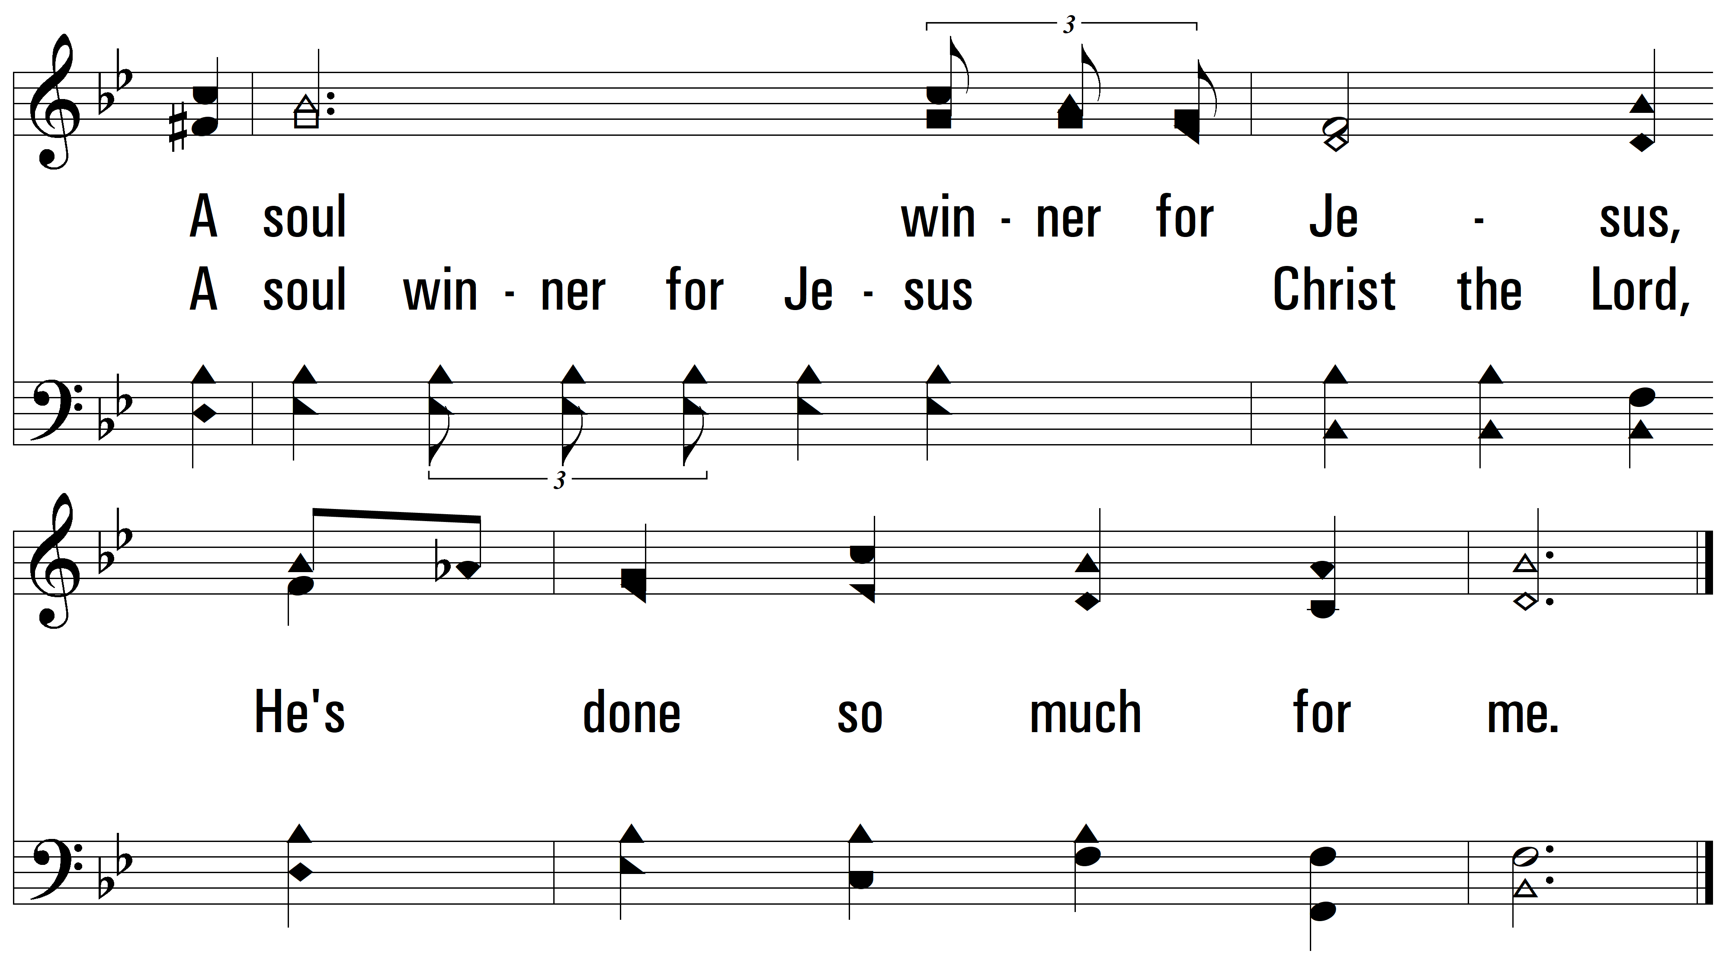
vs. 1

Slide 7
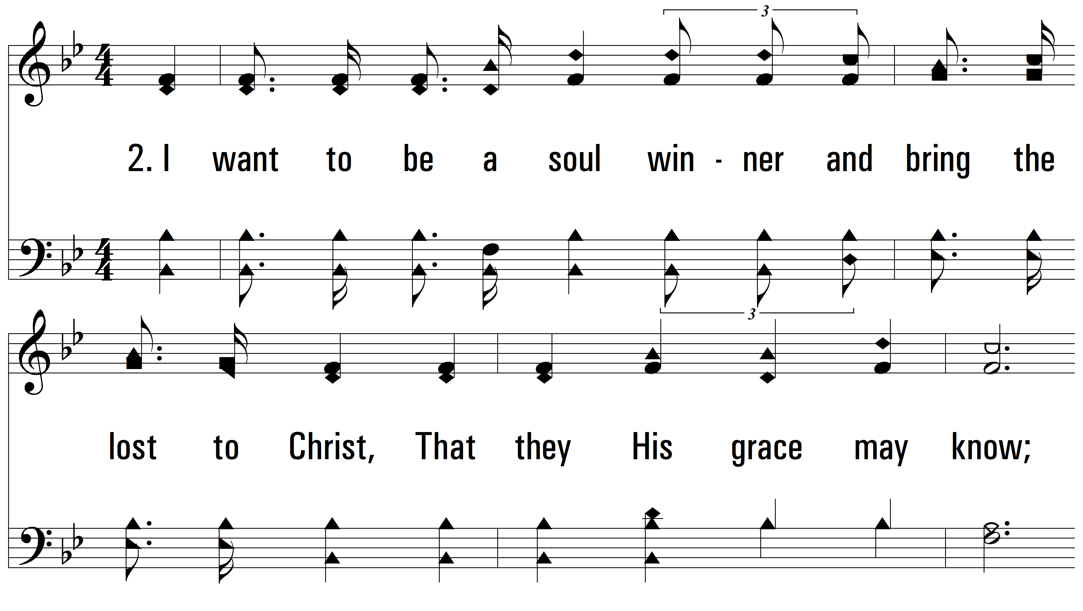
vs. 2 ~ A Soul Winner For Jesus

Slide 8
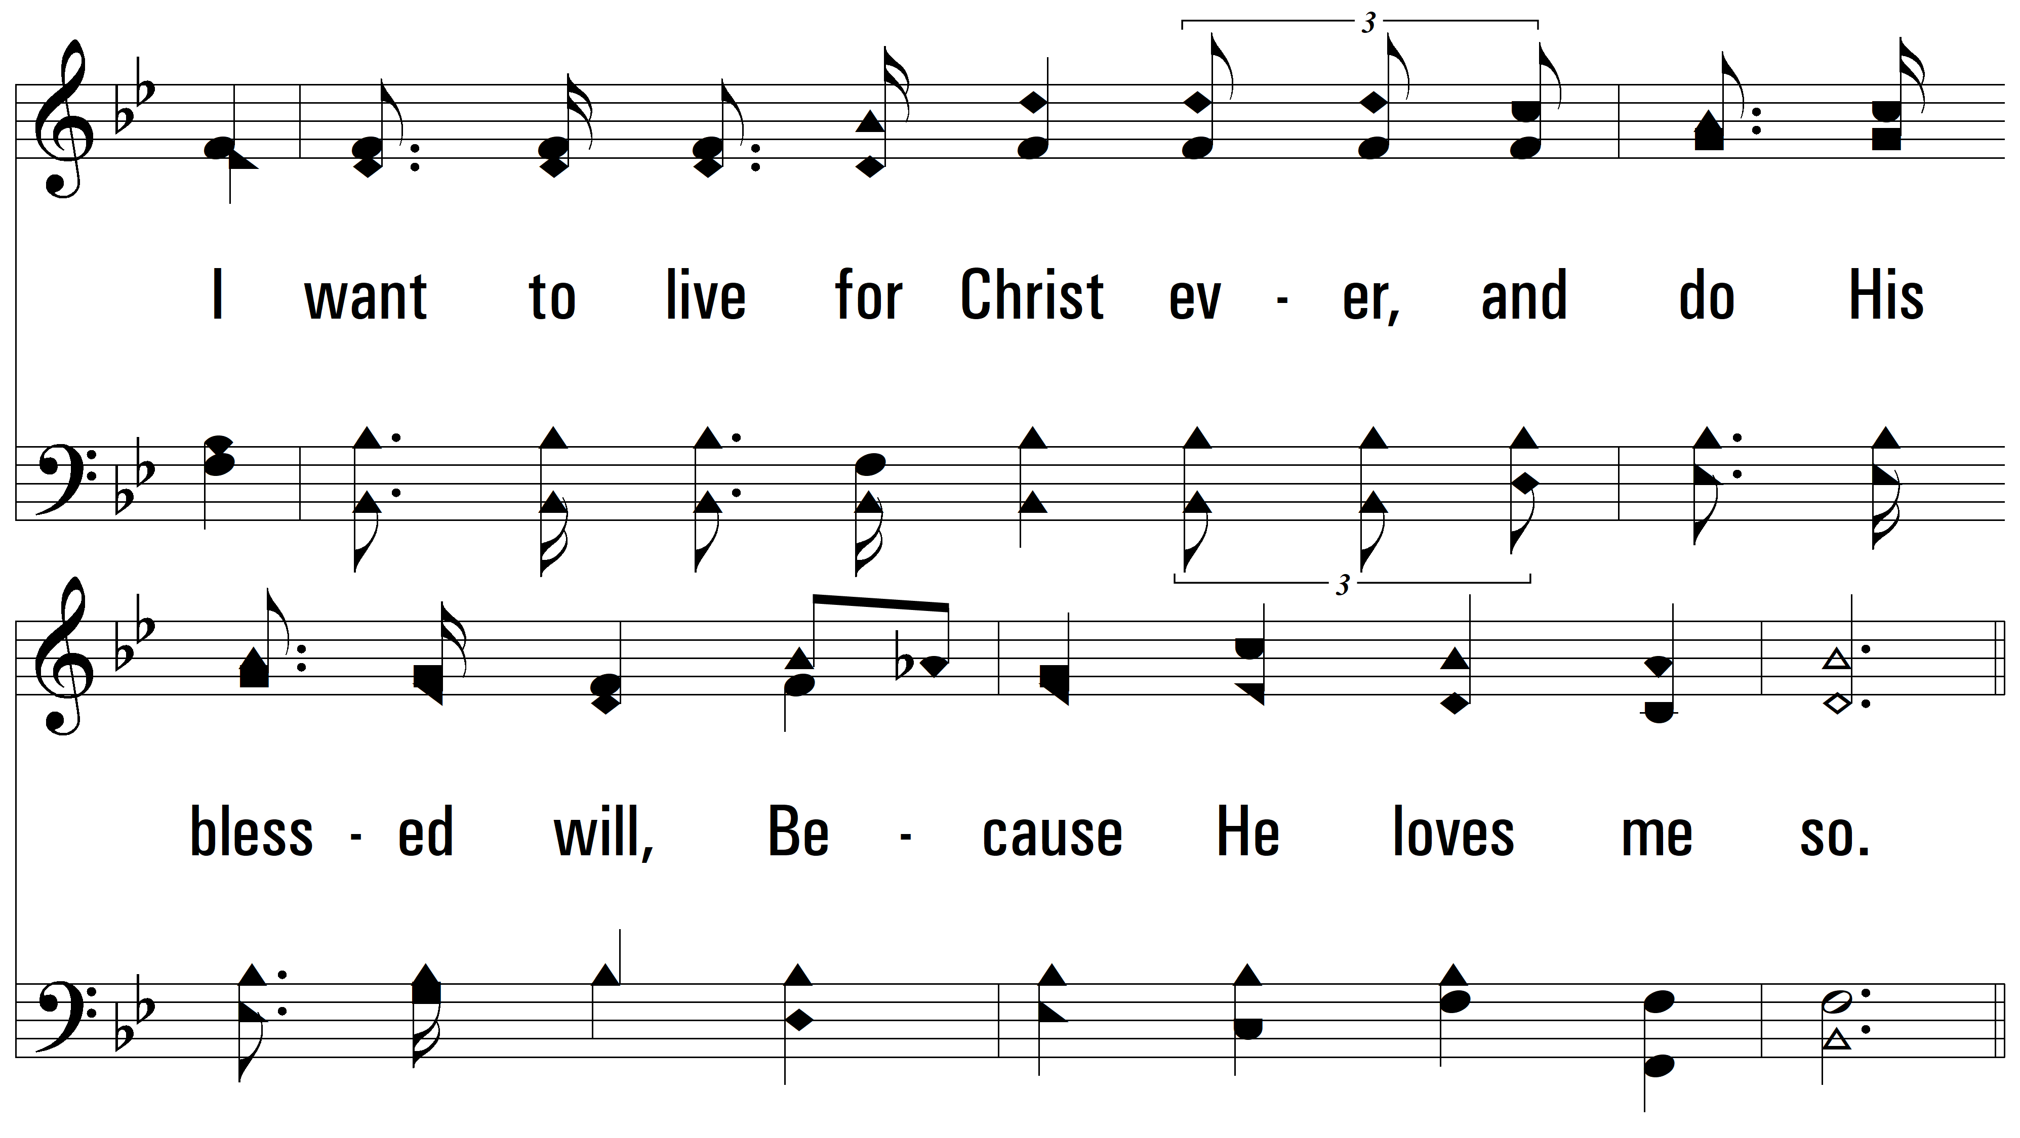
vs. 2

Slide 9
vs. 2

Slide 10
vs. 2

Slide 11
vs. 2

Slide 12
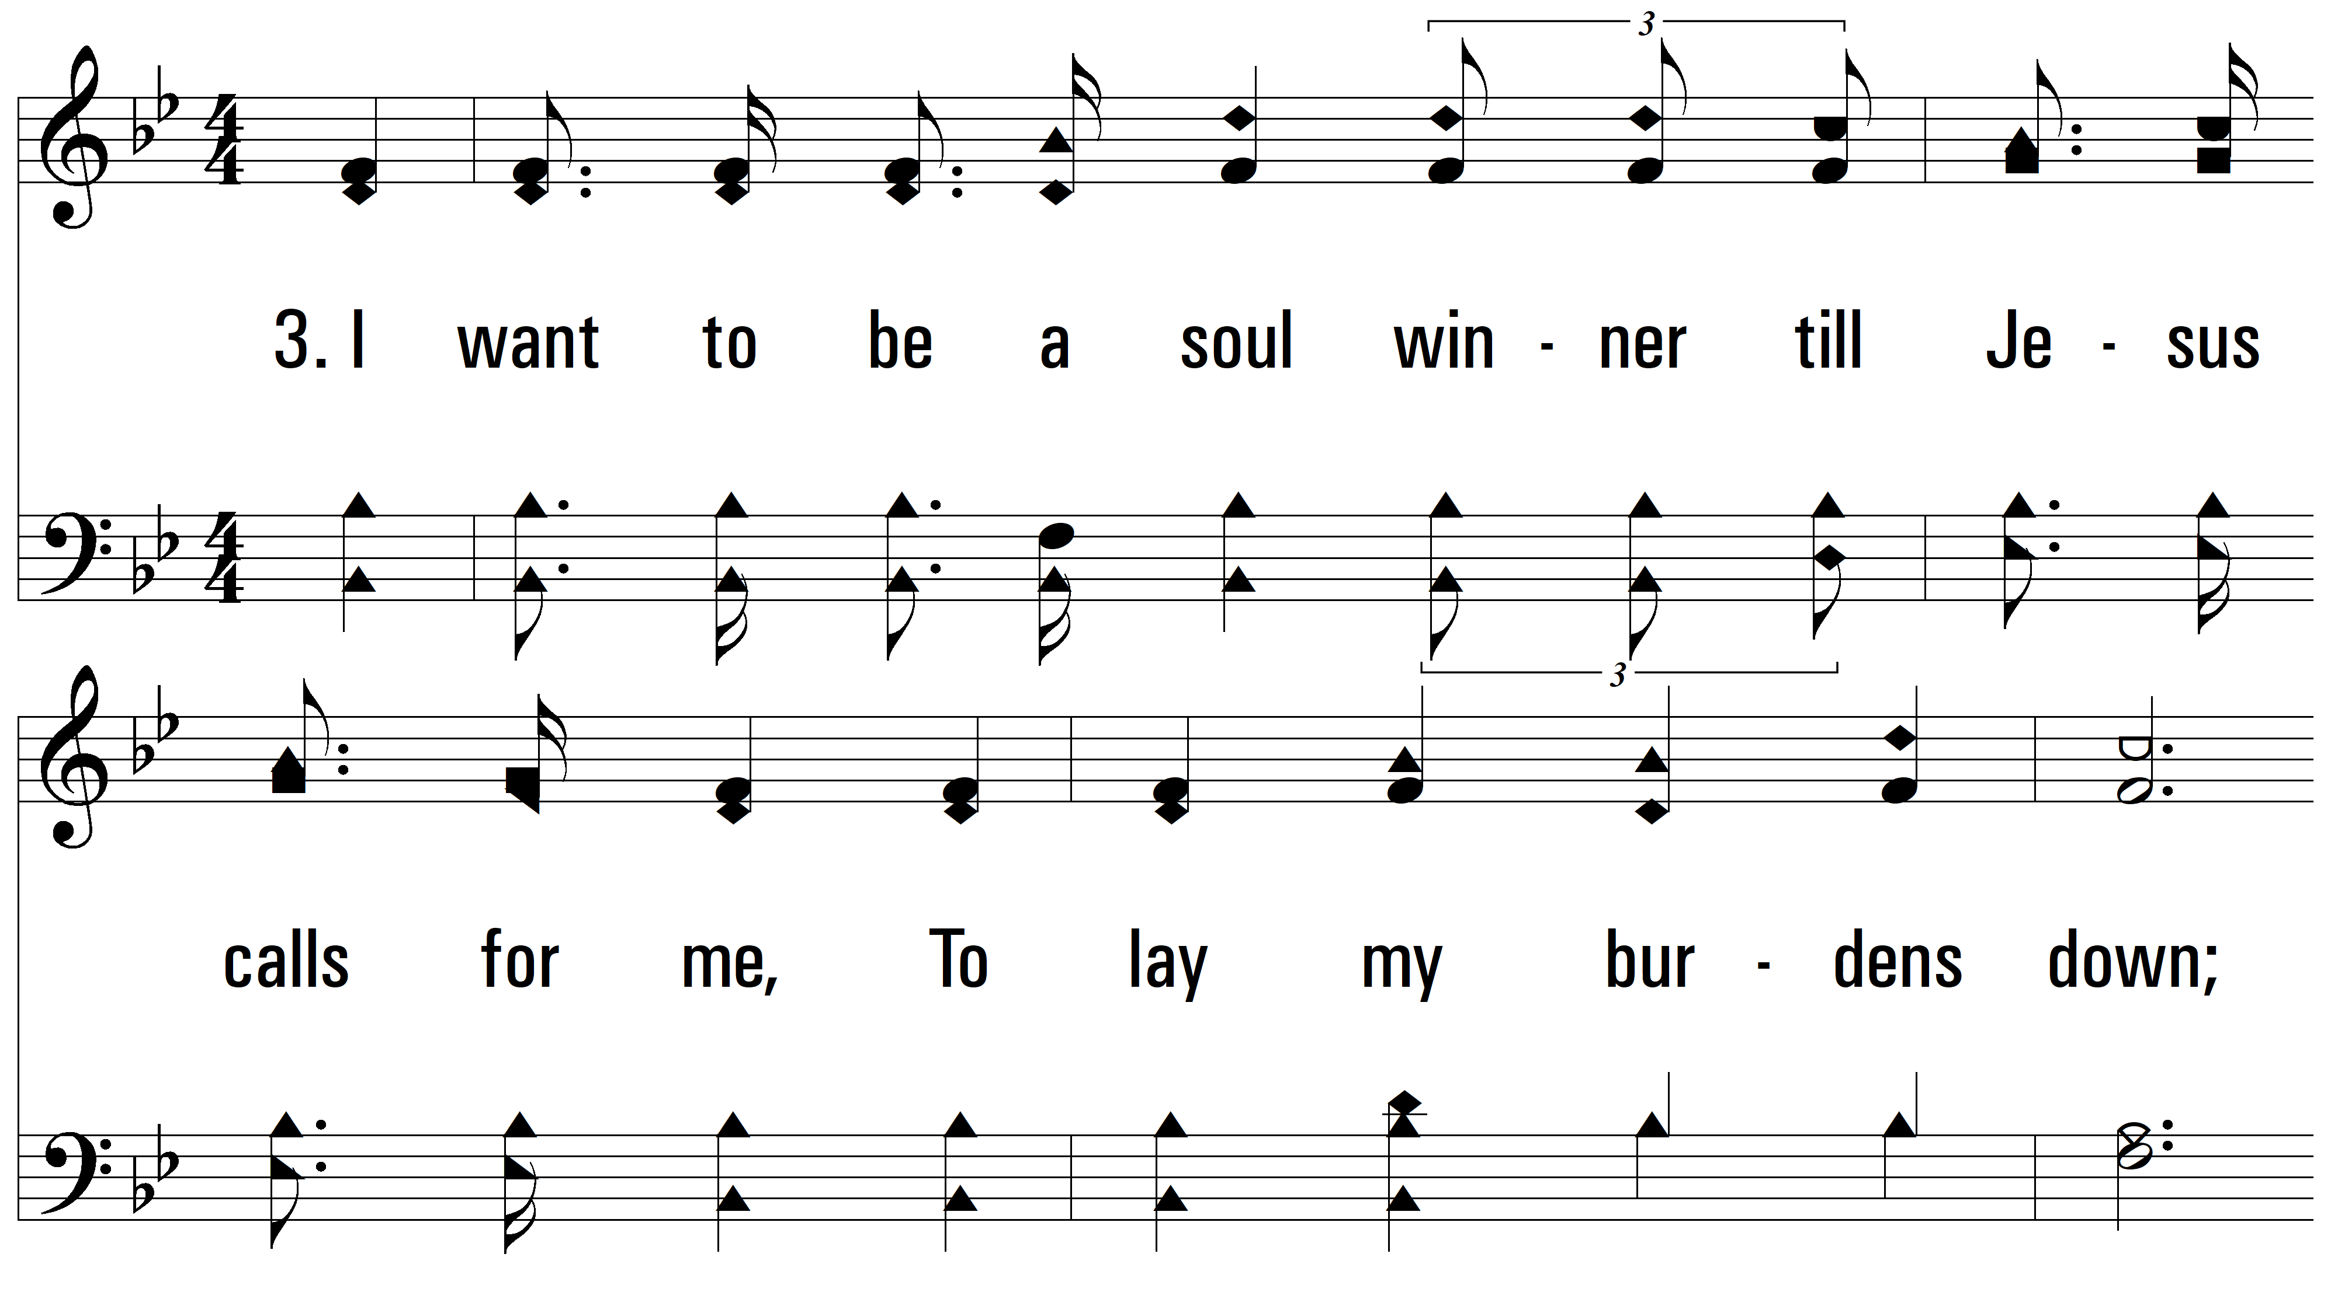
vs. 3 ~ A Soul Winner For Jesus

Slide 13
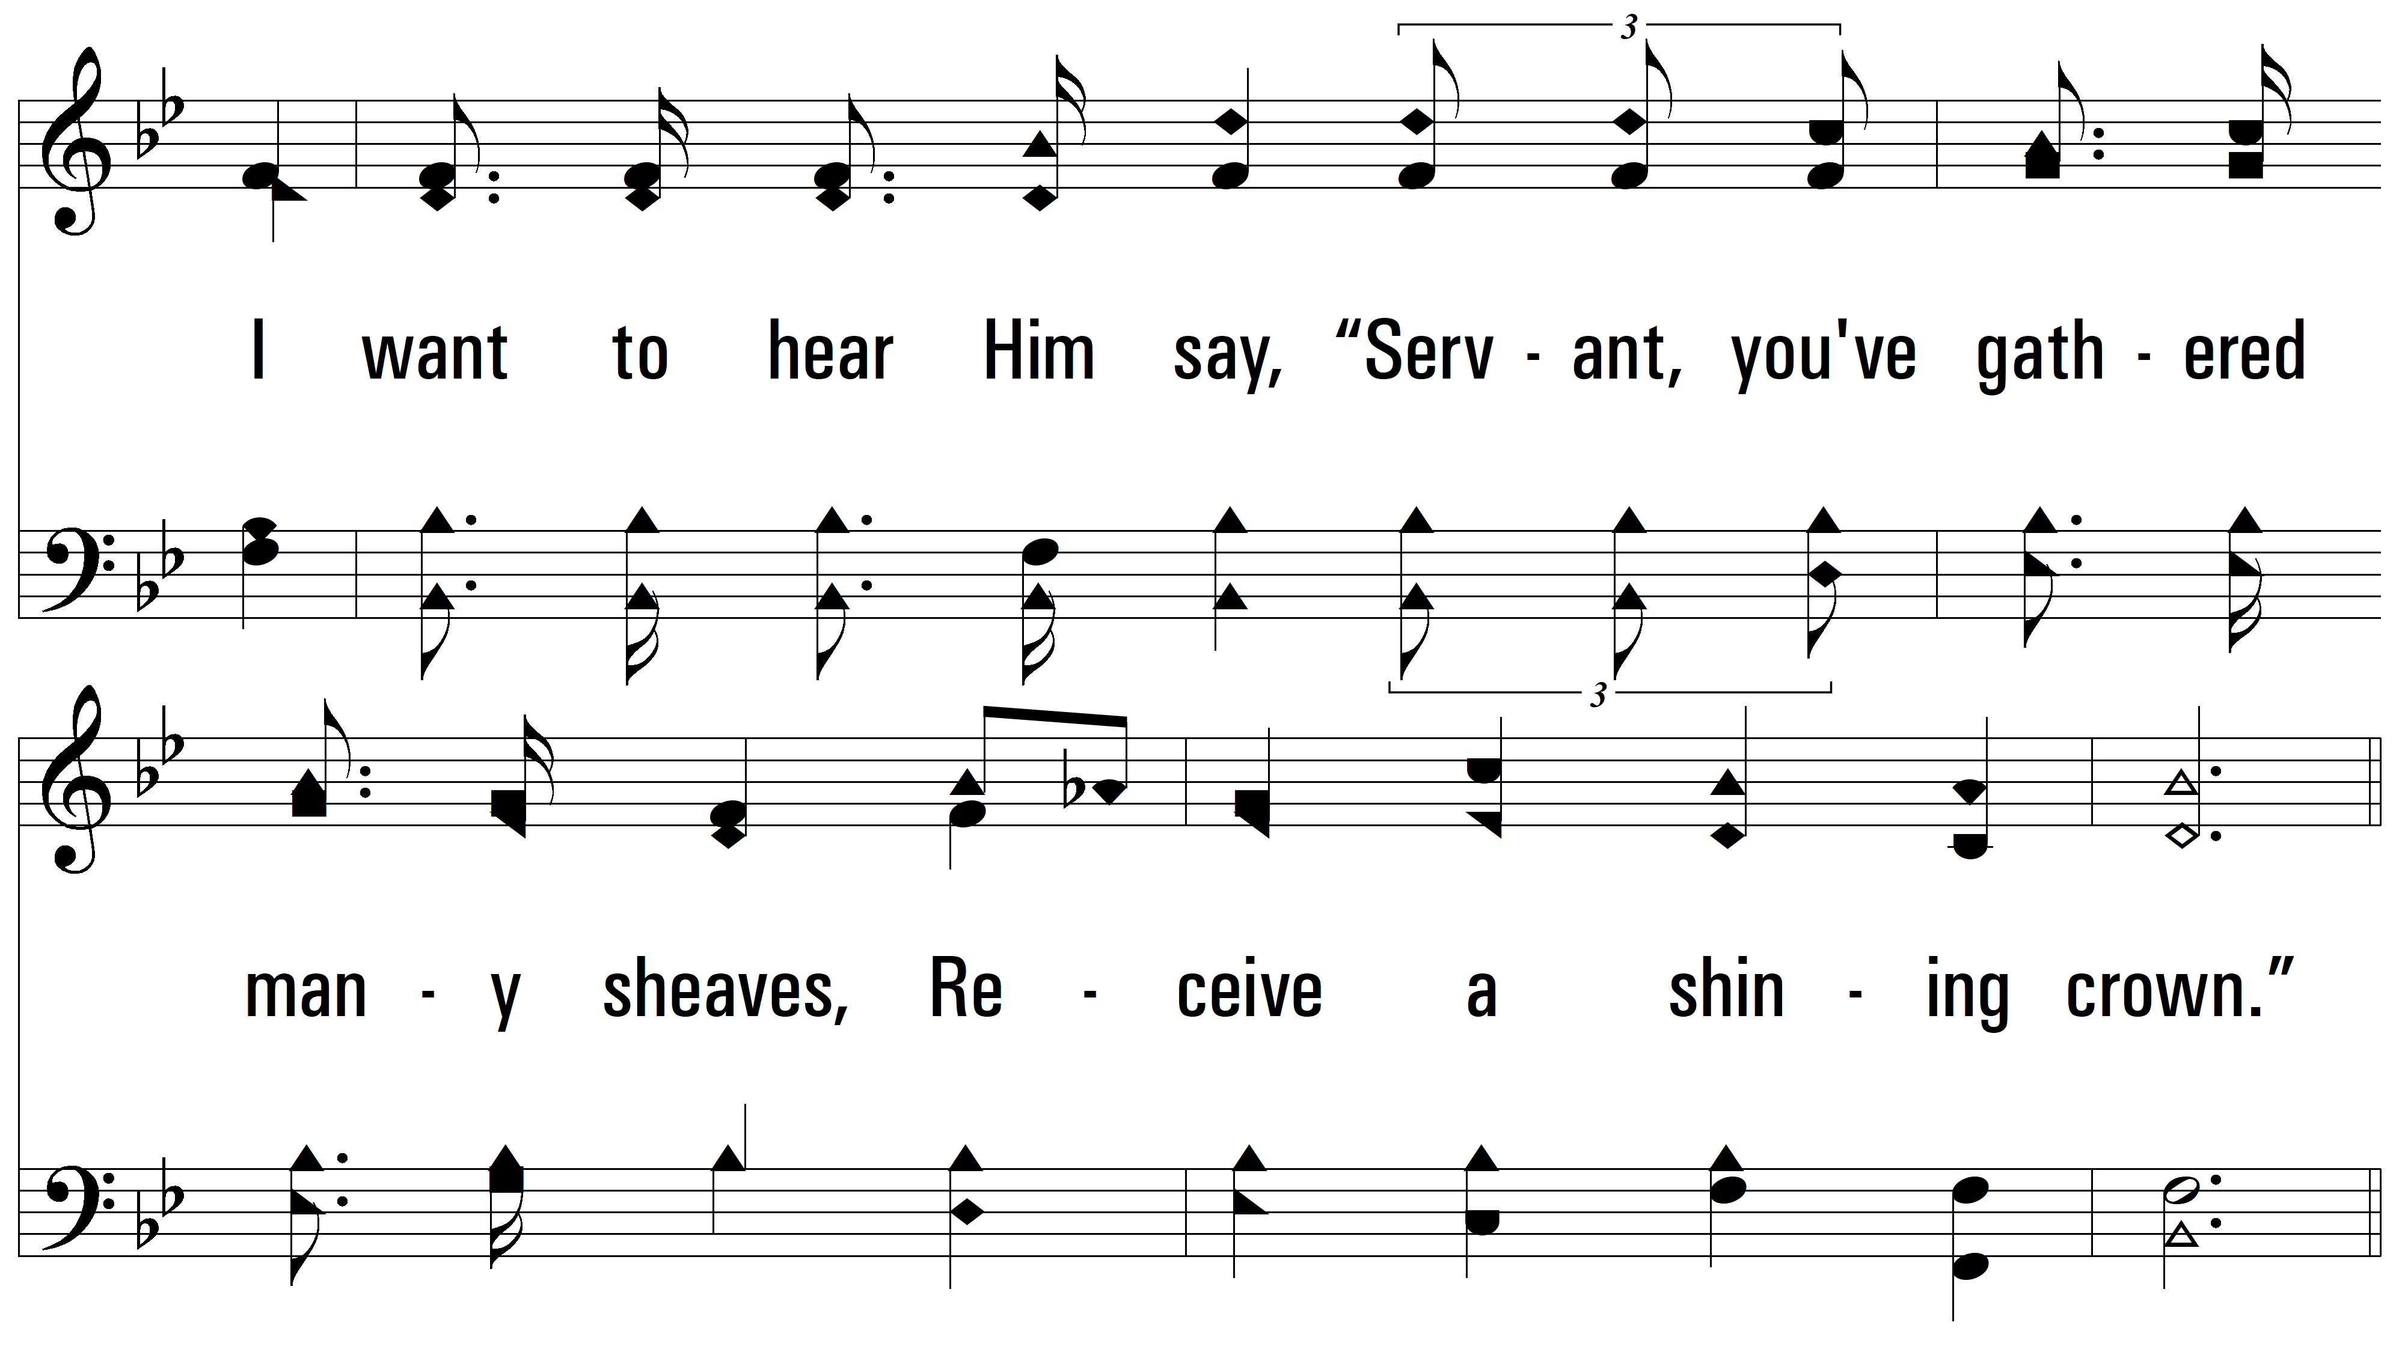
vs. 3

Slide 14
vs. 3

Slide 15
vs. 3

Slide 16
vs. 3
PDHymns.com
END

